Slide 1
Reasoning using ontologies
(protégé intro)
Ph.D. Esteban Guerrero.
esteban@cs.umu.se
Office: MIT building C424
Notes:
1

Slide 2
Content
(Recap) What knowledge modelling for?
(Recap) A tool for knowledge modelling: Protégé
Some examples
About projects

Slide 3
Why
Recap

Slide 4
Why
Recap
Ontology:
Focus: meaning (shared understanding)
Defines a set of concepts and relationships
Represents content and structure
Core purpose: agents communication, interoperability, search, etc.
Database scheme
Focus: Data
Defines structure of database
Core purpose: structure instances for efficient storage and querying

Slide 5
Why
Recap
Database:
Closed world assumption (CWA)
Missing information treated as false
Unique name assumption (UNA)
Each individual has a single, unique name
Schema behaves as constraints on structure of data
Define legal database states
Ontology:
Open world assumption (OWA)
Missing information treated as unknown
No UNA
Individuals may have more than one name
Ontology axioms behave like implications (inference rules)
Entail implicit information
Ontologies and databases. Ian Horrocks. Information Systems Group. Oxford University Computing Laboratory

Slide 6
Why
Recap
Database:
Entities
Attributes, relations
Constraints
No taxonomy
Constraints for integrity, foreign key
Ontology:
Classes
Properties
Axioms
Taxonomy is backbone
Constraints for meaning, consistency and integrity

Slide 7
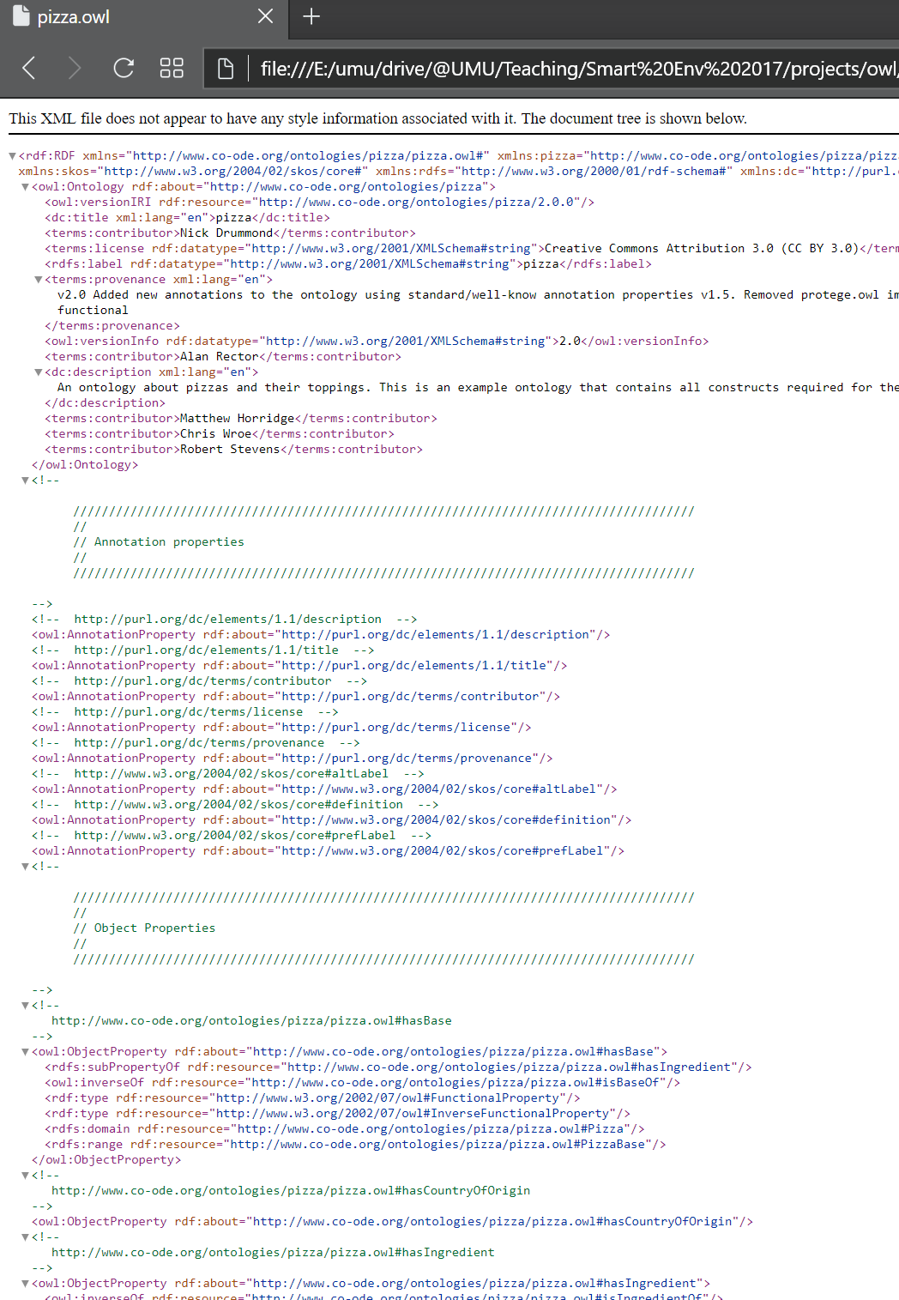
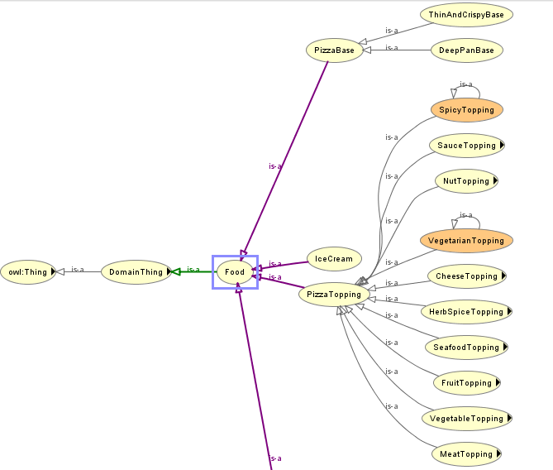
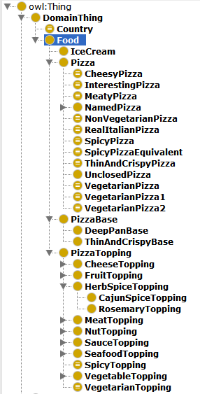
Protégé
https://protege.stanford.edu
Free, open-source platform to construct domain models and knowledge-based applications with ontologies.
Used for:
Modelling
Reasoning (deductive classifiers)

Slide 8
Protégé
Examples (online)
Pizza
People

Slide 9
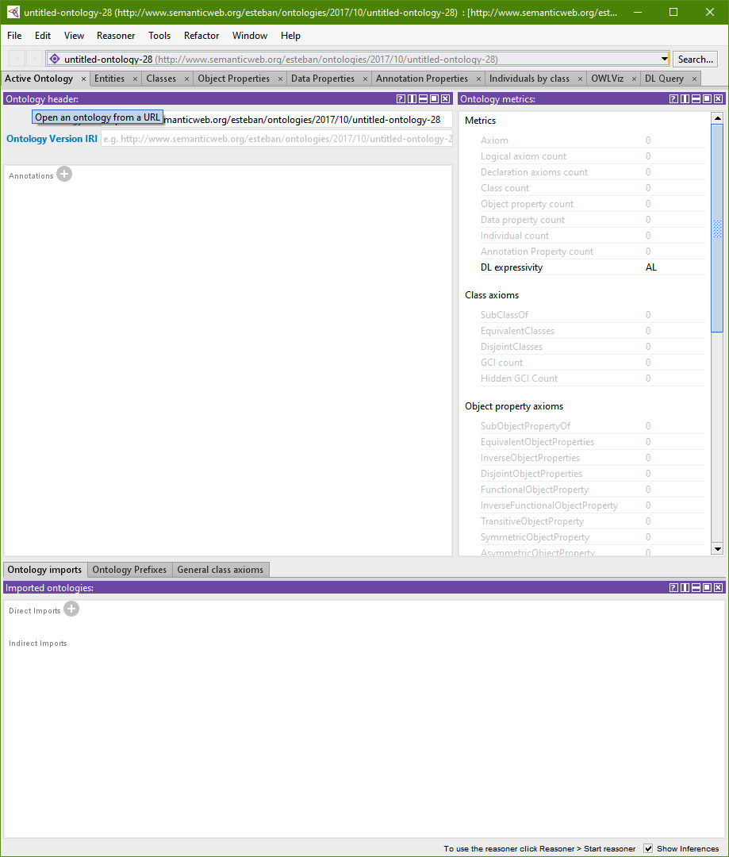
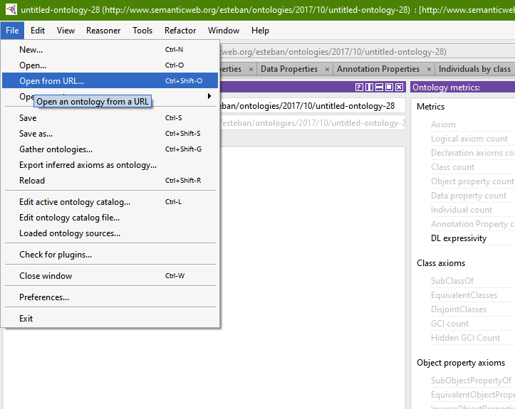
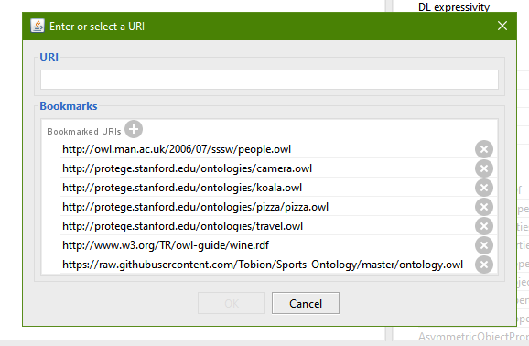
Protégé

Slide 10
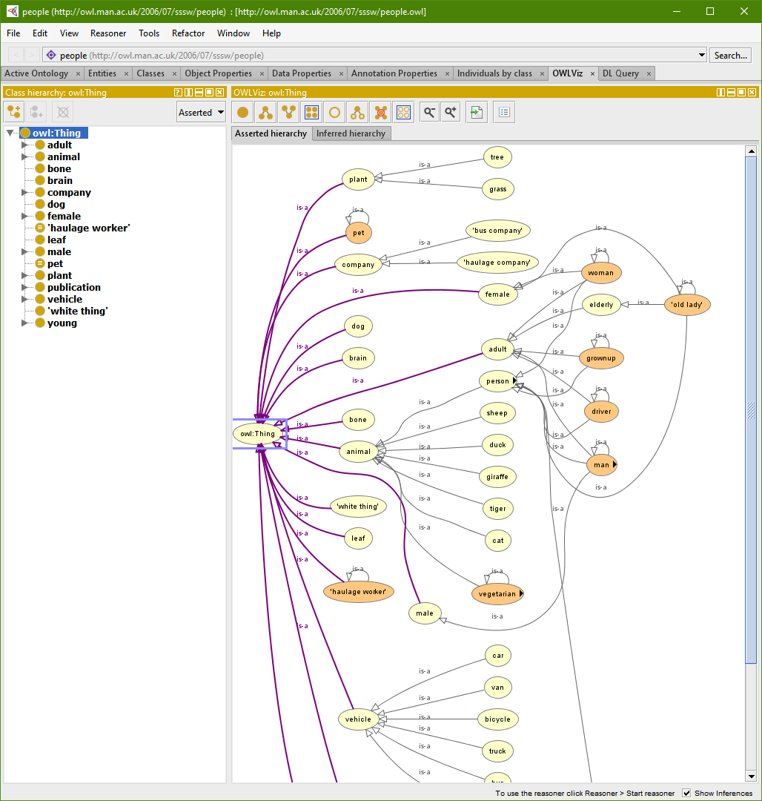
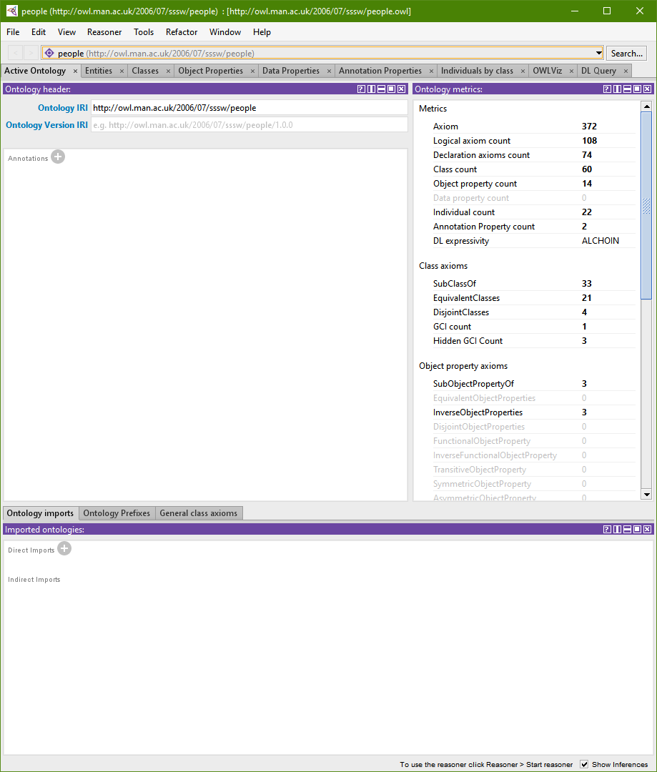
Protégé

Slide 11
Protégé
Type of information objects (roughly speaking):
An entity can be different types of information entities (e.g. a class, an individual, etc.)
Classes: define ancestors and descendants of the topology (e.g. cats, mouse, dogs).
Object properties: part of the semantic relationships linking other entities (e.g. cats eat mouse; cat is_pet_of person).
Data properties: (OWL2) properties of data mostly in individuals (Dr. obvious) (e.g. timestamps, birthdays: cat hasBirthYear)

Slide 12
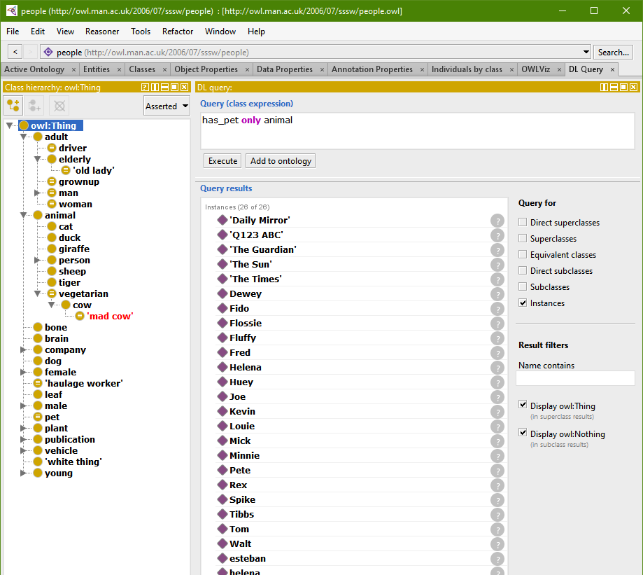
Protégé

Slide 13
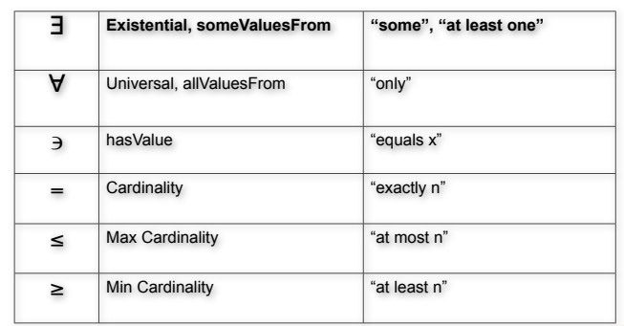
Protégé
Try some queries with people ontology and check the explanations:
adult and has_pet some cat or has_pet some dog
adult and has_pet value Rex
woman and has_pet min 1 cat
animal and is_pet_of some adult

Slide 14
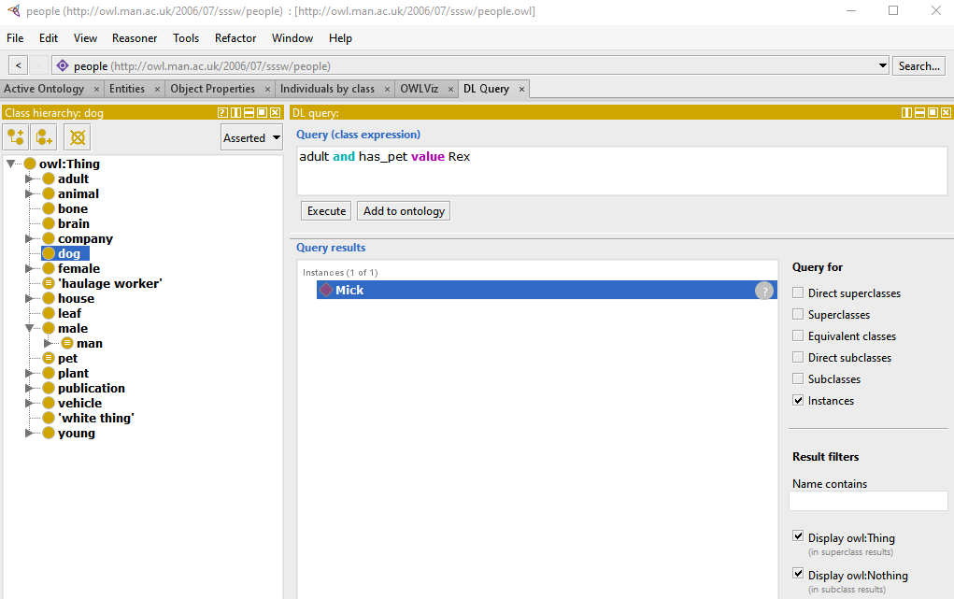
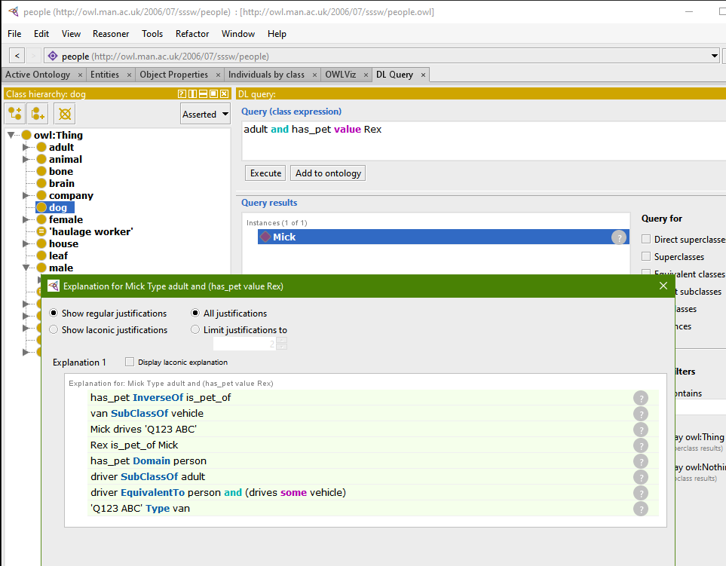
Protégé
Check the explanation!
Try some queries with people ontology and check the explanations:

Slide 15
Protégé
Can you do it?

Slide 16
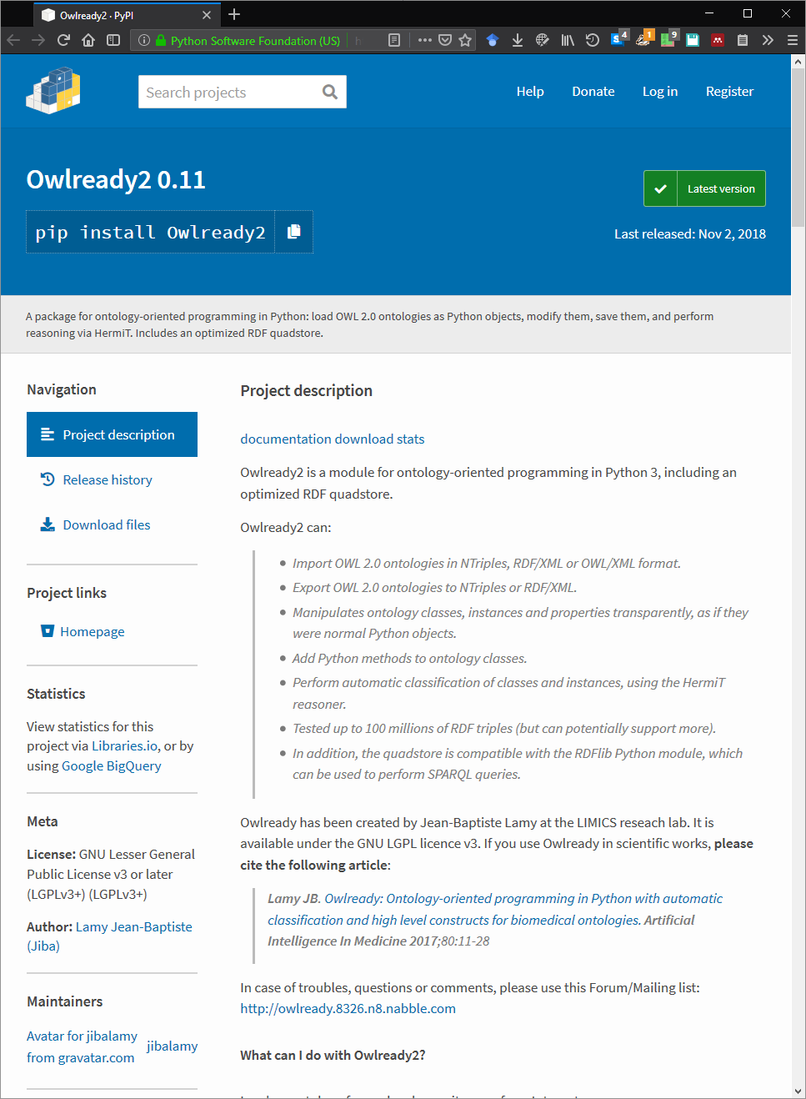
Using Python
An example: Owlready

Slide 17
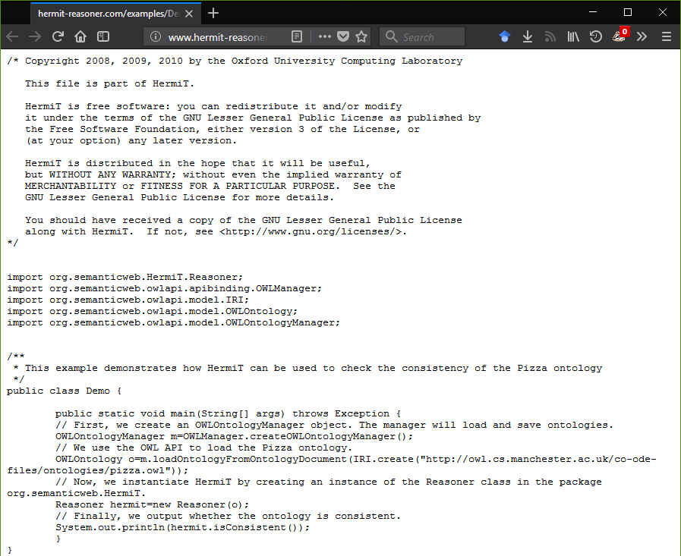
Using Java
http://www.hermit-reasoner.com/

Slide 18
END
Questions

