Slide 1
engineering
Virtual environments
Ph.D. Esteban Guerrero.
esteban@cs.umu.se
Office: MIT building C424
Notes:
1

Slide 2
Content
Short talk about augmented agency
Show JaCaMo demo
Test Holens
Show MED-AR prototype

Slide 3
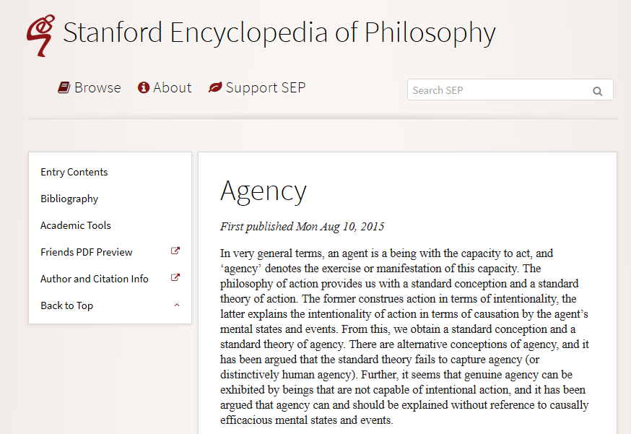
Agency
“…an agent is a being with the capacity to act, and ‘agency’ denotes the exercise or manifestation of this capacity.”
https://plato.stanford.edu/entries/agency/#OthKinAgeMenShaColRelArt

Slide 4
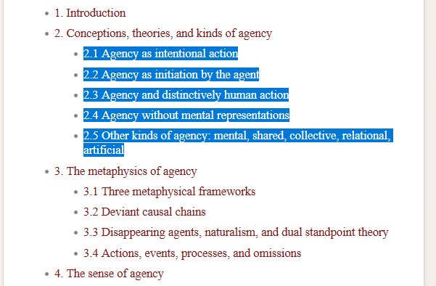
Agency
“…an agent is a being with the capacity to act, and ‘agency’ denotes the exercise or manifestation of this capacity.”
https://plato.stanford.edu/entries/agency/#OthKinAgeMenShaColRelArt

Slide 5
Agency
Multi-agent systems use different “agency” concepts:
Examples (among many others):
Jason: a platform for the development of multi-agent systems, with many user-customisable features. Jason is available Open Source, and is distributed under GNU LGPL. http://jason.sourceforge.net/wp/
JaCaMo: a framework for Multi-Agent Programming that combines three separate technologies: Jason – for programming autonomous agents, Cartago – for programming environment artifacts, Moise – for programming multi-agent organisations http://jacamo.sourceforge.net/
3APL: a programming language for implementing cognitive agents. It provides programming constructs for implementing agents' beliefs, goals and basic capabilities. http://www.cs.uu.nl/3apl/
A list in Wikipedia (outdated!!): https://en.wikipedia.org/wiki/Category:Multi-agent_systems

Slide 6
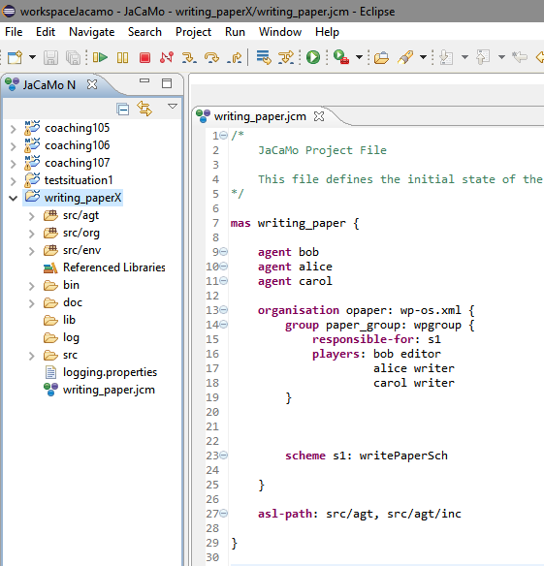
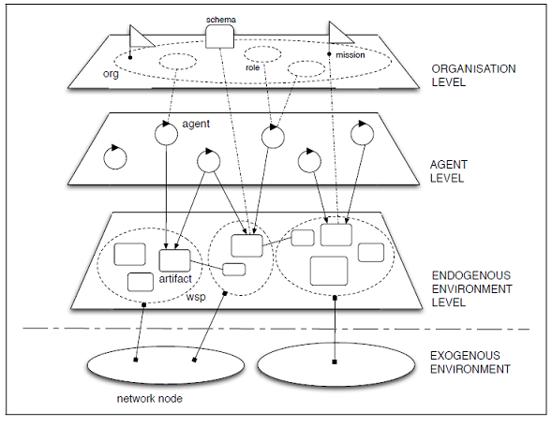
Agency
Short example of JaCaMo. Building an environment with agents.

Slide 7
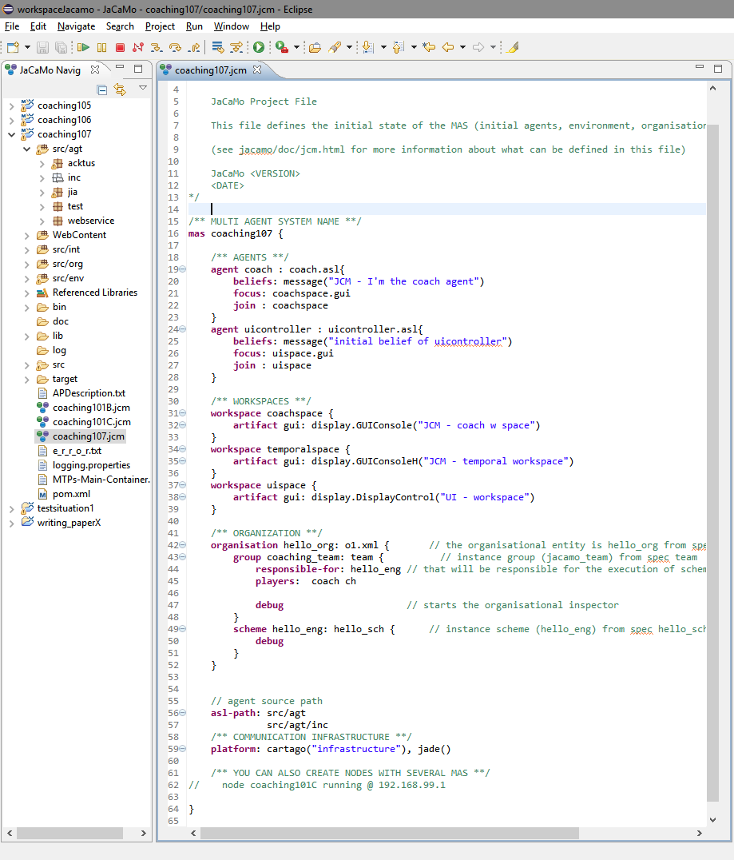
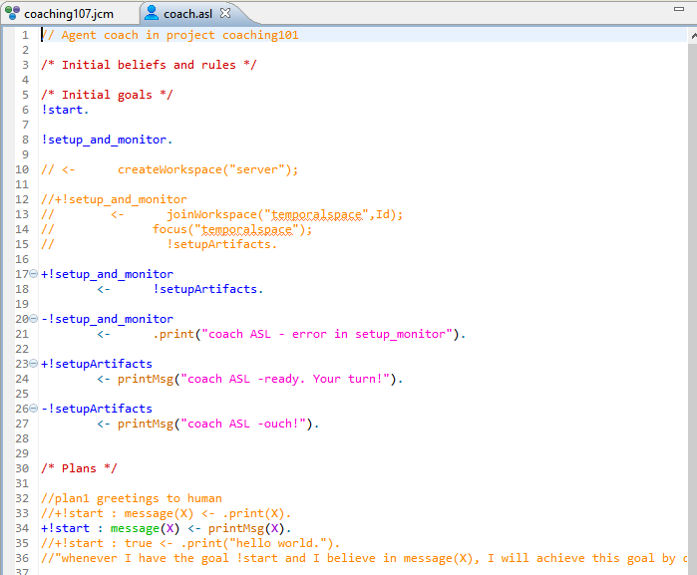
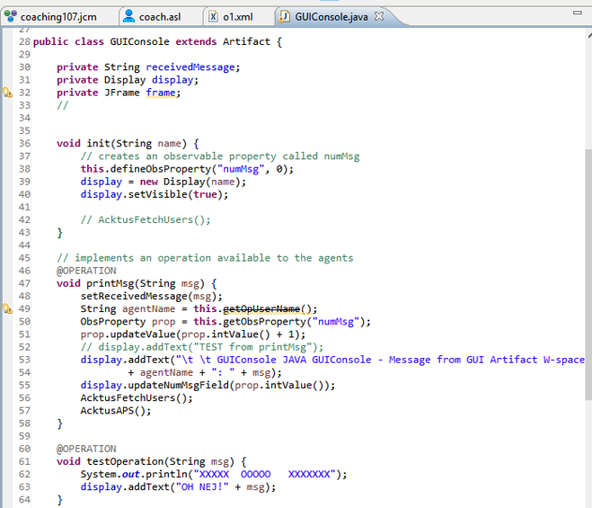
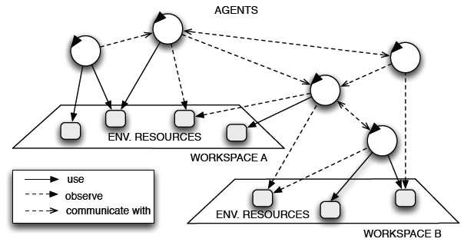
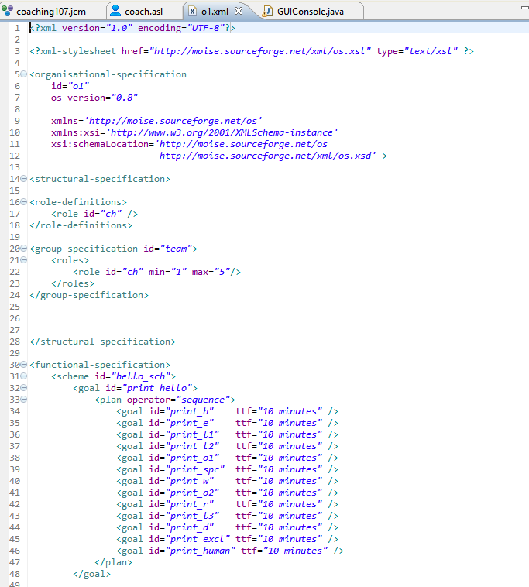
Agency
Short example of JaCaMo. Building an environment with agents.

Slide 8
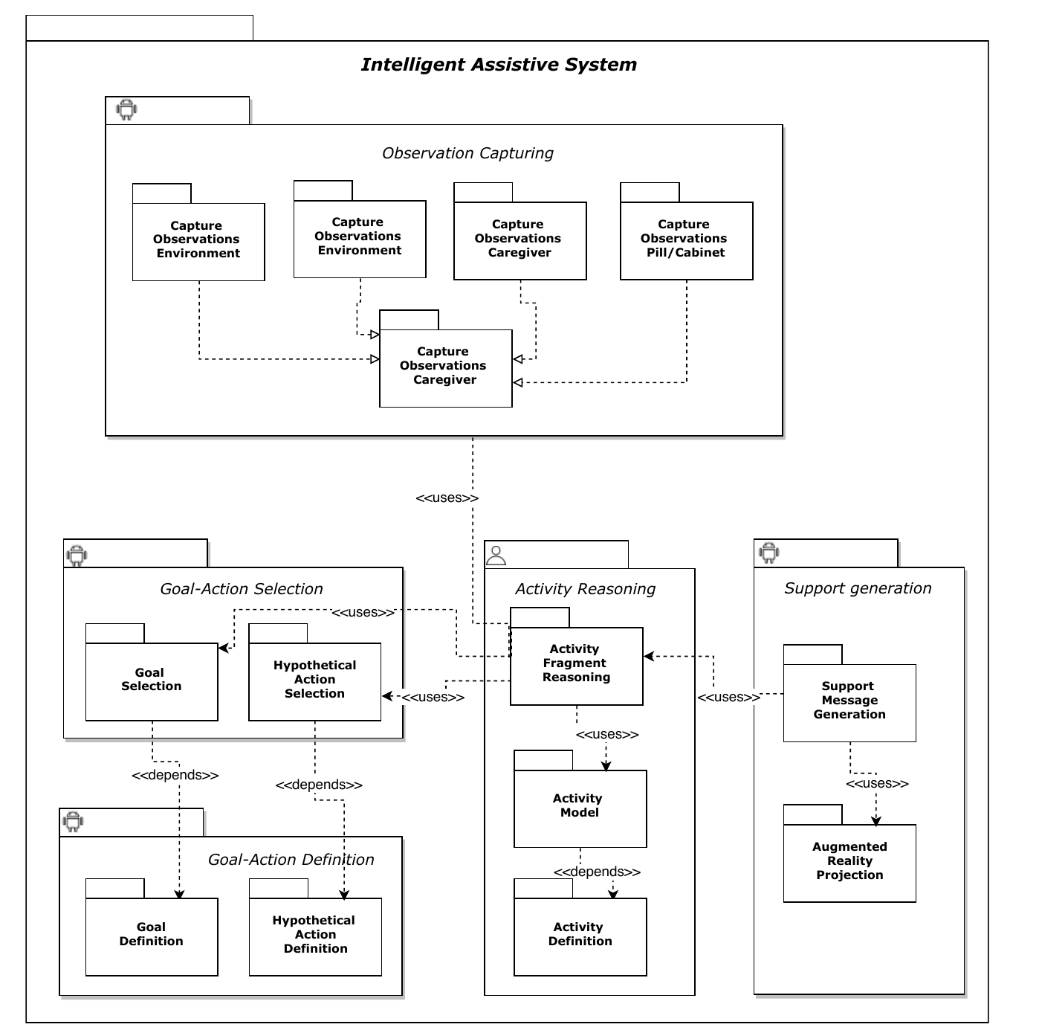
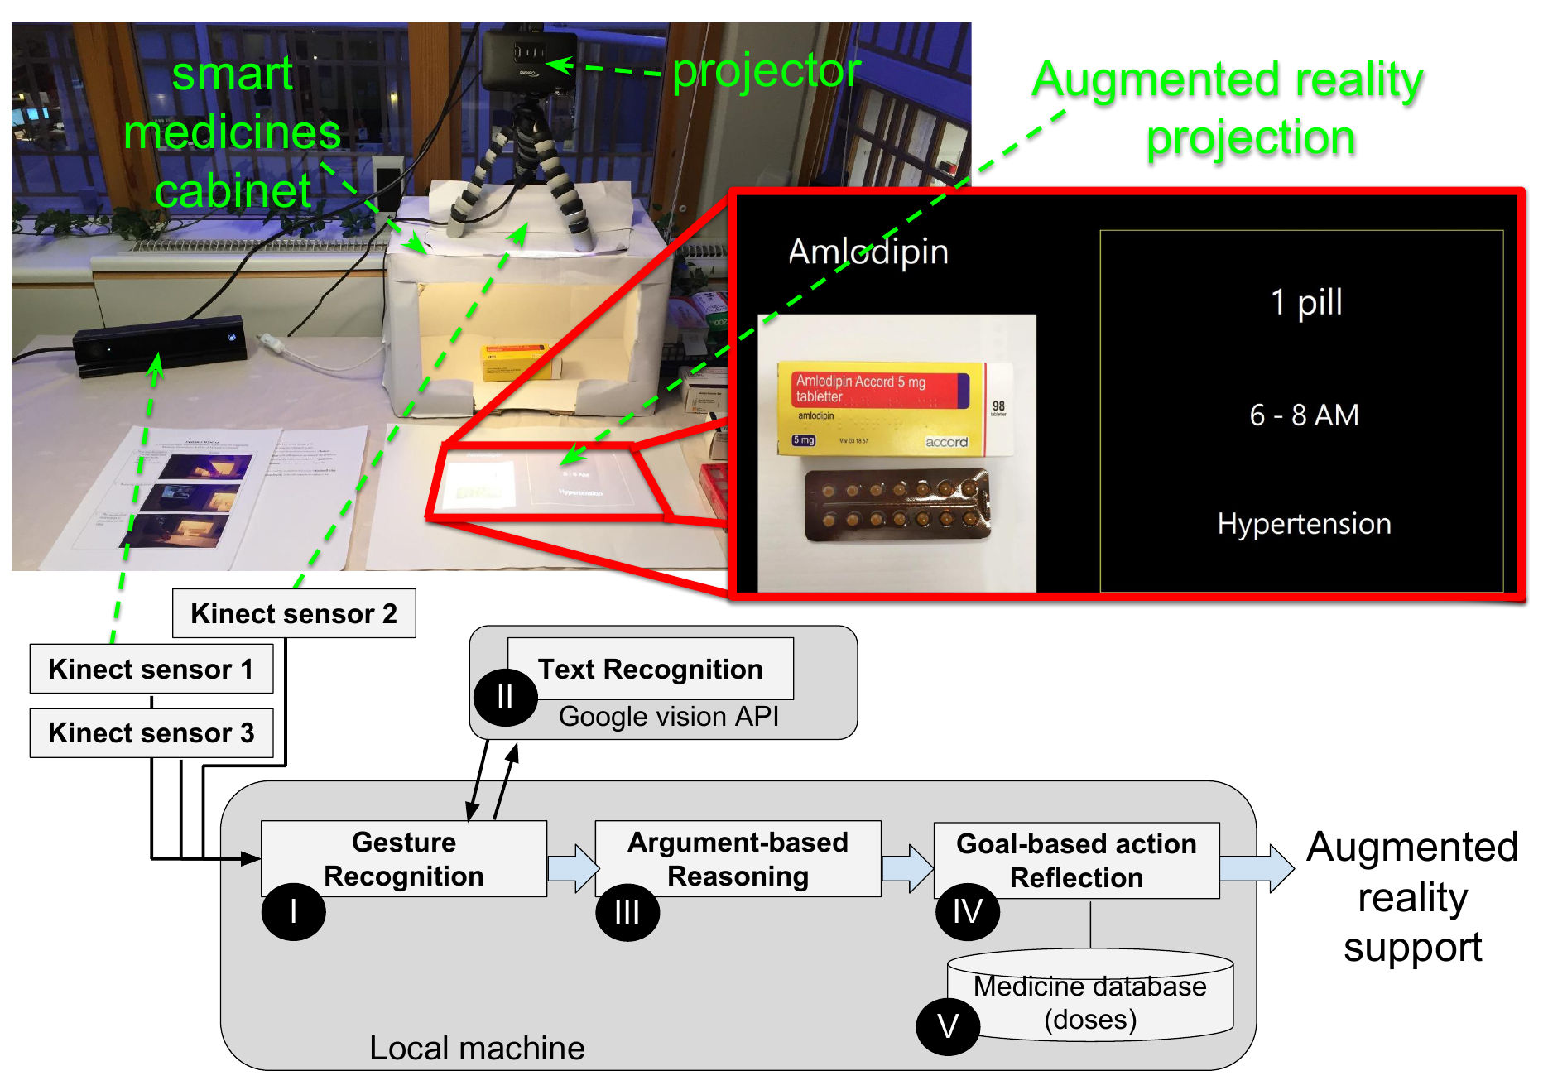
MED-AR
Prototype

Slide 9
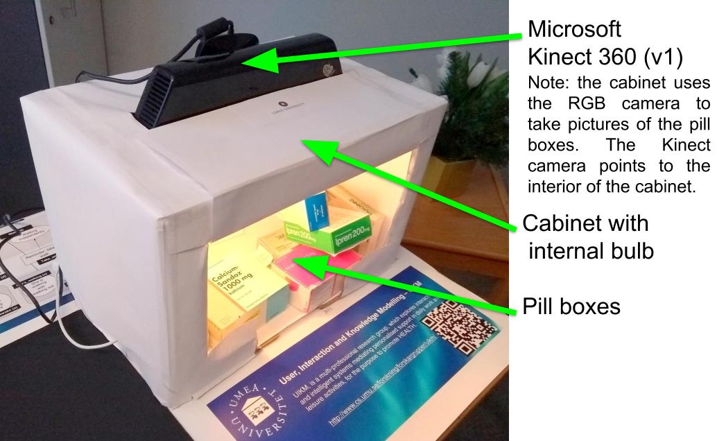
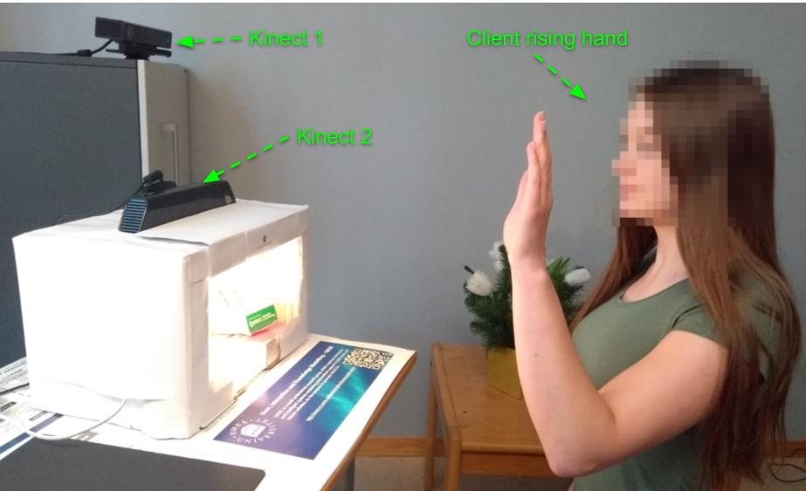
MED-AR

Slide 10
END
Questions

