Slide 1
Engineering agents
Part II
Ph.D. Esteban Guerrero.
esteban@cs.umu.se
Office: MIT building C424
Notes:
1

Slide 2
Part II
Projects

Slide 3
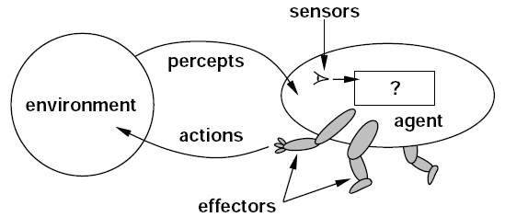
a software Agent:
A general view
Figure agent-environment relationship
Russell, S., & Norvig, P. (2003). Artificial Intelligence: A Modern Approach. Prentice Hall Series in Artificial Intelligence.
Belief–desire–intention software model
Bratman, M. E. (1999). Intention, Plans, and Practical Reason. CSLI Publications. ISBN 1-57586-192-5.
Notes:
3

Slide 4
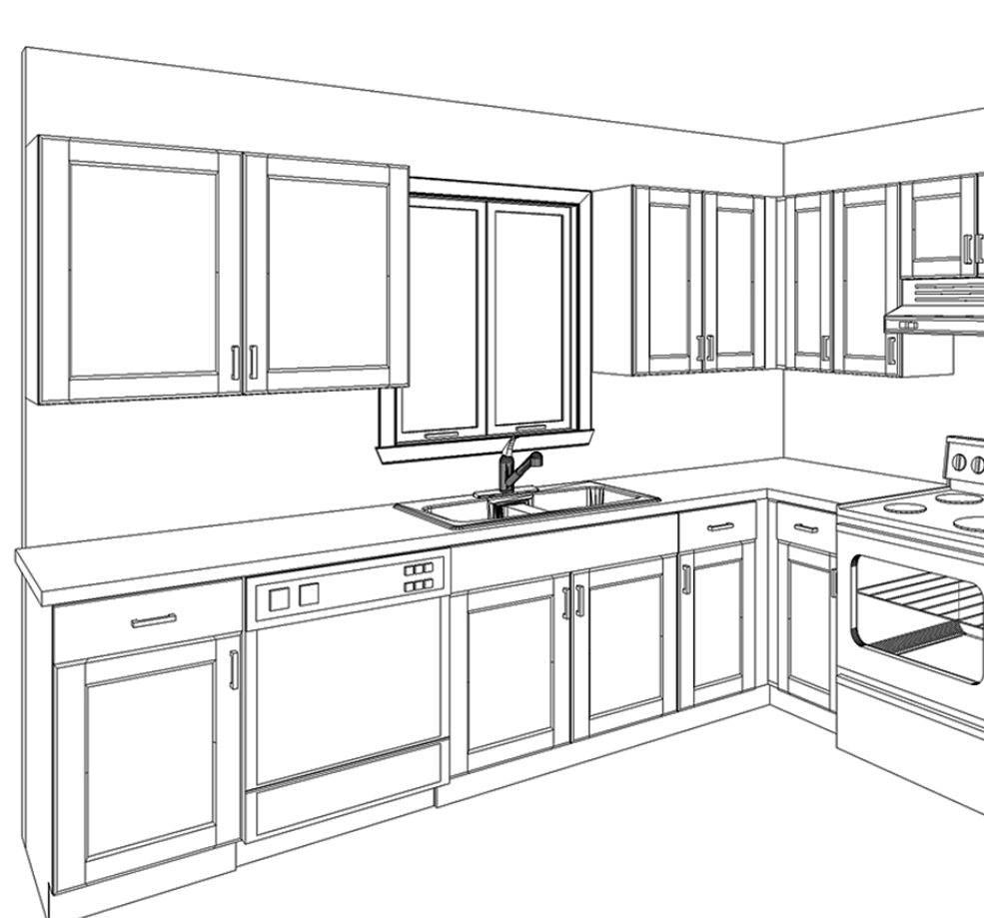
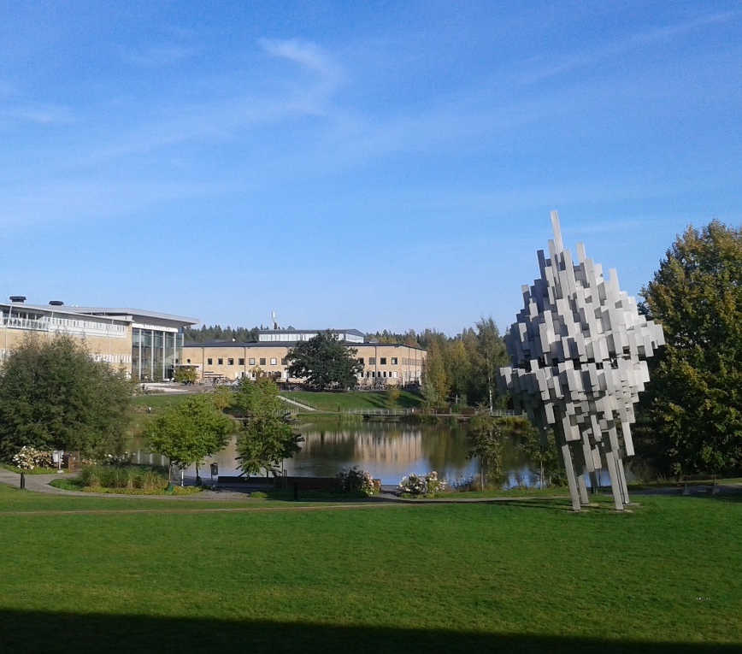
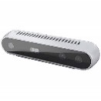
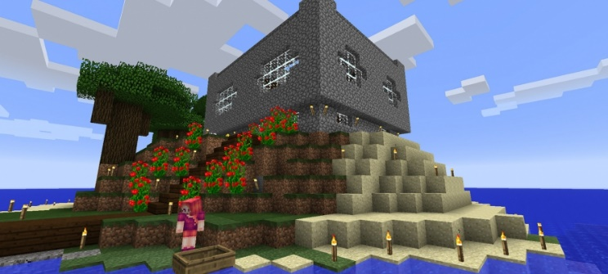
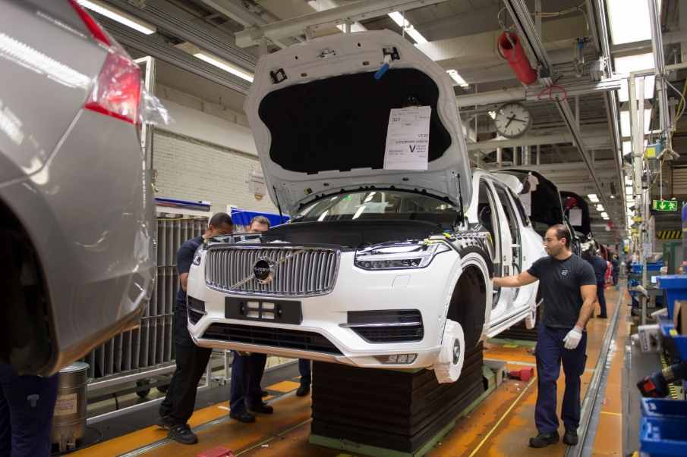
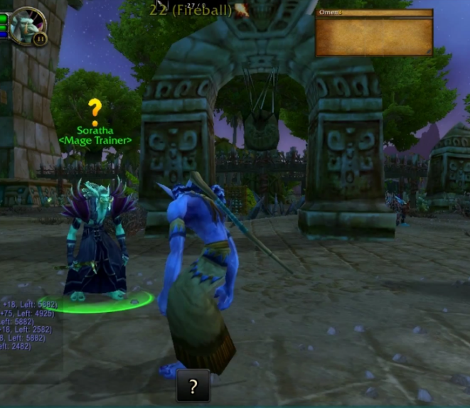
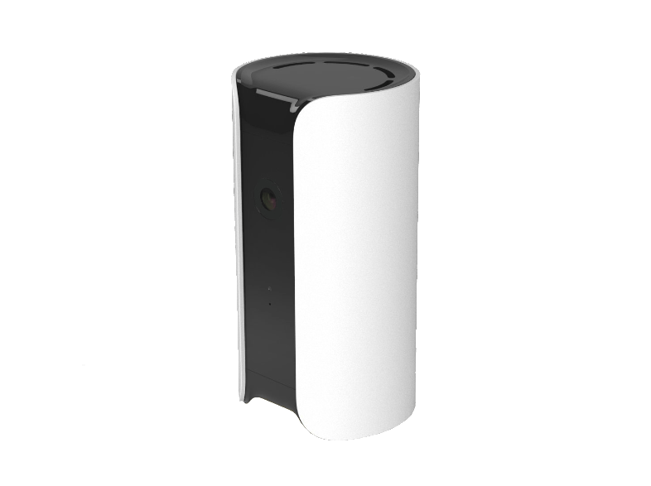
Problem setting
INPUT
Time: 21:00
Specific problem: xe forgets to activate dishwasher in the evening, with different consequences next day.
Mmmh… xe’s not responding.
Well… I’ll start the dishes anyway
Time: 19:00
Sensing
Hi! The dish-washer is full. Should I start it?
Reasoning
Learning
Response
OUTPUT
Agent
Image1: “Intel RealSense D415”
Image2: “CANARY All In One Home Security Device”
Notes:
4

Slide 5
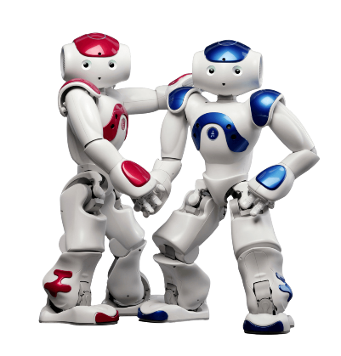
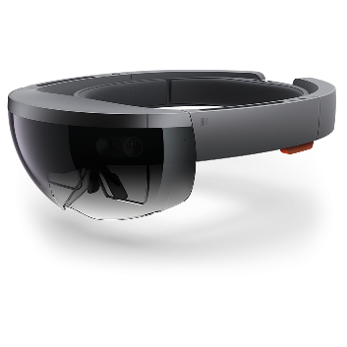
Inputs - outputs
Weather
Temperature
Location (GPS, WiFi, etc.)
Biomechanics (gestures, acceleration, speed, etc.)
Emotions (face detect.)
Voice/sounds
INPUT
Specific problem: xe forgets to activate dishwasher in the evening, with different consequences next day.
Sensing
Robot (Nao)
AR googles (Hololens)
Reasoning
Learning
Response
OUTPUT
Visual (texts, images, wall-projections, VR, AR, etc.)
Haptic (textures, materials, vibrations, etc.)
Voice/sounds
Mix
Agent
Mobile phone (app) is not always a best
Input - Output
Robot (Nao)
AR googles (Hololens)
Notes:
IN HERE, SHOW THE NAO AND THE HOLOLENS!
5

Slide 6
Problem COMPLEXITY
INPUT
Sensing
Reasoning
Learning
Response
OUTPUT
Agent
Notes:
6

Slide 7
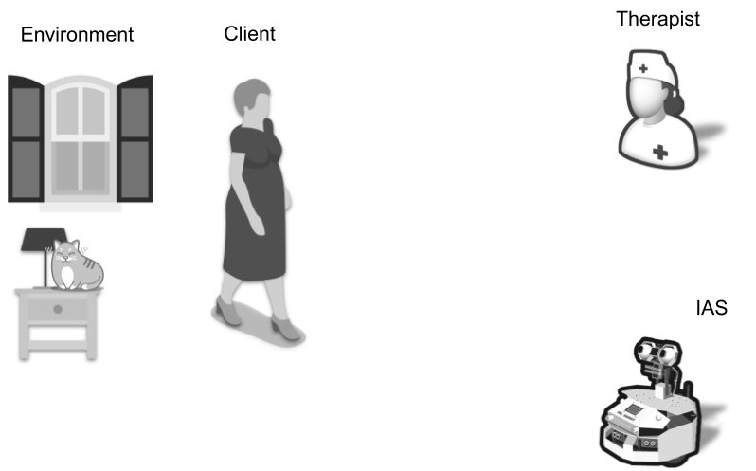
Problem COMPLEXITY
e.g. advice,
recommendation, etc.
IAS: Intelligent Assistive System
(part of the smart environment)
Notes:
7

Slide 8
Create scenarios
Scenario 1
Scenario 2
Output v1
Output v2
Version 1
Version 2
Scenario x
Try to create different scenarios. Make it work for at least one of them!
Output v X
Version x
Notes:
8

Slide 9
Sensors checklist considerations
Checklist to decide
What specific variable do you need to measure?
Do you need discrete or continuous data?
How variables (sensors data) can be combined (fuse)?
Can a variable be inferred from another (triangulation, interpolation, etc.)?
Notes:
Interactivity in smart environments
Physical space
(mathematics) calculation of the value of a function between the values already known

Slide 10
Inputs - outputs
Weather
Temperature
Location (GPS, WiFi, etc.)
Biomechanics (gestures, acceleration, speed, etc.)
Emotions (face detect.)
Voice/sounds
INPUT
Specific problem: xe forgets to activate dishwasher in the evening, with different consequences next day.
Sensing
Robot (Nao)
AR googles (Hololens)
Reasoning
Learning
Response
OUTPUT
Visual (texts, images, wall-projections, VR, AR, etc.)
Haptic (textures, materials, vibrations, etc.)
Voice/sounds
Mix
Agent
Mobile phone (app) is not always a best
Input - Output
Robot (Nao)
AR googles (Hololens)
Notes:
IN HERE, SHOW THE NAO AND THE HOLOLENS!
10

Slide 11
Problem COMPLEXITY
INPUT
Sensing
Reasoning
Learning
Response
OUTPUT
Agent
Notes:
11

Slide 12
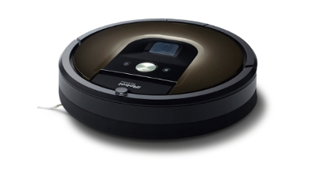
Problem COMPLEXITY
S2: still smart in a Smart Environment
Detect humans: calculate safe distance (variable)
Detect environment: avoid wall/object collisions (mostly static)
Localize itself in the environment: avoid re-cleaning; find closest electrical outlet
Detect human body: obtained from the SE
Detect wall/object: infrared, ultra sound (obtained from smart objects)
Location: GPS; WiFi; structure-based (inferred from planning*), obtained from the SE
Communication with other devices

Slide 13
Problem COMPLEXITY
e.g. advice,
recommendation, etc.
IAS: Intelligent Assistive System
(part of the smart environment)
Notes:
13

Slide 14
Create scenarios
Scenario 1
Scenario 2
Output v1
Output v2
Version 1
Version 2
Scenario x
Try to create different scenarios. Make it work for at least one of them!
Output v X
Version x
Notes:
14

Slide 15
Hardware architecture considerations
Checklist to decide
What specific variable do you need to measure?
Do you need discrete or continuous data?
How variables (sensors data) can be combined (fuse)?
Can a variable be inferred from another (triangulation, interpolation, etc.)?
Energy consumption
More watts → More money
Less watts → More mobility
More watts → Less environmental friendly
Notes:
Interactivity in smart environments
Physical space
(mathematics) calculation of the value of a function between the values already known

Slide 16
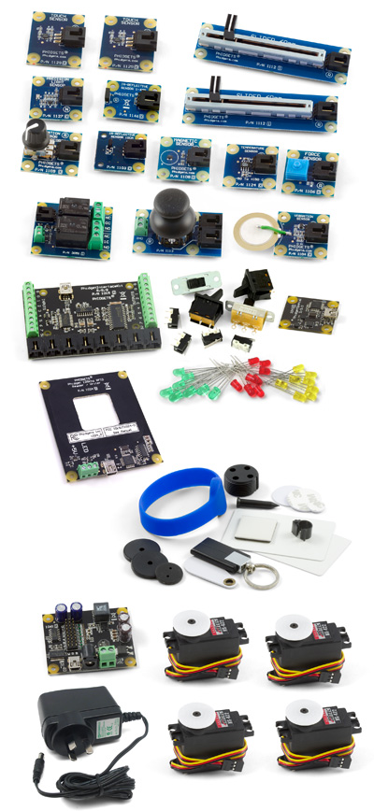
Available Data sources
Infrared distance sensor
Magnetic
Motion
Pressure
Temperature
Force
Touch
Vibration
…

Slide 17
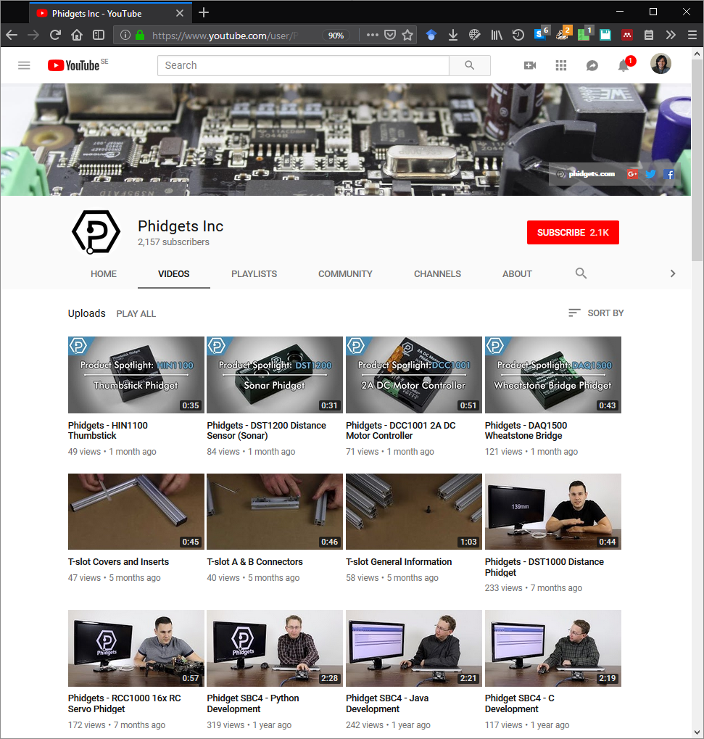
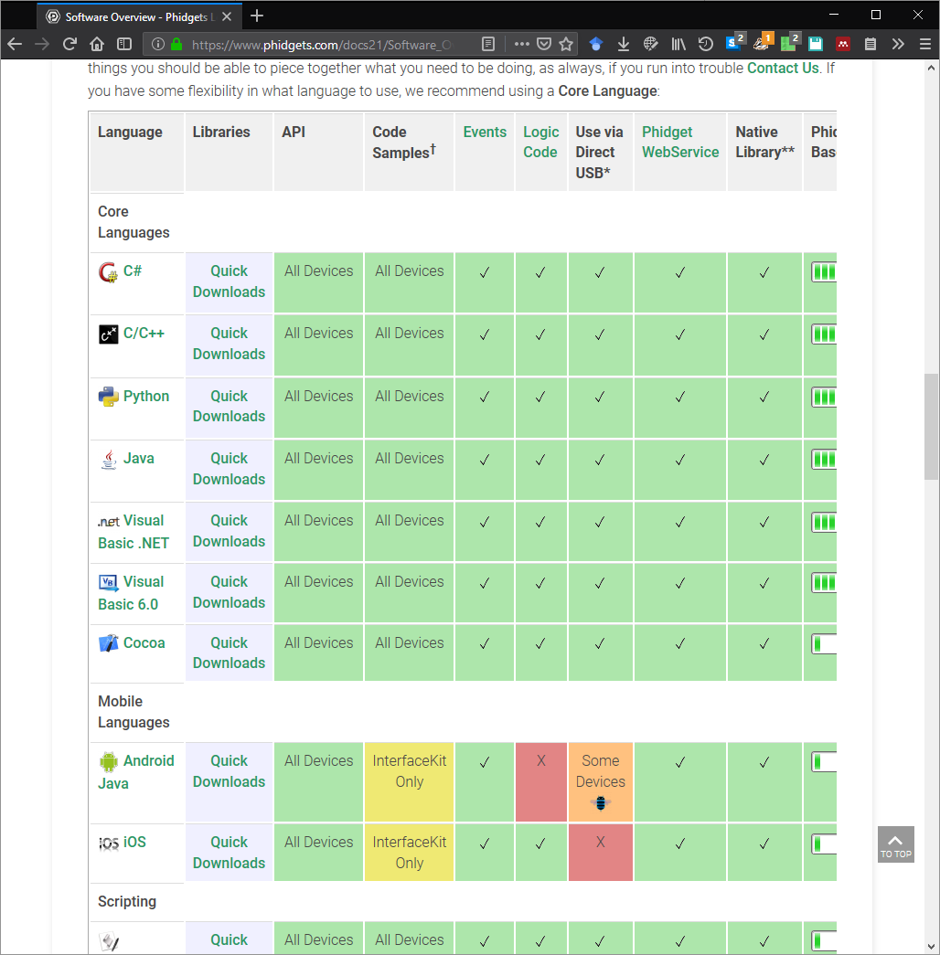
Available Data sources

Slide 18
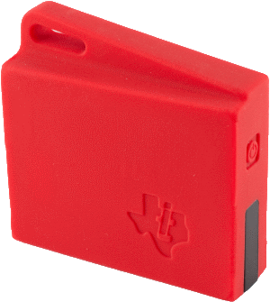
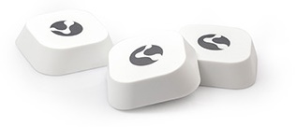
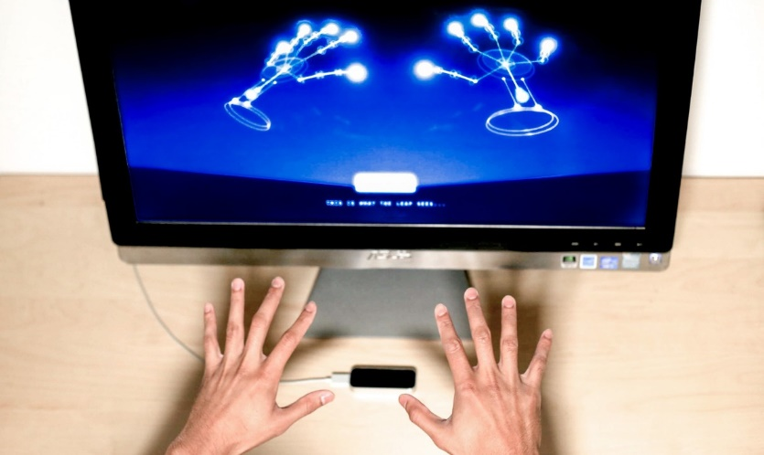
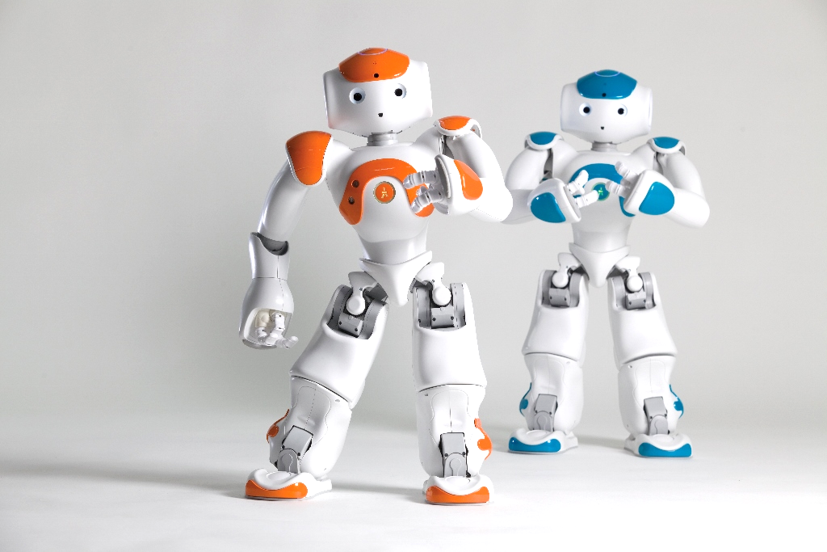
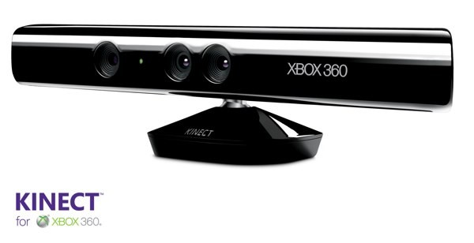
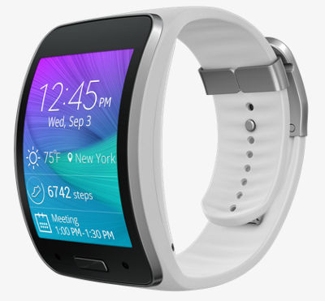
Available Data sources
Beacons / Tags
Leap motion sensor
Nao robots
Kinect
Samsung Gear S
Your mobile phones
Hololens

Slide 19
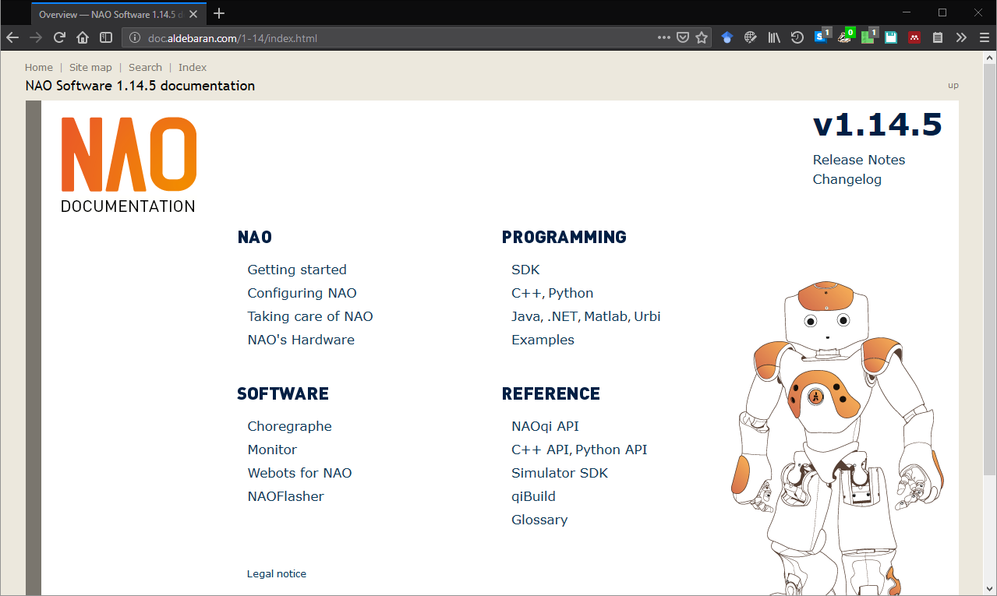
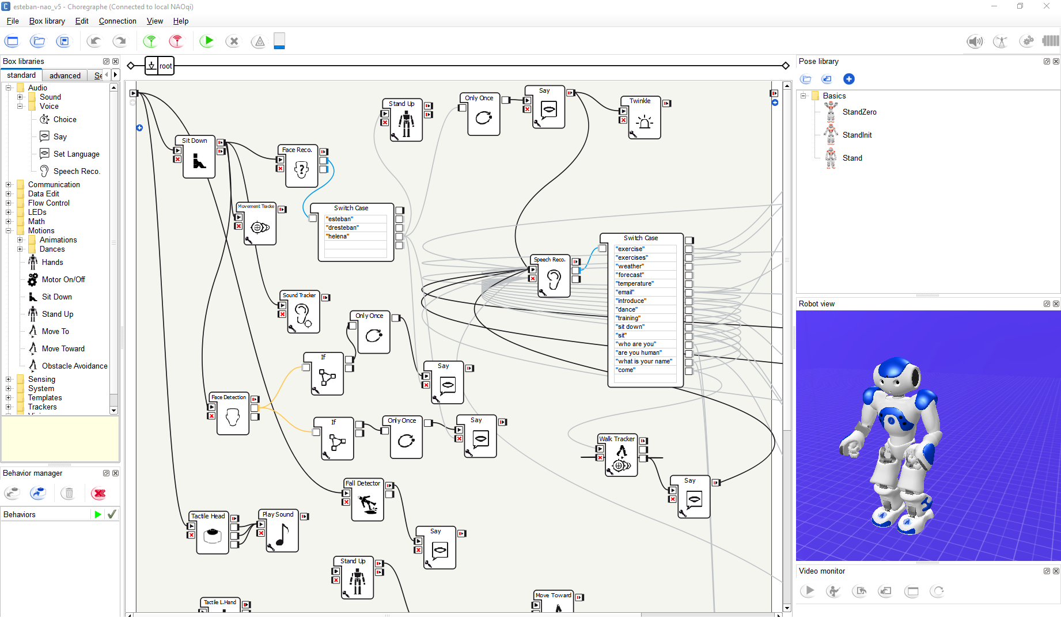
Available Data sources
Nao robots
Toolkit Choregraphe

Slide 20
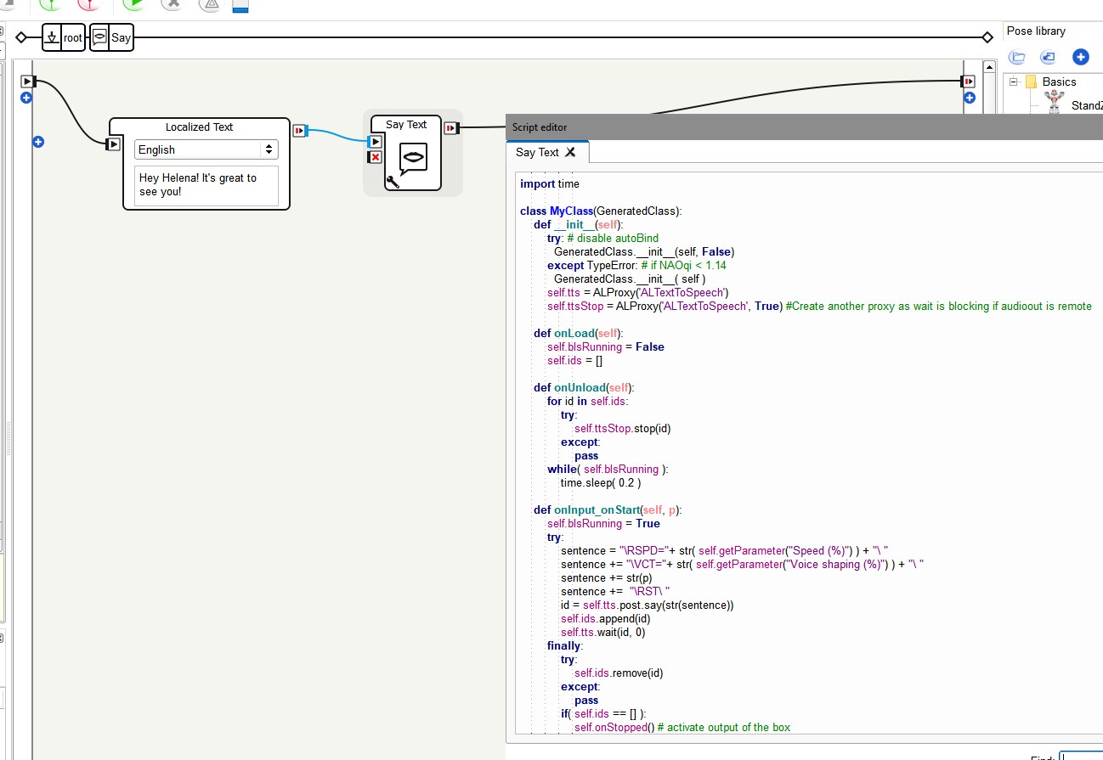
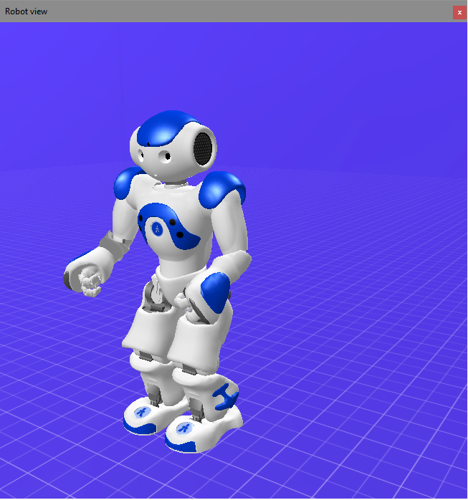
Available Data sources
Nao robots
Toolkit Choregraphe
Includes simulator
Available libraries for Nao robot in C++, Python, Java, Matlab, etc.

Slide 21
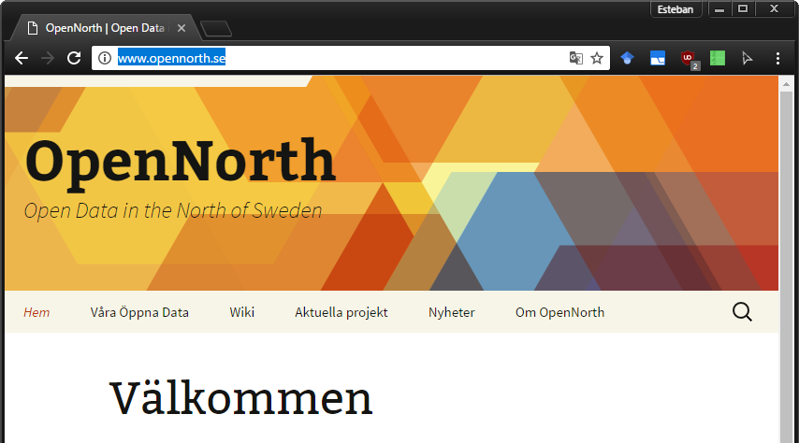
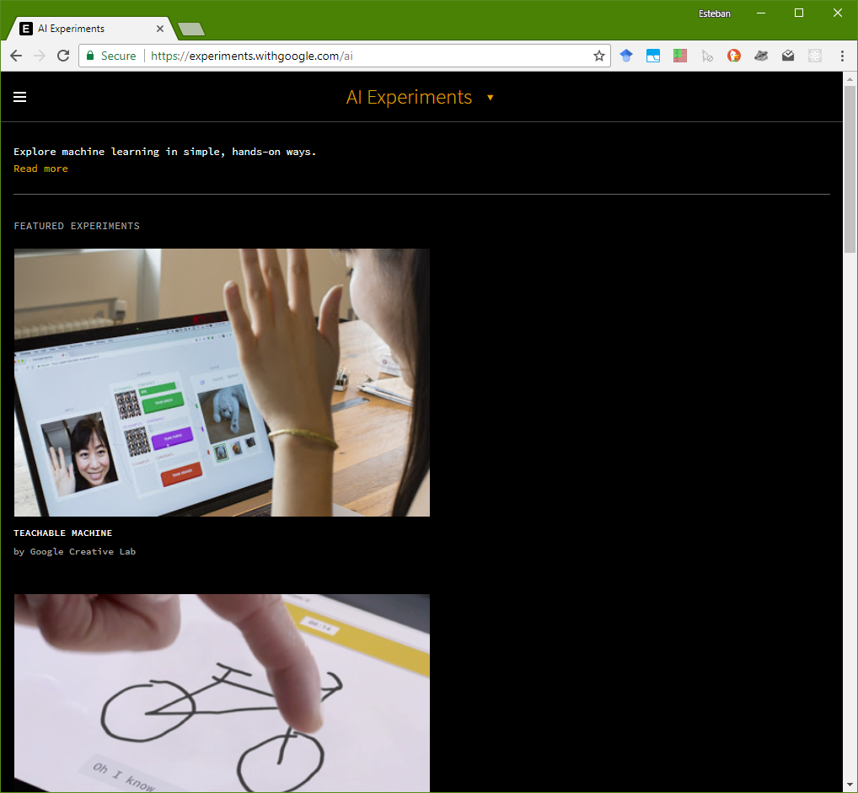
Available Web data sources
Weather: SMHI, yr.no, etc.
Maps
Location services
Object, voice, gestures recognition services (e.g. Google, Microsoft, etc.)
Transportation: local bus/trains, flights, etc.
Open data: http://www.opennorth.se/

Slide 22
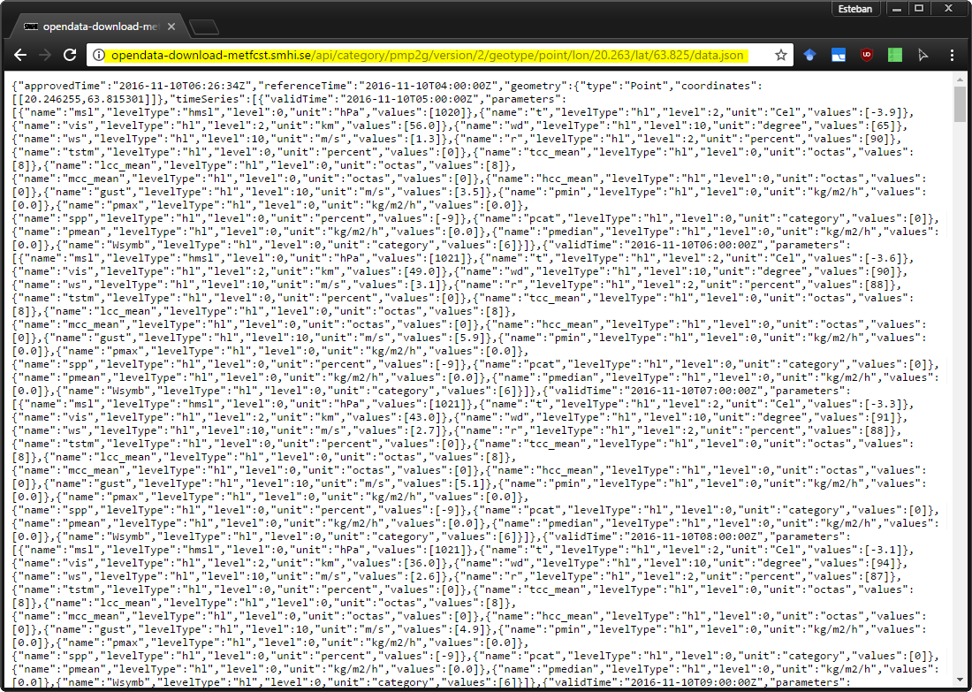
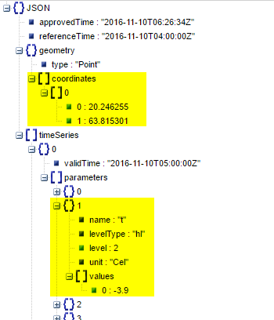
Examples
SMHI Forecast Web service
Yr.no Forecast Web service

Slide 23
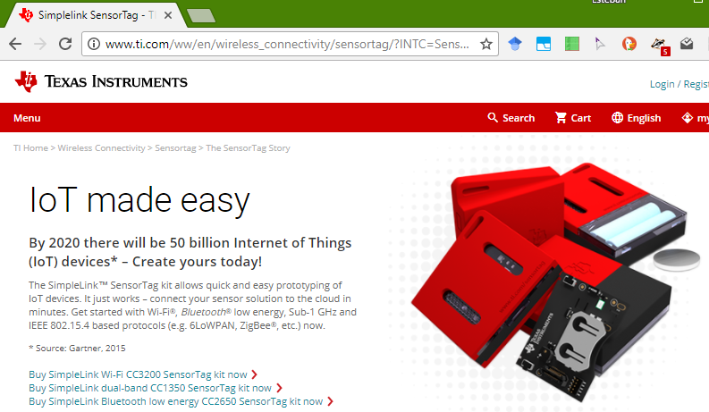
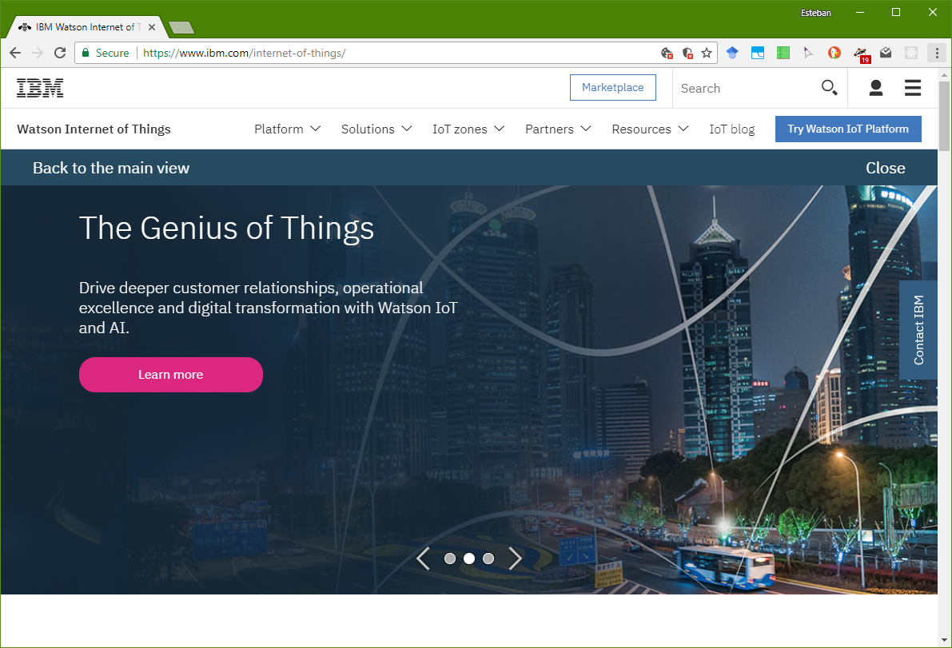
Examples
IBM Watson IoT
Google Cloud IoT
Microsoft IoT
…

Slide 24
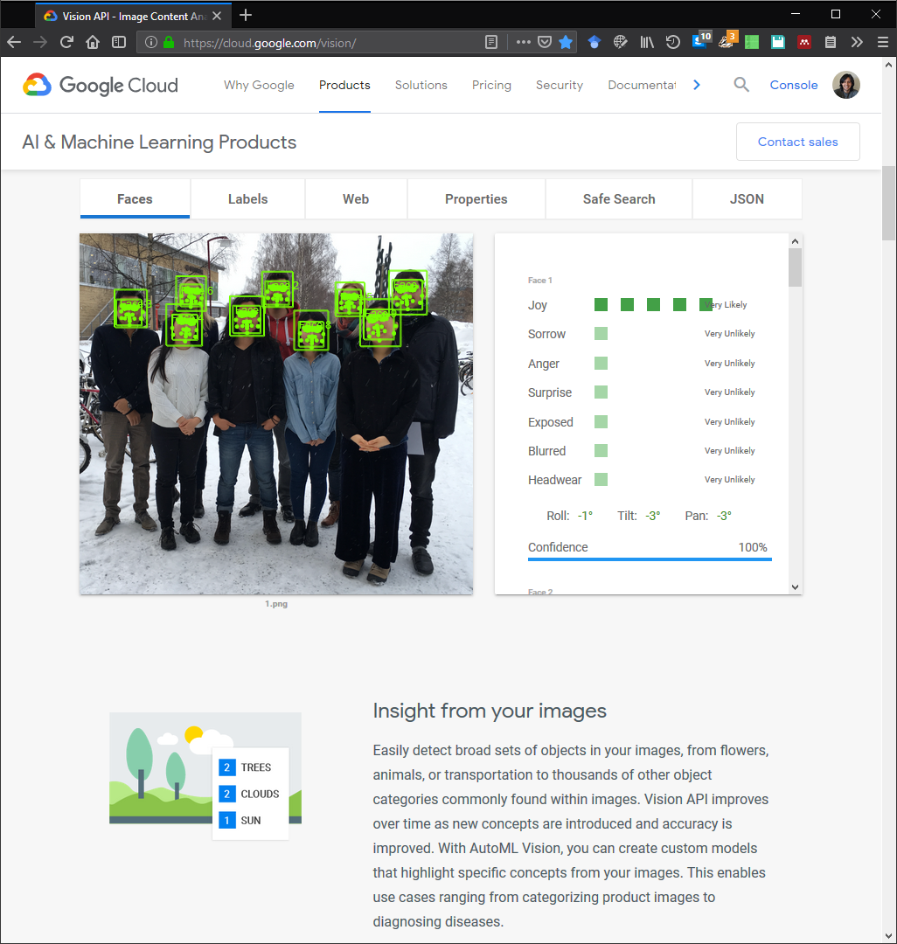
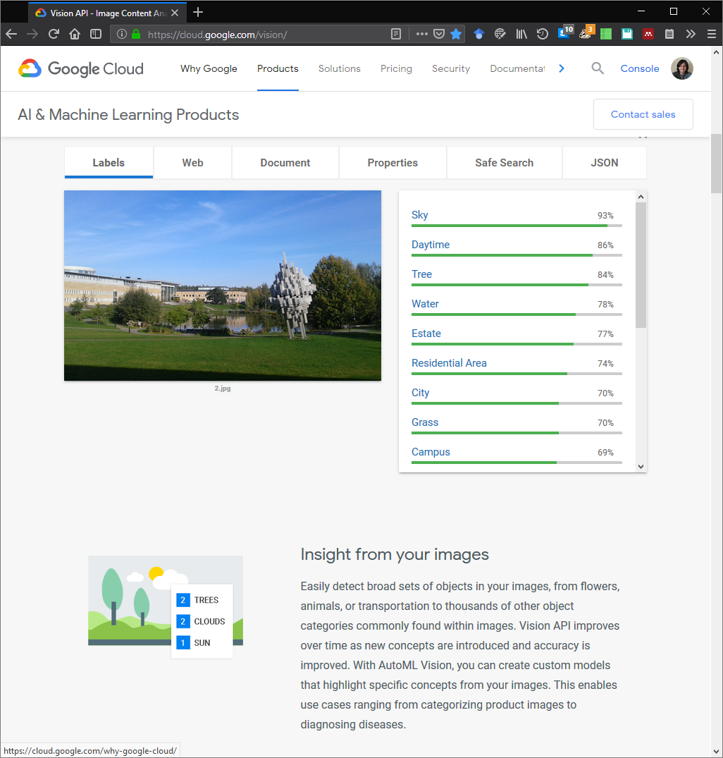
Tools for building agent’s modules
Sentiment/emotion
analysis
AI tool boxes for recognition of objects, persons, places, etc. using image, text, video and sounds):
EXAMPLE
Google cloud AI & Machine Learning tools
https://cloud.google.com/vision/
Object analysis
Environment analysis

Slide 25
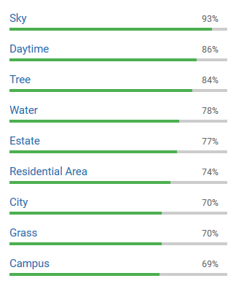
SOFTWARE AGENT
Tools for building agent’s modules
is-a
NON-HUMAN
ACTOR
BODY
hasLocation
PHYSICAL SPACE
has
PHYSICAL SPACE
VIRTUAL SPACE
is-a
HUMAN
ACTOR
is-a
is-a
ACTOR
is-a
uses
SPACE
SPACE
has
has
DESIRE
has
has
ROLE
BELIEF
INTENTION
ACTION
hasLocation
ConsistsOf
ACTIVITY
isDefinedBy
OBJECTIVE
isToolIn
is-a
OBJECT
is-a
MENTAL OBJECT
is-a
is-a
Russell, S., & Norvig, P. (2003). Artificial Intelligence: A Modern Approach. Prentice Hall Series in Artificial Intelligence.
PHYSICAL OBJECT
VIRTUAL OBJECT
Notes:
25

Slide 26
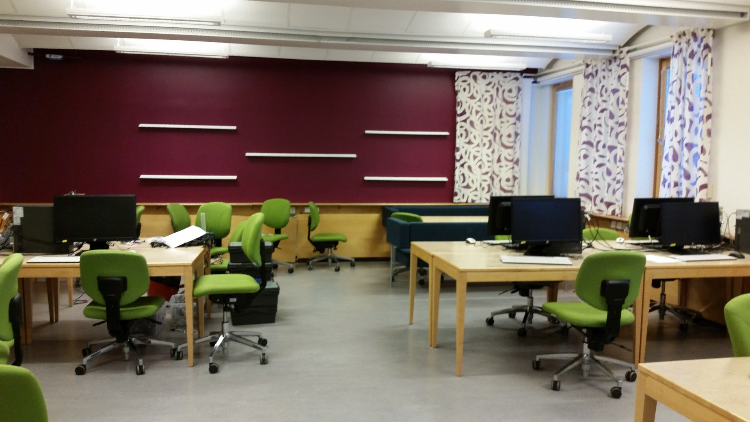
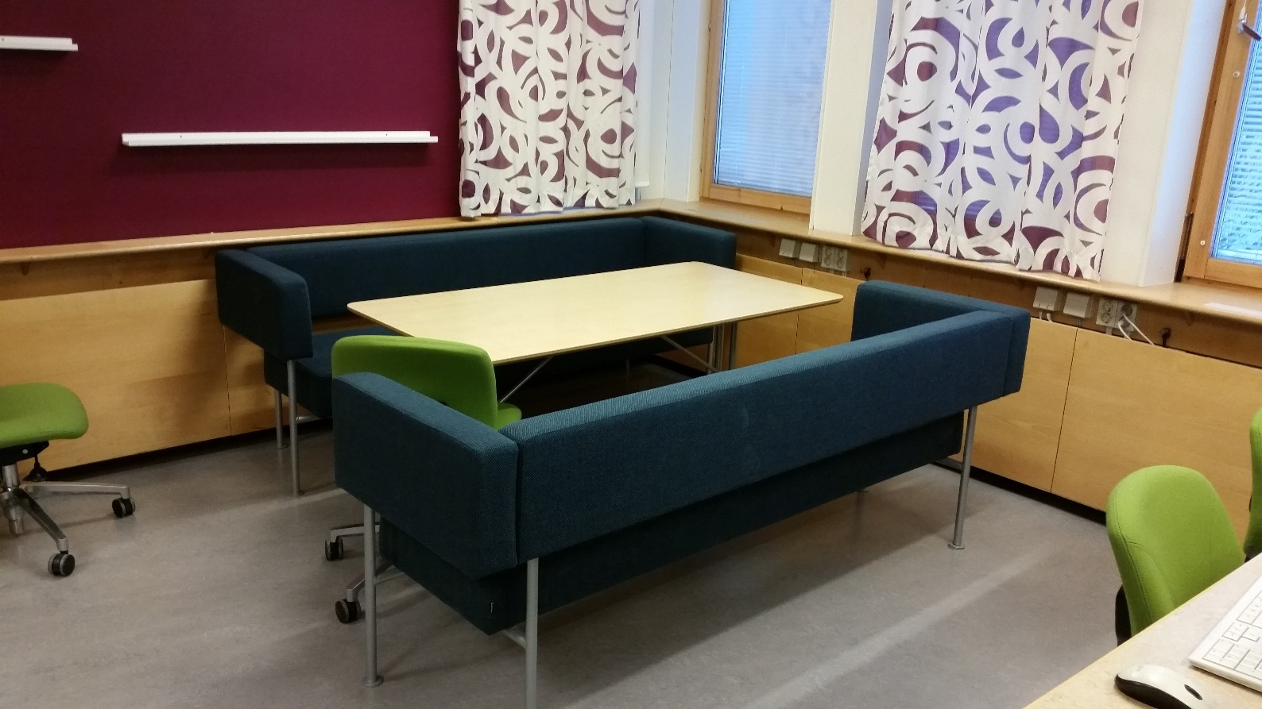
Facilities
MC343 + Mini lab (C420)

Slide 27
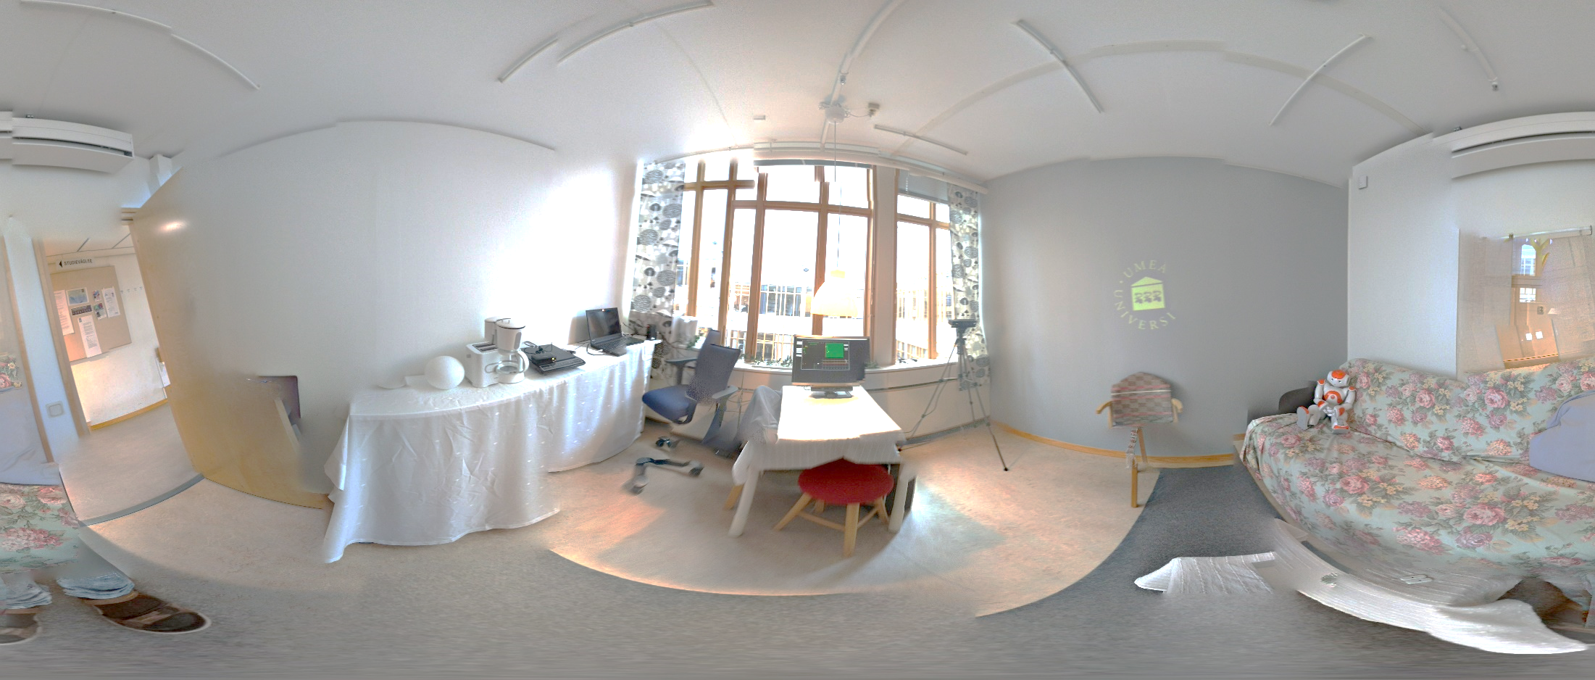
Facilities
Mini lab (C420)

