Slide 1
Engineering agents
Part I
Ph.D. Esteban Guerrero.
esteban@cs.umu.se
Office: MIT building C424
Notes:
1

Slide 2
Part I
Knowledge representation
Overview of tools

Slide 3
Content
Tools you may use for building agent’s modules.
How to model knowledge from agent and its environment?
Examples and a tool software Protégé (a tool for knowledge modelling)

Slide 4
Tools for building agent’s modules
Depends on the problem.
Tools selection depends on ways to solve that problem

Slide 5
Tools for building agent’s modules
AI tool boxes for recognition of objects, persons, places, etc. using image, text, video and sounds):
Google cloud AI & Machine Learning tools https://cloud.google.com/products/ai/
Amazon Machine Learning tools https://aws.amazon.com/
Microsoft Cognitive Services https://azure.microsoft.com/en-us/services/cognitive-services/
Matlab computer vision https://se.mathworks.com/products/computer-vision.html
Facebook open source artificial intelligence https://opensource.fb.com/
R tools (open source!) https://www.r-project.org/
Python for AI https://wiki.python.org/moin/PythonForArtificialIntelligence
Many more (2018)

Slide 6
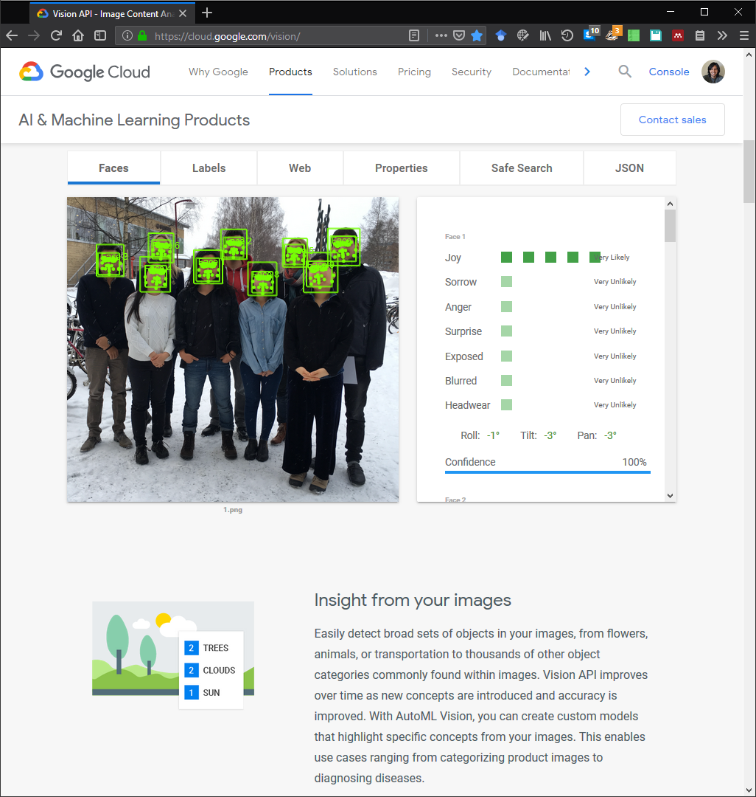
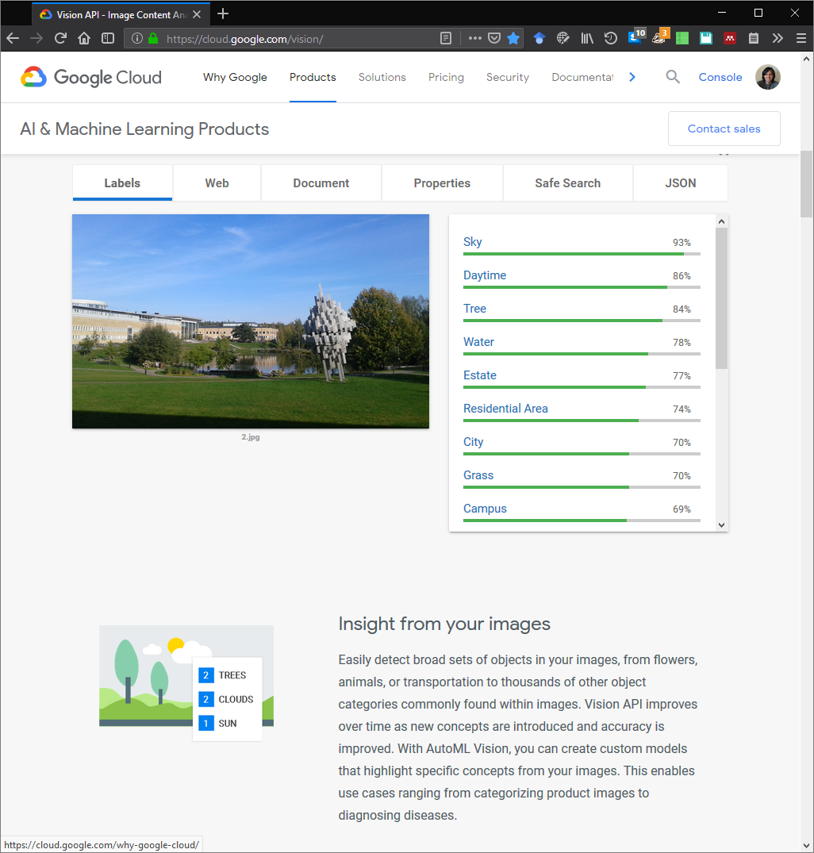
Tools for building agent’s modules
Sentiment/emotion
analysis
AI tool boxes for recognition of objects, persons, places, etc. using image, text, video and sounds):
EXAMPLE
Google cloud AI & Machine Learning tools
https://cloud.google.com/vision/
Object analysis
Environment analysis

Slide 7
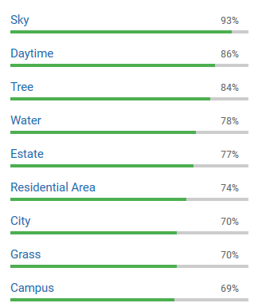
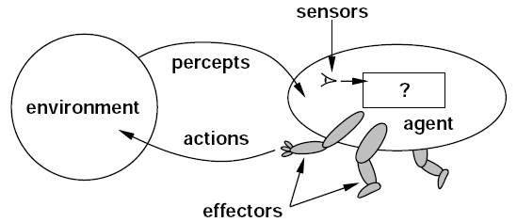
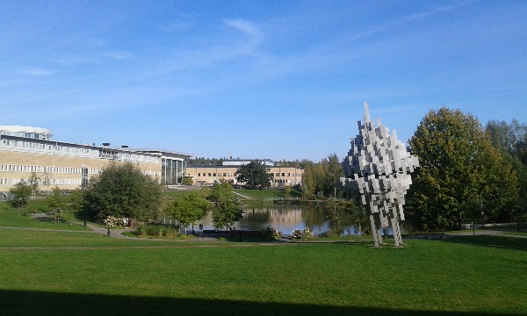
SOFTWARE AGENT
Tools for building agent’s modules
is-a
NON-HUMAN
ACTOR
BODY
hasLocation
PHYSICAL SPACE
has
PHYSICAL SPACE
VIRTUAL SPACE
is-a
HUMAN
ACTOR
is-a
is-a
ACTOR
is-a
uses
SPACE
SPACE
has
has
DESIRE
has
has
ROLE
BELIEF
INTENTION
ACTION
hasLocation
ConsistsOf
ACTIVITY
isDefinedBy
OBJECTIVE
isToolIn
is-a
OBJECT
is-a
MENTAL OBJECT
is-a
is-a
Russell, S., & Norvig, P. (2003). Artificial Intelligence: A Modern Approach. Prentice Hall Series in Artificial Intelligence.
PHYSICAL OBJECT
VIRTUAL OBJECT
Notes:
7

Slide 8
Tools for building agent’s modules
AI tool boxes for capturing, representing knowledge
Google cloud AI, Amazon Machine Learning, Microsoft Cognitive Services, Matlab, Facebook, R tools, Python for AI.
Protégé https://protege.stanford.edu/
Many more (2018)

Slide 9
KNOWLEDGE CAPTURING AND INTERPRETATION
Ontology:
Focus: meaning (shared understanding)
Defines a set of concepts and relationships
Represents content and structure
Core purpose: agents communication, interoperability, search, etc.
Database scheme
Focus: Data
Defines structure of database
Core purpose: structure instances for efficient storage and querying

Slide 10
KNOWLEDGE CAPTURING AND INTERPRETATION
Database:
Closed world assumption (CWA)
Missing information treated as false
Unique name assumption (UNA)
Each individual has a single, unique name
Schema behaves as constraints on structure of data
Define legal database states
Ontology:
Open world assumption (OWA)
Missing information treated as unknown
No UNA
Individuals may have more than one name
Ontology axioms behave like implications (inference rules)
Entail implicit information
Ontologies and databases. Ian Horrocks. Information Systems Group. Oxford University Computing Laboratory

Slide 11
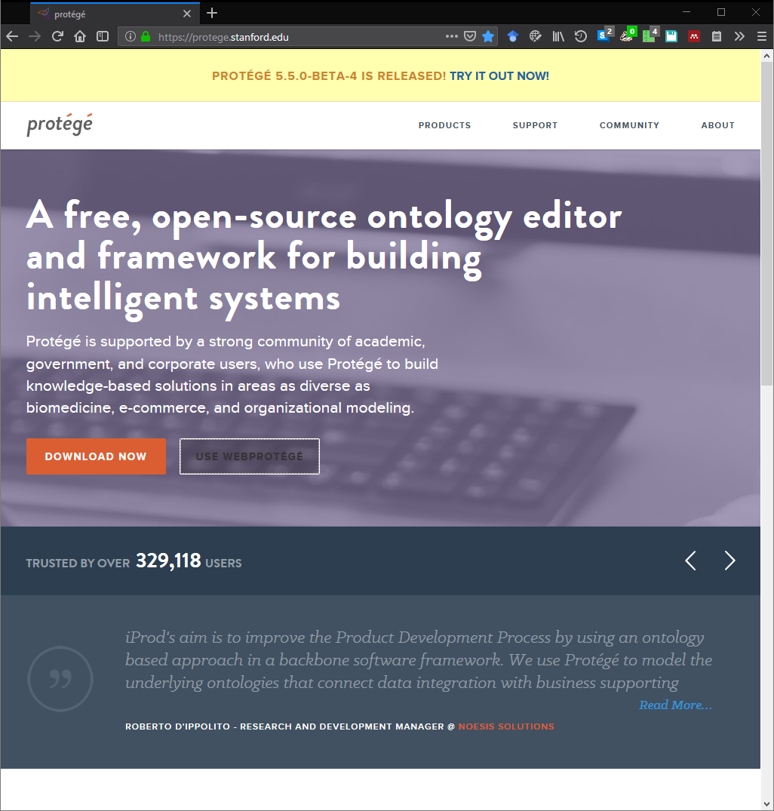
Protégé
https://protege.stanford.edu/
https://webprotege.stanford.edu/
Example
People

Slide 12
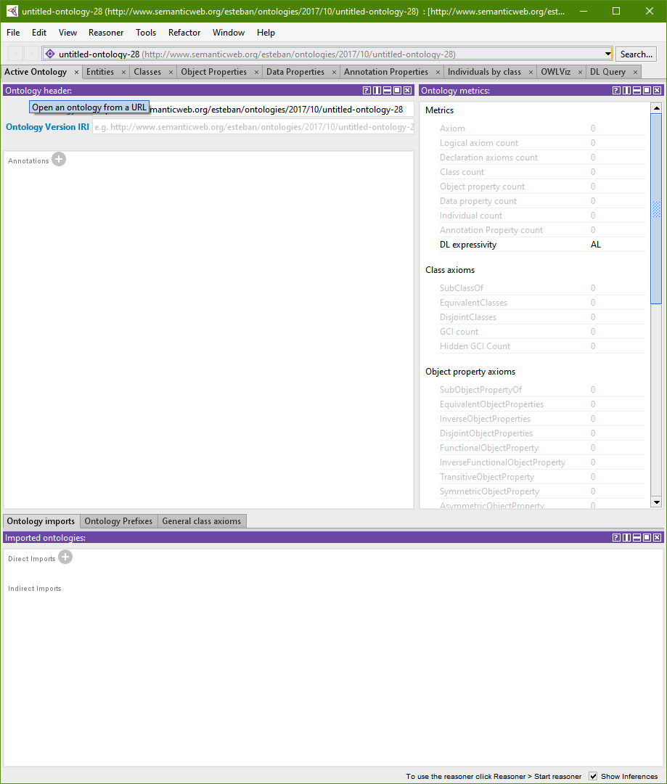
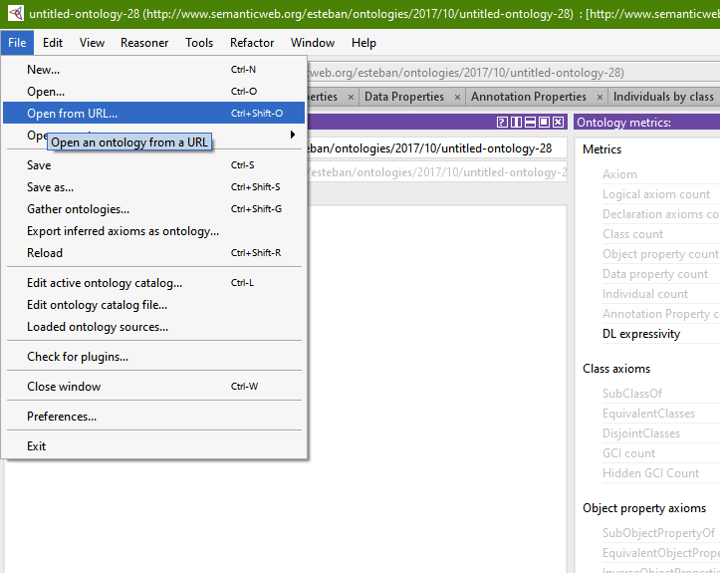
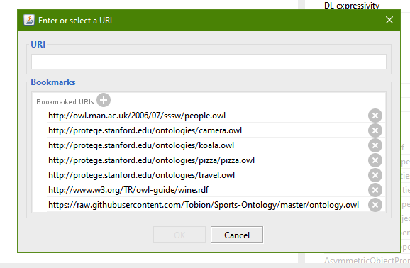
Protégé

Slide 13
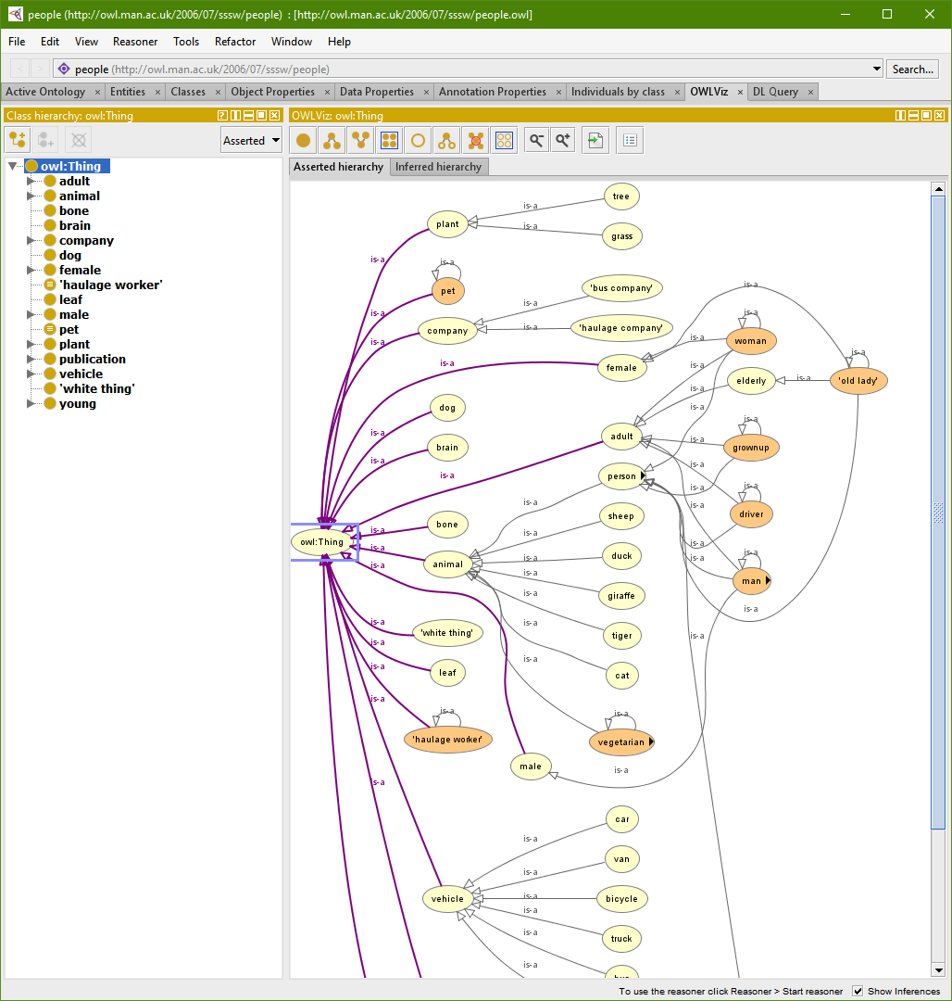
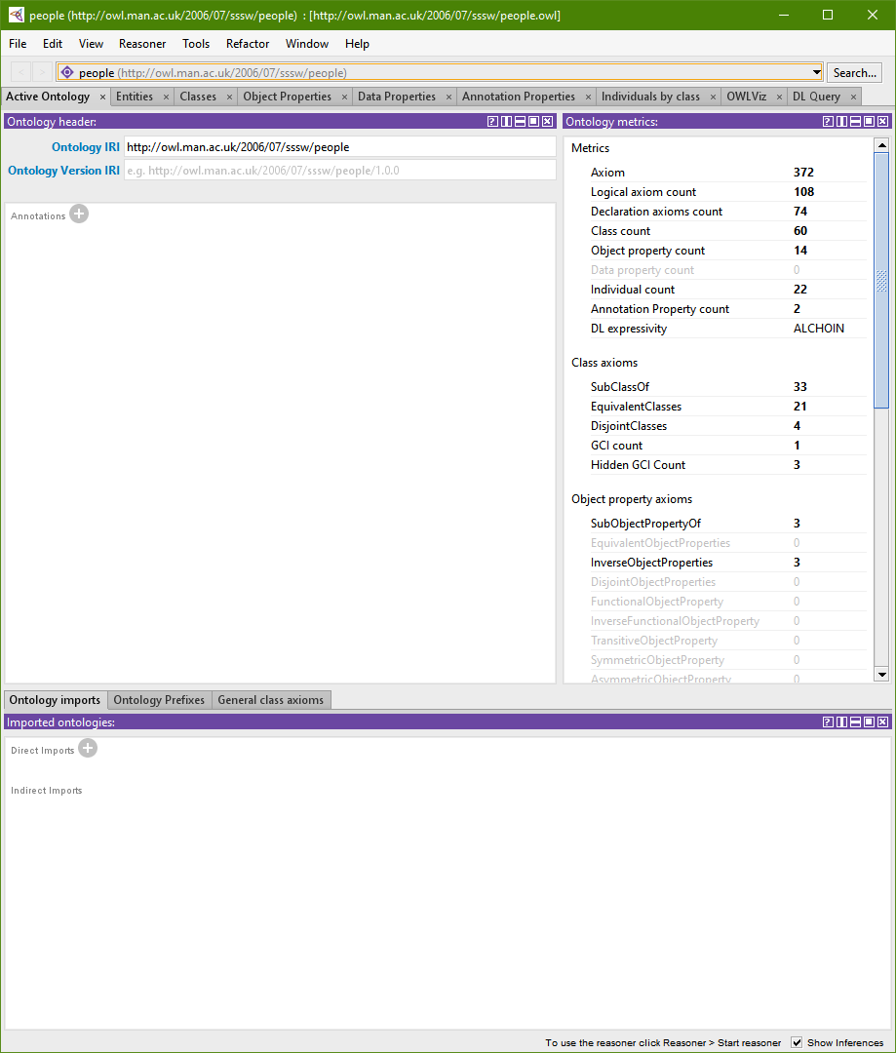
Protégé

Slide 14
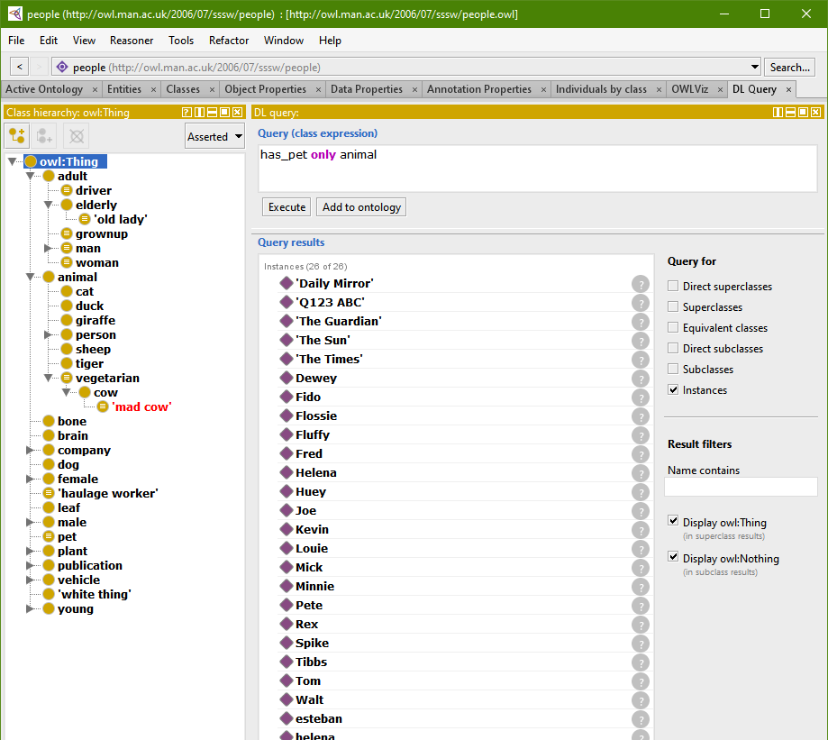
Protégé

Slide 15
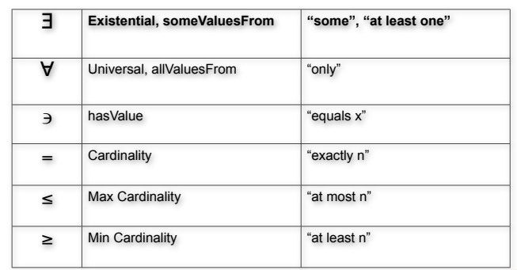
Protégé
Try some queries with people ontology and check the explanations:
adult and has_pet some cat or has_pet some dog
adult and has_pet value Rex
woman and has_pet min 1 cat
animal and is_pet_of some adult

Slide 16
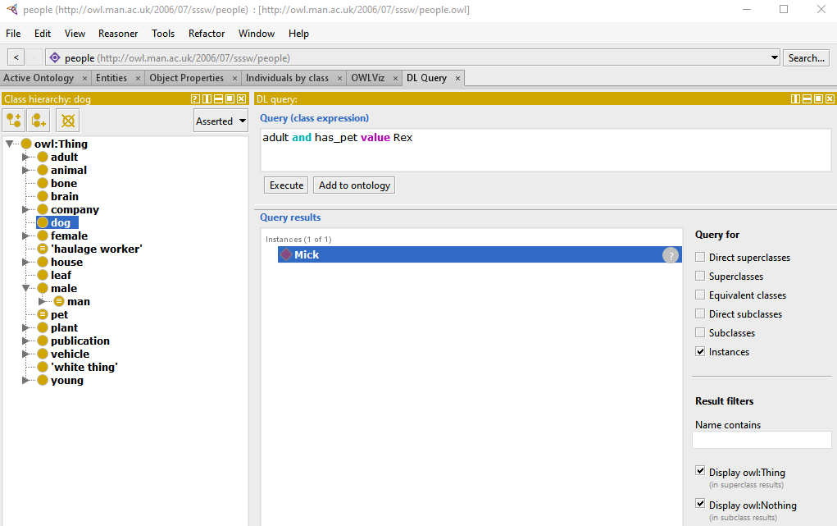
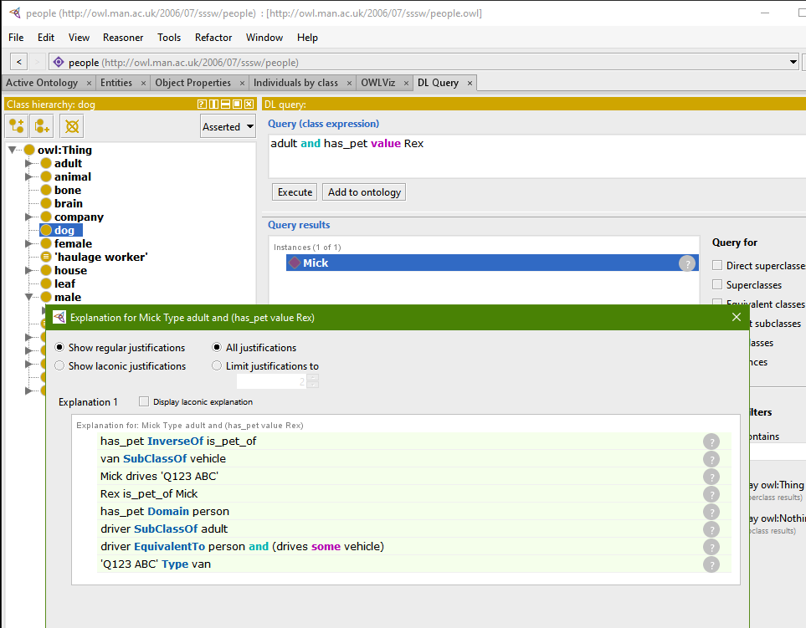
Protégé
Check the explanation!
Try some queries with people ontology and check the explanations:

Slide 17
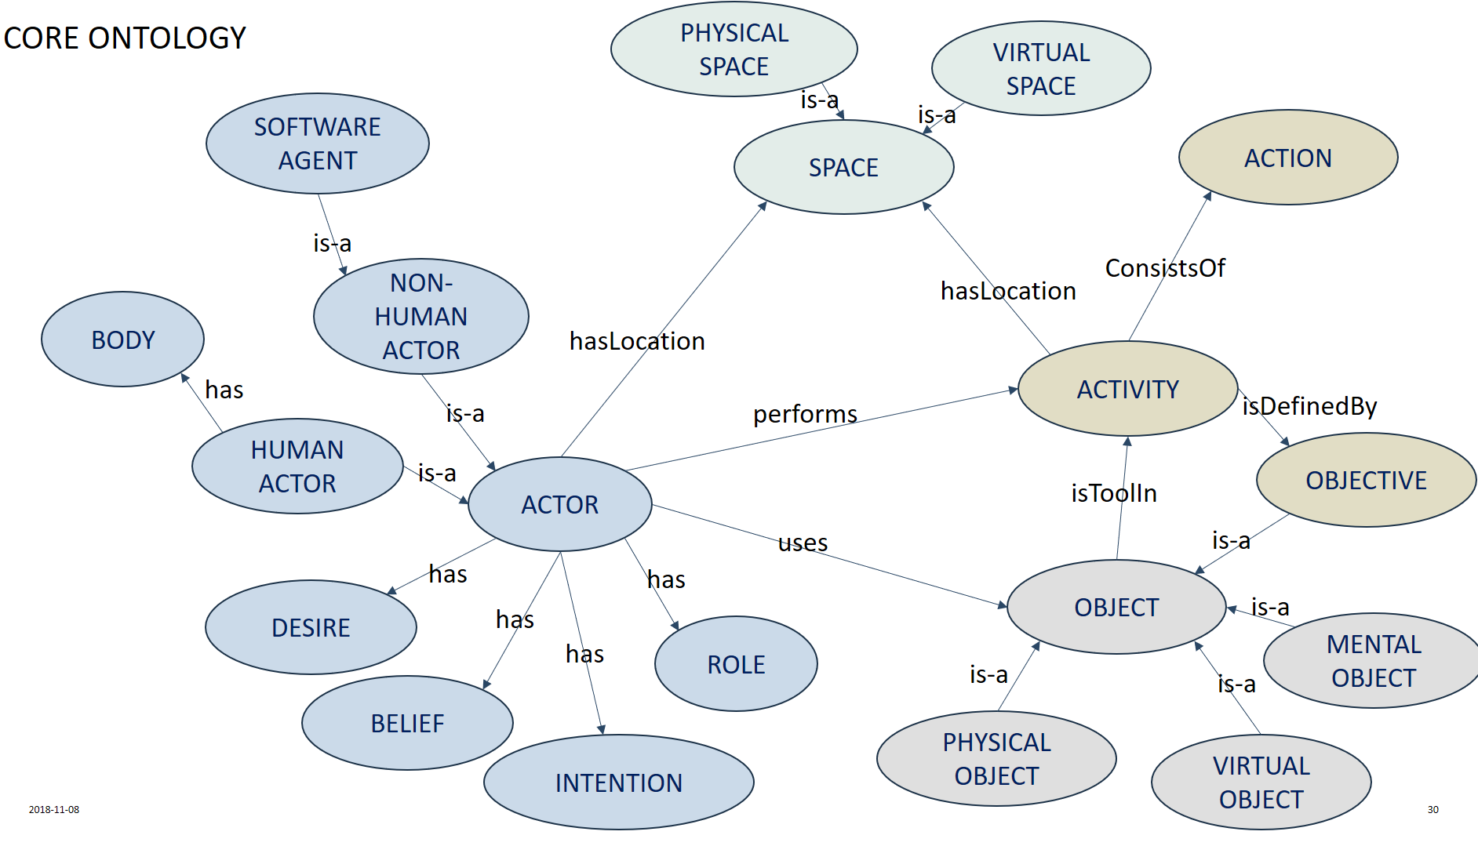
Protégé
Try Protégé with the core ontology!

Slide 18
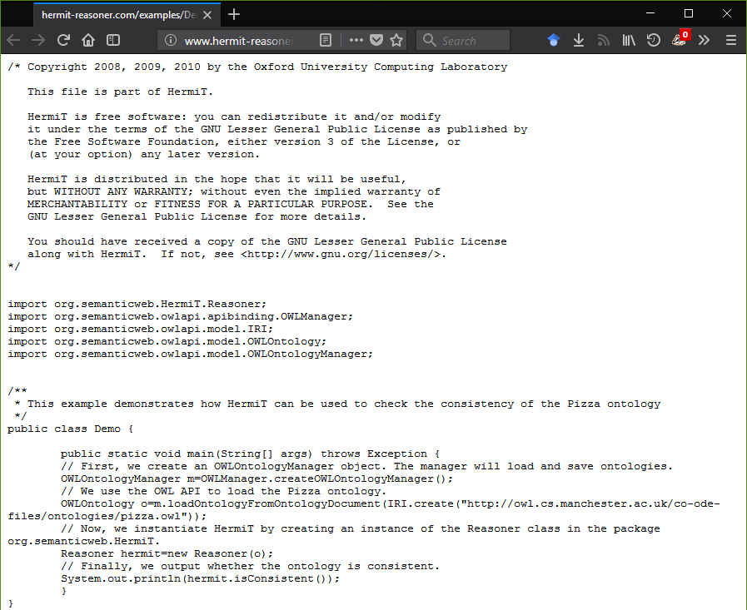
Note: Hermit reasoner
http://www.hermit-reasoner.com/
It can be used as a plugin in Protégé but also as a library, e.g.:

Slide 19
Real-world examples
ACKTUS ontology
http://acktus.cs.umu.se/
Exercises by the Umeå School of Sports Science

