Slide 1
Interactivity in smart Environments
Lecture 1:
INTRODUCTION TO THE COURSE and
INTERACTIVE, INTELLIGENT AGENTS
Helena Lindgren
November 8, 2018

Slide 2
Course Management
Helena Lindgren, helena@cs.umu.se
Juan Carlos Nieves, jcnieves@cs.umu.se
Esteban Guerrero, esteban@cs.umu.se
Elin Granholm
Caroline Fischl
Information on Cambro
Theoretical part
Laboratory part: project
Pedagogic methodology

Slide 3
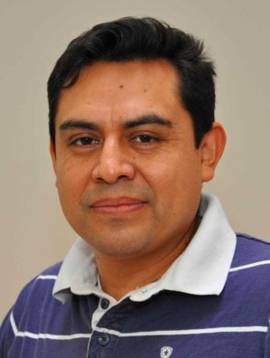
Presentations
Helena
Main interests are intelligent and personalised knowledge-based support systems for work and leisure activities.
Has developed decision-support systems and made user studies in Japan, Korea, rural areas in Sweden.
Takes particular interest in challenging adaptation to individuals’ special and changing needs. Has a background in ergonomics and work rehabilitation.
Juan Carlos
Main interests are knowledge representation and reasoning with uncertain and incomplete information.
Intelligent systems and Internet of Things.

Slide 4
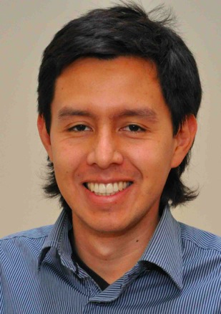
Presentations
Esteban
Postdoctoral researcher Affiliated with School of Sports Science
Main interests are activity recognition, reasoning and emerging smart technologies tailored to individuals.
Caroline
Her research studies focuses on computer-supported social activities in the daily life of older adults.
She investigates health, well-being and social inclusion as potential effects of personalised support systems.

Slide 5
Coordination of two courses at two faculties
Interactivity in Smart Environments (Computing Science)
50%
Innovation and Change Management in Collaboration (Occupational Therapy)
100%
Elin Granholm, Caroline Fischl
(Project Management (TFE))
50%
Stig Byström
Affects some ID students

Slide 6
Advanced course
Builds on earlier courses:
Possibility to apply knowledge from other courses BUT also new knowledge is required for the projects!
More independent work
Less structured format:
One project instead of lab assignments
Scientific articles as literature and references in project reports
Apply templates for project plan and project report following the typical outline for scientific report/articles
Apply peer-review, feedback

Slide 7
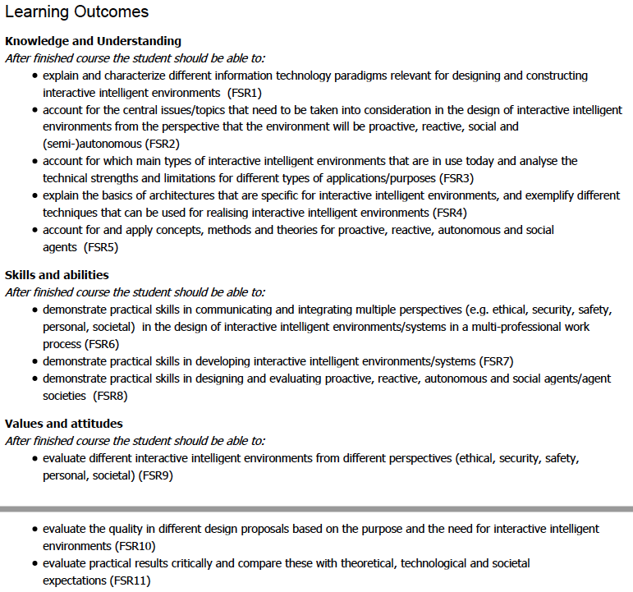
Today:
Social and Intelligent Agent
Architecture of an Intelligent Agent
Social and Intelligent Agent

Slide 8
Course evaluations and changes
Theory before project work begins:
Reduces tendencies to jumping to conclusions using only previous knowledge in project work
Exam halfway last year, now in January:
Reasons: one week shorter before Christmas, and useful to have the experiences from projects at the exam
Logistics and coordination with TFE course
Is reduced by each year, no conflicting scheduling of obligatory events this year
Project work:
More contacts with the organisation representatives
Collaborations with OT students
Common demo event now split into two events of which one is obligatory
Good things to keep:
Peer review

Slide 9
Interactivity in smart environments and intelligent agents

Slide 10
What do we mean by interactivity?
Simplified:
a phenomenon occurring wherever and whenever two objects (biological or other physical, or virtual, or cyber-physical) need to coordinate their beings and actions

Slide 11
What are smart environments?
Simplified:
environments where computing is involved for producing aggregated values beyond the basic information
For a PURPOSE
to improve something
to control something
to reduce/minimise undesired events

Slide 12
Why dedicating a course on interactivity in smart environments?
wherever two physical or virtual or cyber-physical objects need to coordinate their beings and actions…
…need for adaptation arise
Limitations in capacity:
Computational / cognitive
Social
Physical
…need for negotiation arise
Conflicting purposes and goals
Rational
Emotional
Social
PURPOSEFUL
INTERACTION
DESIGN
PAIRED WITH
COMPUTING
NEEDED

Slide 13
Human-Centered Computing
Affective Computing
Ubiquitous Computing
Wearable Computing
Ambient Intelligence
Embodied Intelligence
Tangible Interfaces
Augmented Reality
Virtual Reality
Human-robot interaction
Internet of Things
Smart homes, smart cities
Sensor-networks
Computational social norms and agent communities
Persuasive Technology
Adaptive User Interfaces
Assistive Technology
Decision-Support Systems / Expert Systems
Serious Games, …
Intelligent User
Interface (IUI)
and
Computing
Paradigms:
HCI
ID
AI

Slide 14
Interactive, Intelligent Systems and Environments
SOLUTIONS TO PERSON-ADAPTED SUPPORT
Interpretation of the situation and knowledge:
User model
…
Reasoning and decision making:
…
Interaction design:
…
INPUT
Sensor (implicit / contextual) information
Manual (explicit / intensional) information
OUTPUT
(actions/behaviour)
Advice
Decision
Direction
Question
Confirmation
Alert
Facial expression
Change of
environment
…

Slide 15
Design vs. Interaction vs. Computing vs…
The course covers interactivity with intelligent, interactive systems in a societal context based on five perspectives.
Interaction Perspective: Designs, sensor techniques, feedback techniques, content, purpose, behaviour.
Socio-Psychological / Activity-Systemic / Socio-Technical Systems Perspective: evaluate the effect of use, mechanisms for development, change. Motivation, behavior change, autonomy, empowerment, competence, relatedness. Value for the individual, society.
Design Perspective: Theories, methods and techniques, in particular participatory action research approaches, activity-centered design, emergent, agile methods. Cross-professional implementation projects.
Computing/Intelligence Perspective: Machine Learning: Pattern Recognition, Case-Based Reasoning; logics, technology for emergence, adaptation, mixed-initiative systems, etc.
Technical perspective: System architecture, communication patterns, service-oriented architectures, security, etc.
SOCIETAL
CHALLENGE

Slide 16
What is an intelligent software agent?
From now on simply ”intelligent agent” or just ”agent”

Slide 17
HUMAN ACTOR SOFTWARE AGENT
INTELLIGENT - COGNITION:
PERCEPTION
LEARNING
KNOWLEDGE-SKILLS
REASONING
MANAGING UNCERTAINTIES
DECISION MAKING
PLANNIING
COMMUNICATION
INTELLIGENT - COGNITION:
PERCEPTION
LEARNING
KNOWLEDGE-SKILLS?
REASONING
MANAGING UNCERTAINTIES
DECISION MAKING
PLANNIING
COMMUNICATION
ARTIFICIAL INTELLIGENCE METHOD examples:
Pattern Recognition
Machine Learning
Knowledge Representation
Case-Based Reasoning
Formal argumentation
Answer Set Solvers
Planning
Natural Language Processing
COMMON LANGUAGE
INTERACTION

Slide 18
HUMAN ACTOR SOFTWARE AGENT
AUTONOMOUS
CAPABEL
DEVELOPS
SOCIAL
ADAPTIVE/ADAPTABLE
REACTIVE
PROACTIVE
MORAL
EMPHATIC
JUDGEMENT
AUTONOMOUS?
CAPABEL?
DEVELOPS?
SOCIAL?
ADAPTIVE/ADAPTABLE?
REACTIVE?
PROACTIVE?
MORAL?
EMPHATIC?
JUDGEMENT?
ARTIFICIAL INTELLIGENCE METHOD examples:
Pattern Recognition
Machine Learning
Knowledge Representation
Case-Based Reasoning
Formal argumentation
Answer Set Solvers
Planning
Natural Language Processing
interACT
COLLABORATE
COOPERATE

Slide 19
intelligent agent
In general, intelligent (software) agents are expected to express some kind of behavior which – to some degree – resembles the human mind's capability of problem solving.
A popular definition of the properties of an intelligent agent are:
Autonomy: An agent executes actions on its own incentive, not (generally) depending on the interaction with external entities like a human user.
Proactivity: An agent shall be able to decide about actions and take action, which purposefully bring it closer to achieving its goals. The actions are goal oriented.
Reactivity: An agent reacts to changes in its environment, adapting its plans appropriately.
Social capabilities: An agent is capable of exchanging information with other agents and utilizes it for achieving its goals (negotiation and cooperation).
Do you know a person who complies with all these properties? ☺
Wooldridge, 1999, Reasoning about Rational Agents, The MIT press.

Slide 20
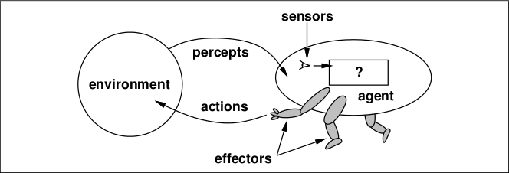
A basic architecture of an intelligent agent

Slide 21
BDI - agents

Slide 22
Rational Behaviour (mental states of an agent)
Practical reasoning following the Belief, Desire and Intention (BDI) model

Slide 23
Belief Desire Intention (BDI) Model of rational agency
Beliefs: information and knowledge that the agent has about world.
Desires: states of affairs (goals) that the agent, in an ideal world, would wish to be brought about.
Intentions: desires that the agent has committed to achieving, which are manifested in a kind of plan.

Slide 24
BDI Model - Reasoning
The intuition is that the agent will not, in general, be able to achieve all its desires. Therefore an agent must focus some subset of its desires and commit resources to achieving them. These chosen desires are intentions.

Slide 25
Reasoning
Practical reasoning is reasoning directed toward actions.
the process of figuring out what to do
Theoretical reasoning is reasoning directed toward beliefs.
The process of managing knowledge and generate new knowledge, ex. All men are mortal AND Socrates is a man -> ?
Practical reasoning includes the following two activities:
Deliberation: Deciding what Desires (goals) to pursue.
Means-ends reasoning: Deciding how we want to achieve these state of affairs, what actions to take and which resources (e.g. interfaces) to use.

Slide 26
Implementing Practical Reasoning Agents
A first step towards an implementation of a practical reasoning agent:
Agent Control Loop Version 1
1. while true
2. observe the world;
3. update internal world model;
4. deliberate about what intention to achieve next;
5. use means-ends reasoning to get a plan for the intention;
6. execute the plan
7. end while

Slide 27
Modelling the knowledge of an agent
ARTIFICIAL INTELLIGENCE METHOD examples
Pattern Recognition
Machine Learning
Knowledge Representation
Case-Based Reasoning
Formal argumentation
Answer Set Solvers
Planning
Natural Language Processing
Notes:
In order to provide information to a software agent, it needs a knowledge base about the user and enviroment

Slide 28
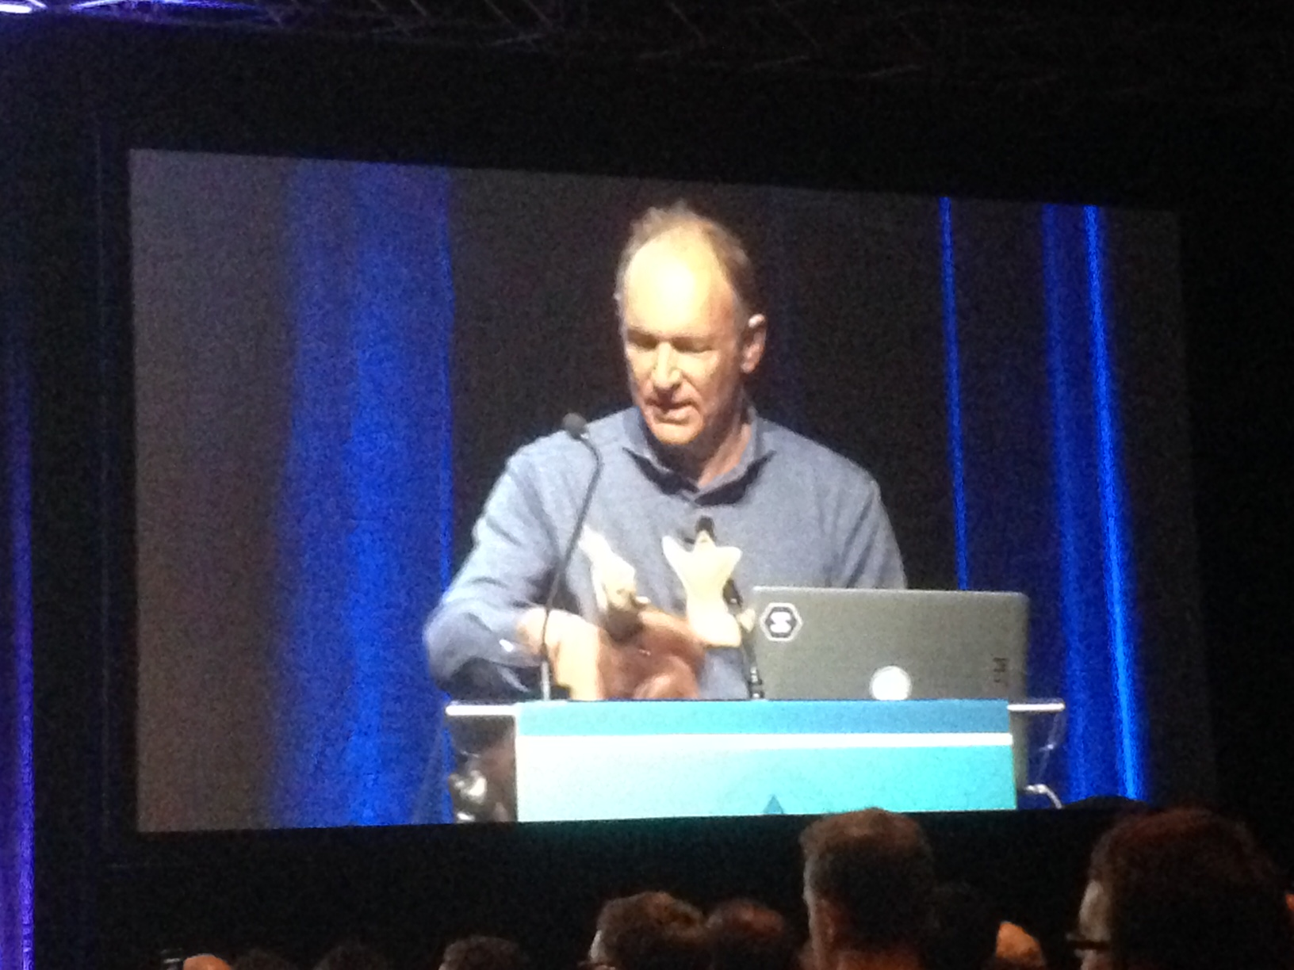
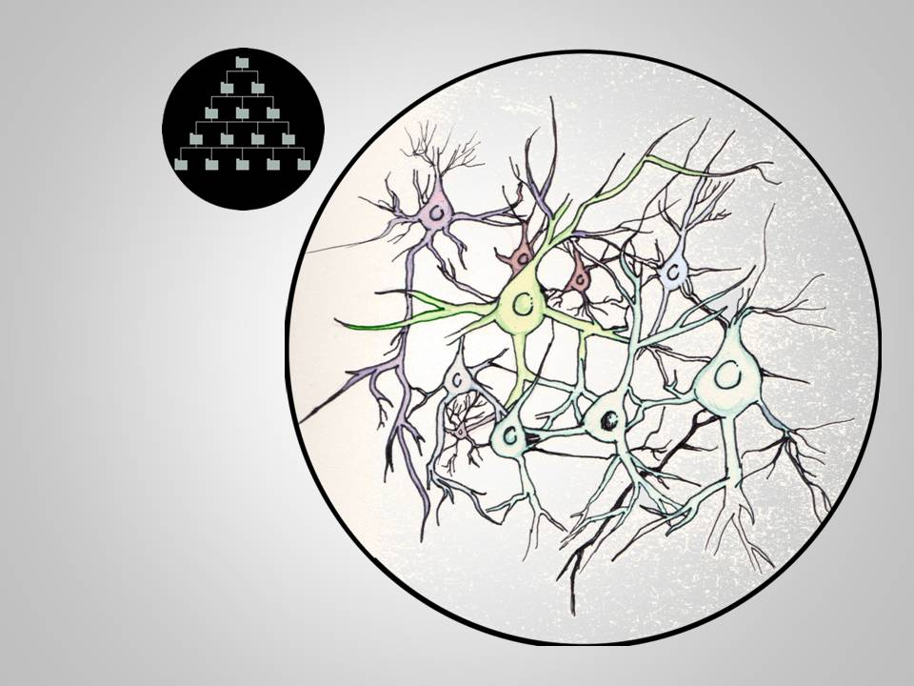
Sir Tim Berners Lee@www16
Terminological
knowledge
Inventor of WWW, Semantic Web
Factual
knowledge
Frank Van Harmelen. 10 Years of Semantic Web: does it work in theory? Keynote at ISWC 2011..
V. Pipek et al. (Eds.): IS-EUD 2009, LNCS 5435, pp. 70–85, 2009
Notes:
Few words about knowledge. Internet is there with tons of information that can be transformed to knowledge, IF we have the energy and interest to read, filter, be critical to do this.

Slide 29
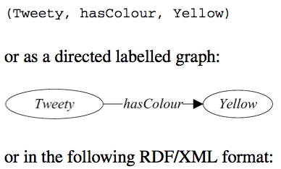
RDF(s): Resource description framework
Web Ontology Language: OWL
Builds on Description Logics
Defintion of ontology :
A set of concepts and categories in a subject area or domain that shows their properties and the relations between them.

Slide 30
CORE ONTOLOGY
PHYSICAL SPACE
VIRTUAL SPACE
is-a
is-a
SOFTWARE AGENT
ACTION
SPACE
is-a
NON-HUMAN
ACTOR
ConsistsOf
hasLocation
BODY
hasLocation
ACTIVITY
has
isDefinedBy
is-a
performs
HUMAN
ACTOR
OBJECTIVE
is-a
ACTOR
isToolIn
uses
is-a
has
has
OBJECT
DESIRE
has
is-a
has
ROLE
MENTAL OBJECT
is-a
is-a
BELIEF
PHYSICAL OBJECT
INTENTION
VIRTUAL OBJECT

Slide 31
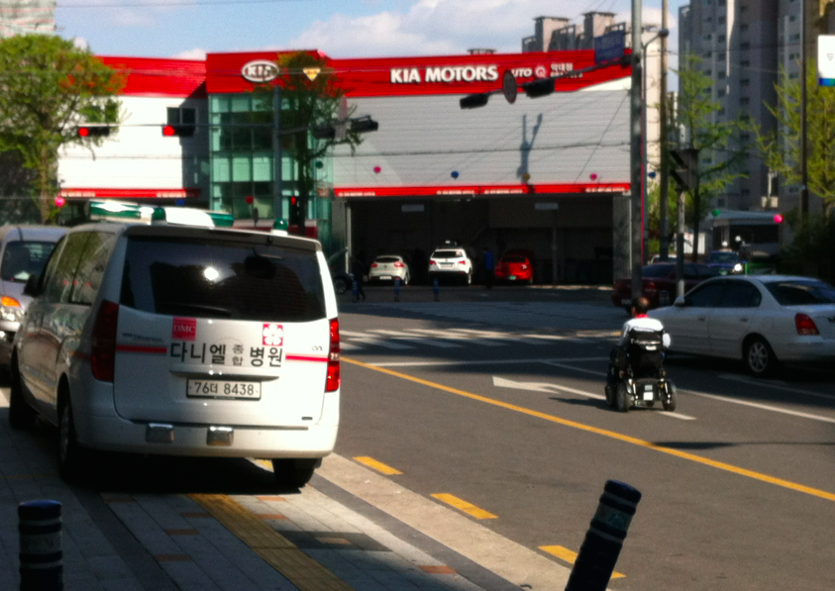
Exercise: Extend the core ontology based on some scenarios
Belief
Desire
Intention

Slide 32
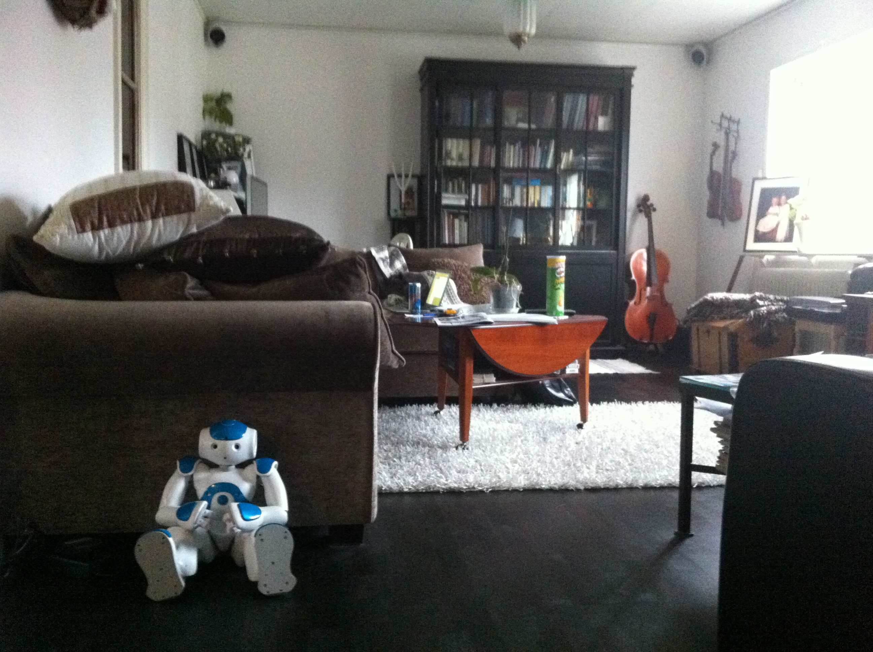
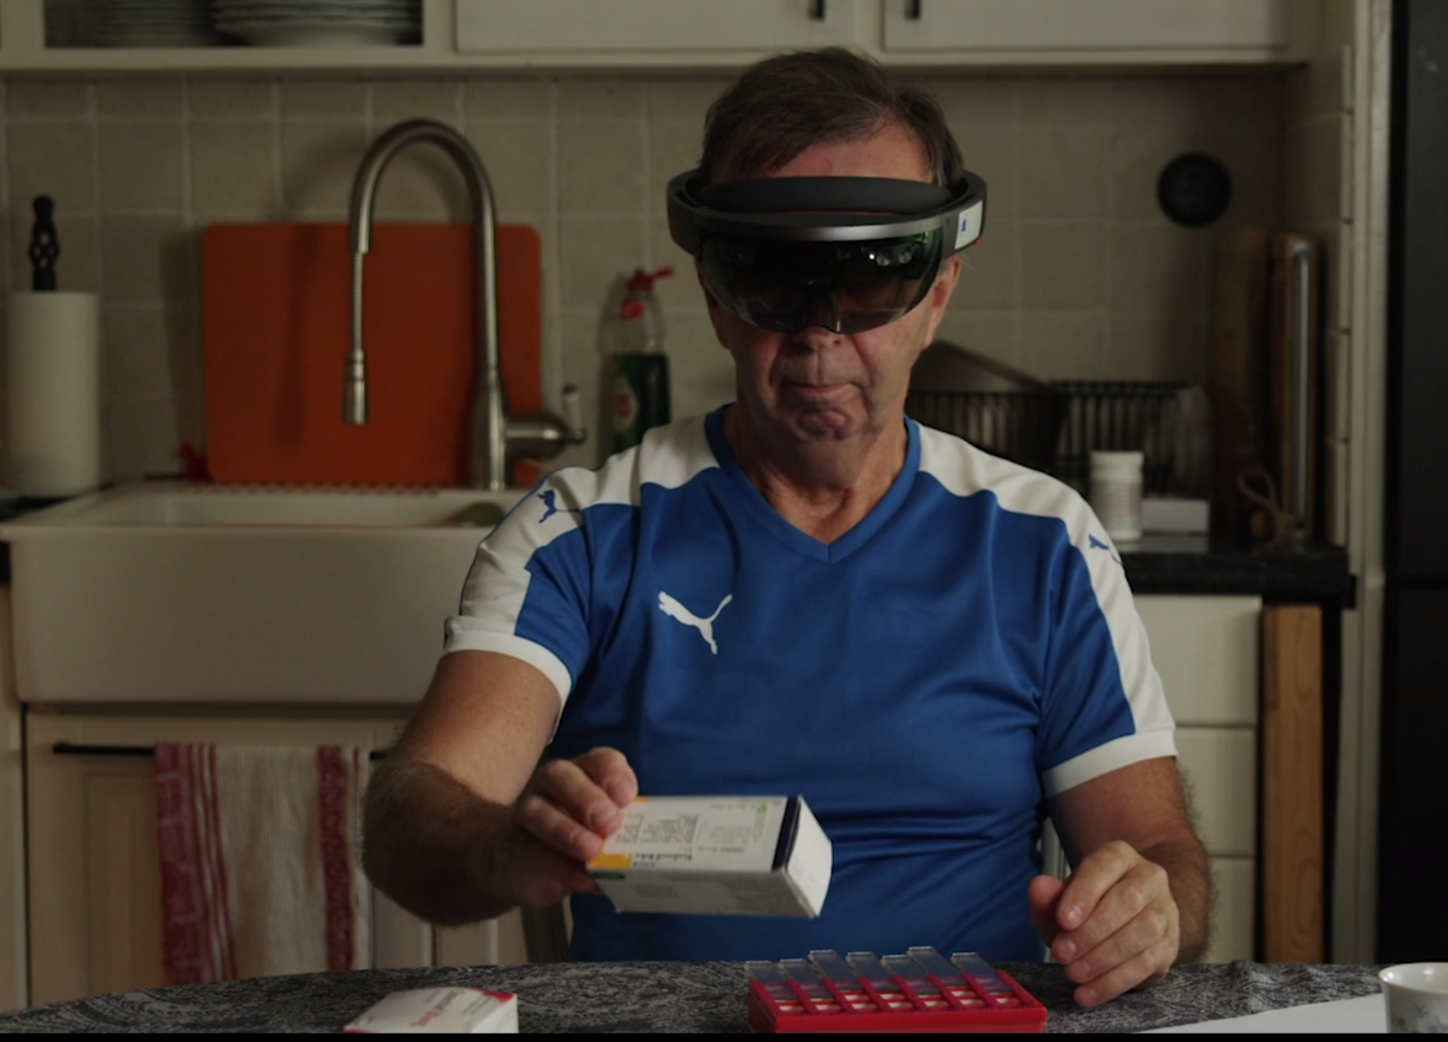
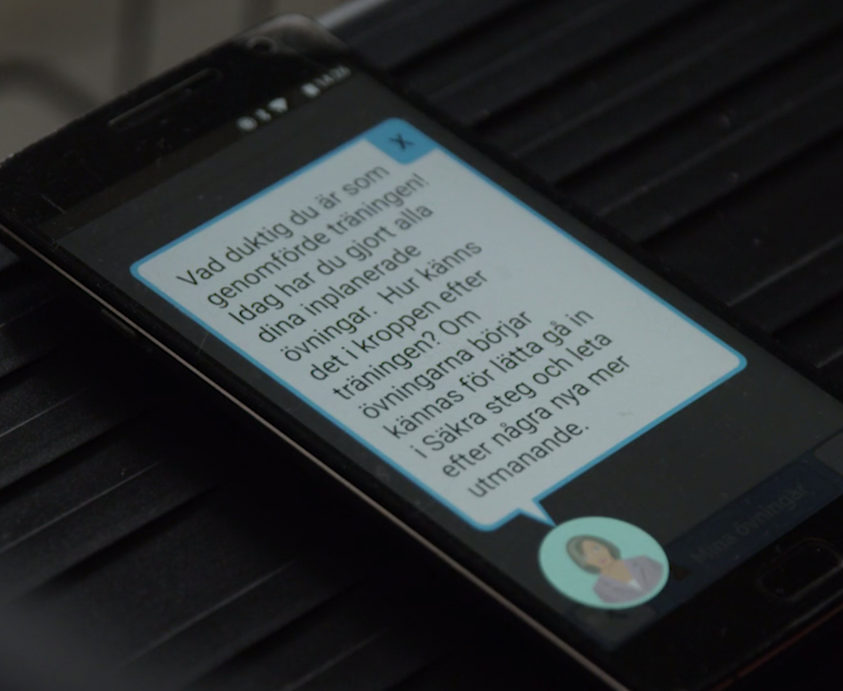
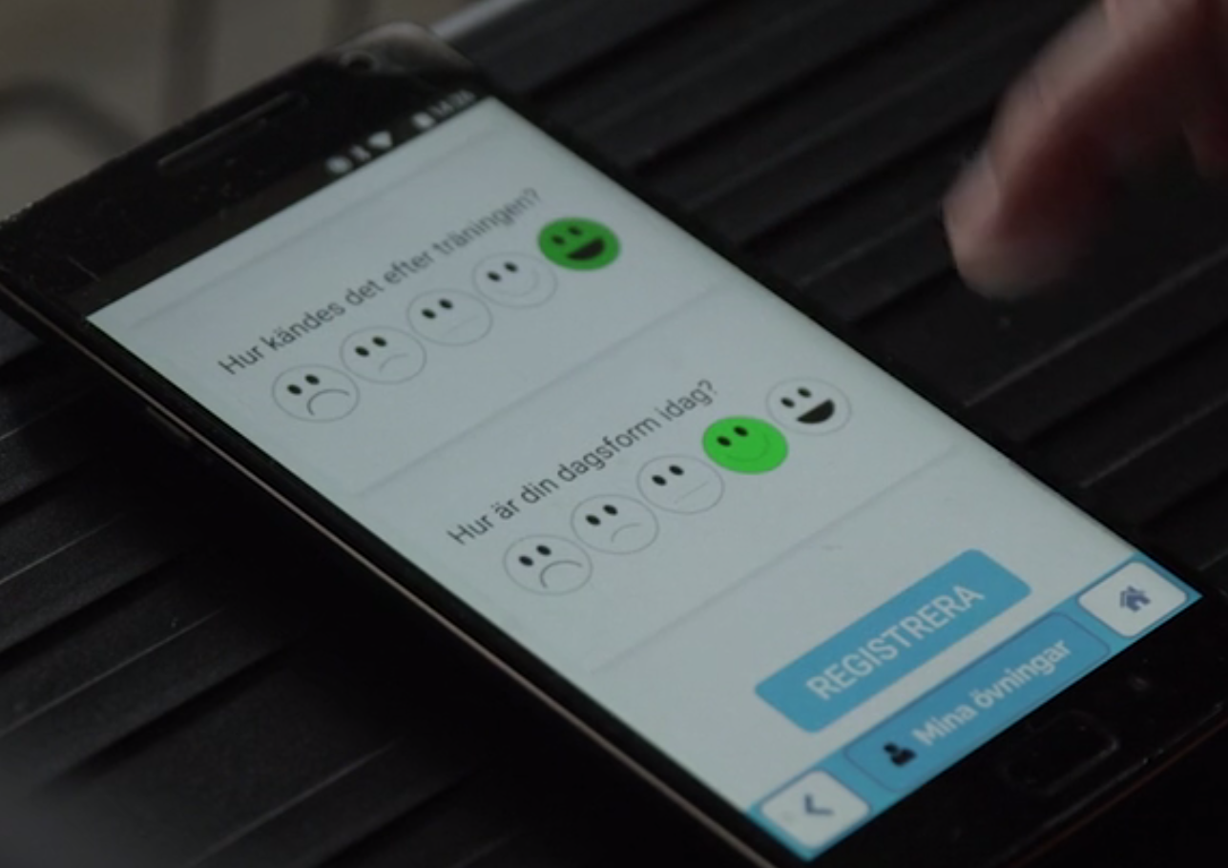
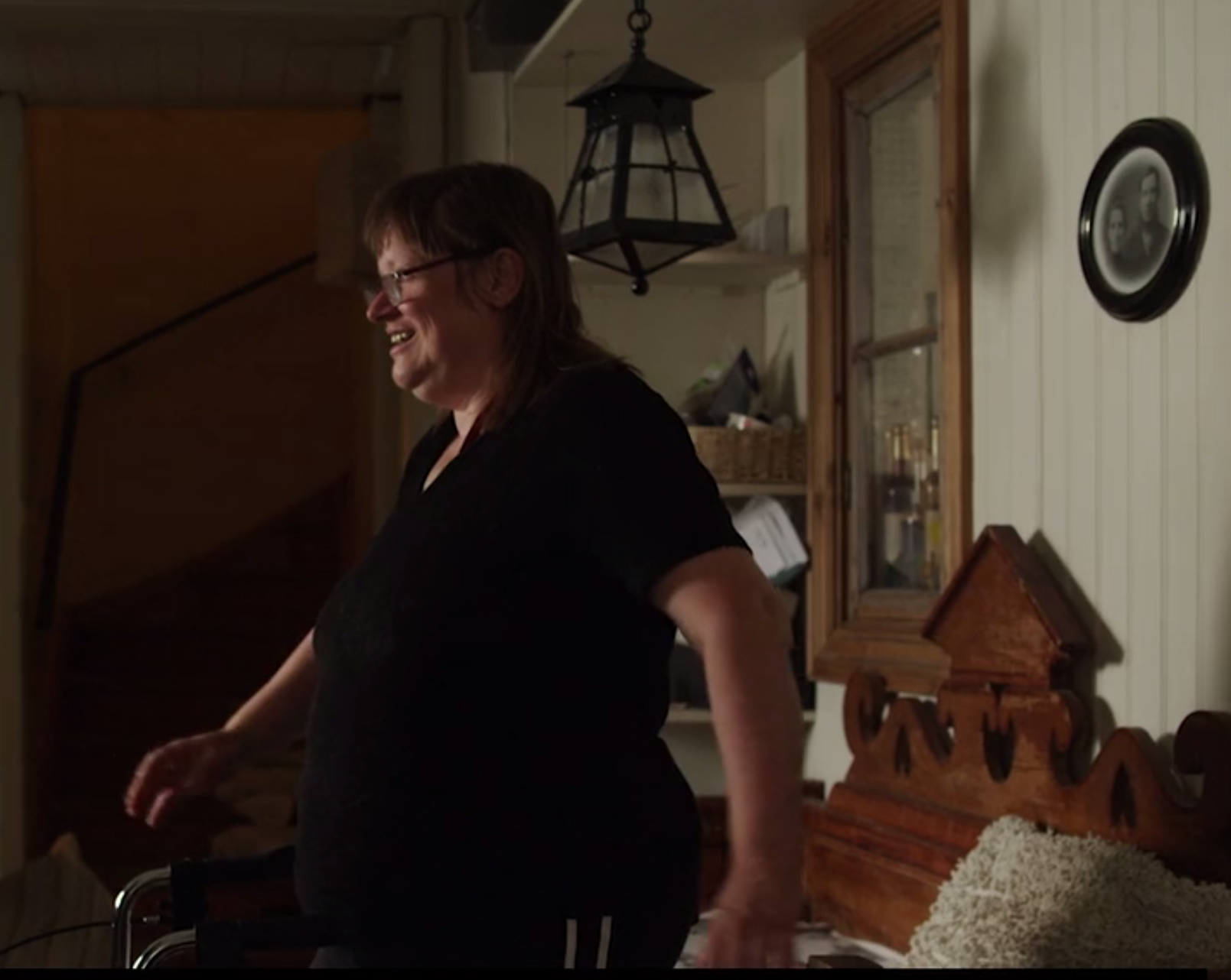

Slide 33
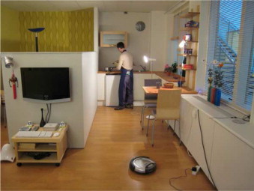
A vision of the behaviour of a rational software agent
Rafael is cooking, I will clean the bedroom now.
The photo was takin from : Photo M. Cirillo, et al.: "Human-aware planning for robots embedded in ambient ecologies." Pervasive and Mobile Computing 8.4 (2012): 542-561.

Slide 34
A multi-agents system (MAS)
A MAS can be conceived in terms of an organized society of individuals in which each agent plays specific roles and interacts with other agents according to protocols determined by the roles of the involved agents

Slide 35
Rational software agents in digital societies

Slide 36
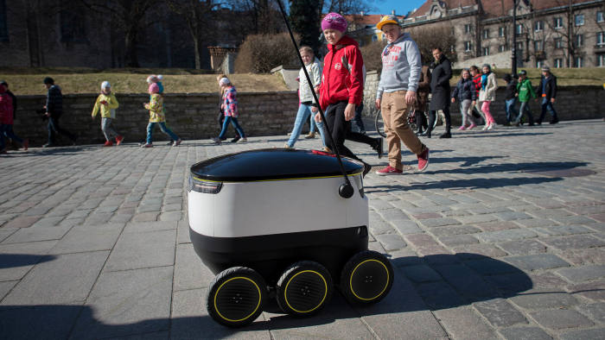
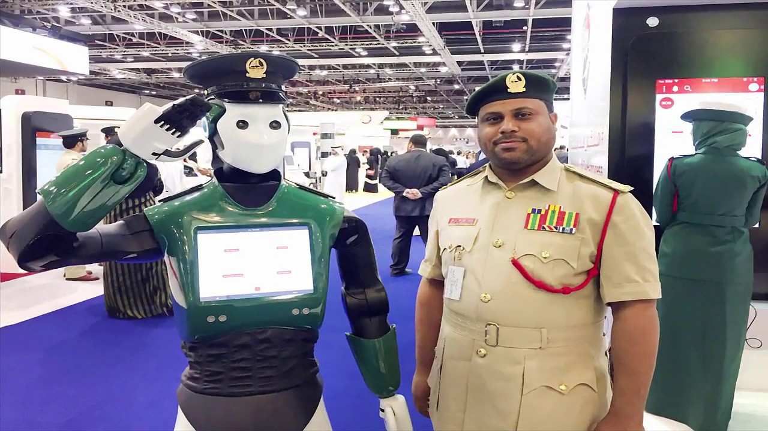
digital societies
© Bloomberg

Slide 37
Course overview

Slide 38
Interactive, Intelligent Systems and Environments
SOLUTIONS TO PERSON-ADAPTED SUPPORT
Interpretation of the situation and knowledge:
User model
…
Reasoning and decision making:
…
Interaction design:
…
INPUT
Sensor (implicit / contextual) information
Manual (explicit / intensional) information
OUTPUT
(actions/behaviour)
Advice
Decision
Direction
Question
Confirmation
Alert
Facial expression
Change of
environment
…

Slide 39
Interaction technologies:
Mediation of data and behaviour
AI technologies:
Management of data and behaviour
TOPICS FOR LECTURES 2-5
Context:
the “WHERE”
is the action?
L2:
DIGITAL/VIRTUAL/
MENTAL SPACE (VR, SOCIAL NORMS, CULTURAL RULES, USER MODEL)
L2:
PHYSICAL SPACE
(SENSORS, WEARABLE COMPUTING)
L3:
PROACTIVE – REACTIVE (DSS, ASSISTIVE TECHNOLOGY)
Lab-L2: Sensors and robots
L3:
VIRTUAL-PHYSICAL
(AR, TANGIBLE UI, SERIOUS GAMES)
L4:
INTERNAL – SOCIAL
(LEARNING, ADAPTATION)
L5:
ACTIONS –
How does the agent…
Lab-L5: Reasoning, deciding, acting
Lab-L4: Knowledge representation
Lab-L3: Augmented Reality
L5: ACTOR(S), ENVIRONMENT, ACTIVITY, SITUATION

Slide 40
ACTIONS – THE “HOW”: How does the agent…
ARTIFICIAL INTELLIGENCE METHOD examples
Pattern Recognition
Machine Learning
Knowledge Representation
Case-Based Reasoning
Formal argumentation
Answer Set Solvers
Planning
Natural Language Processing
Perceive
Sensors, subjective inputs
Interpret
Detect/recognise and represent behaviour/activity
Evaluate behaviour/activity
Reason, decide
Support/assist activity
Learn
Adapt
Persuade

Slide 41
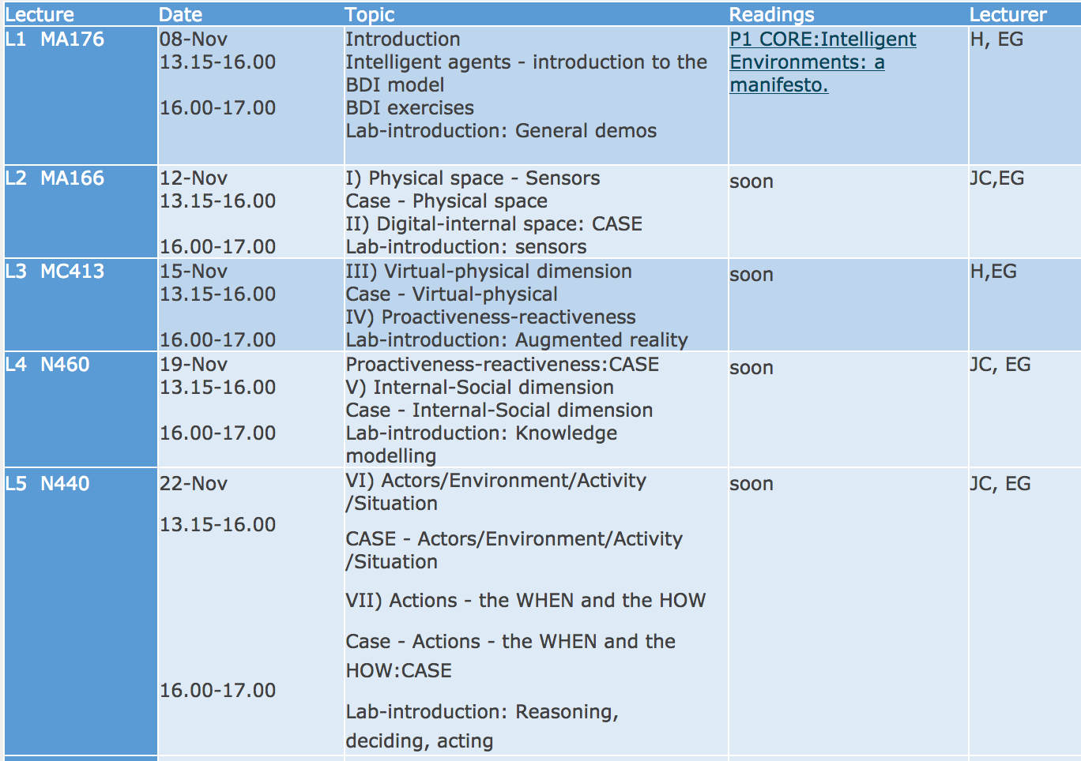
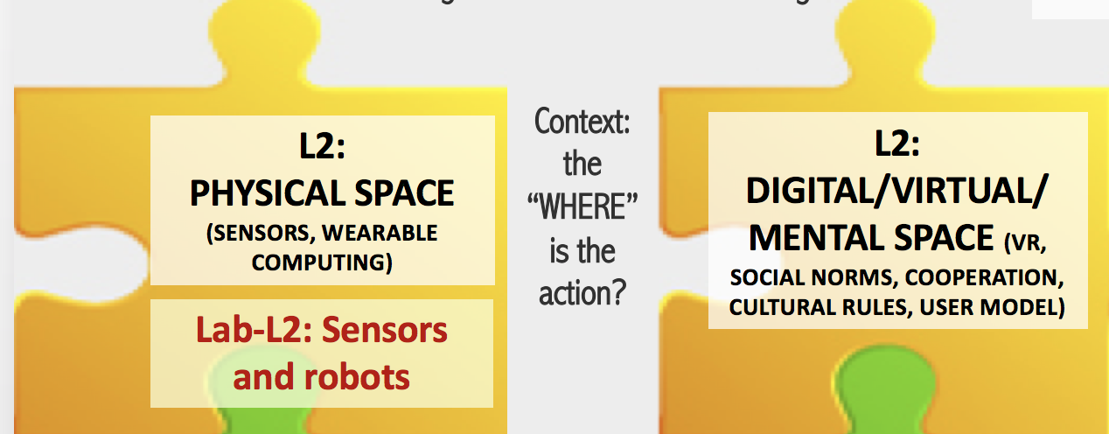
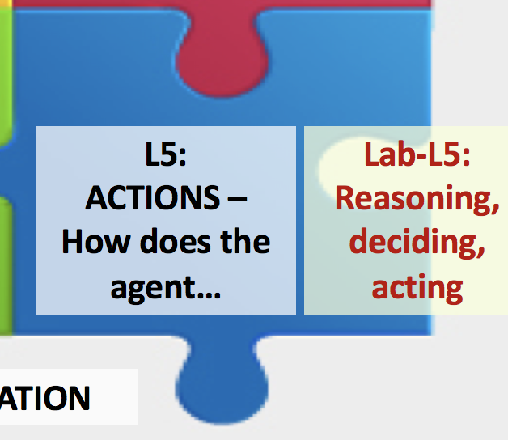

Slide 42
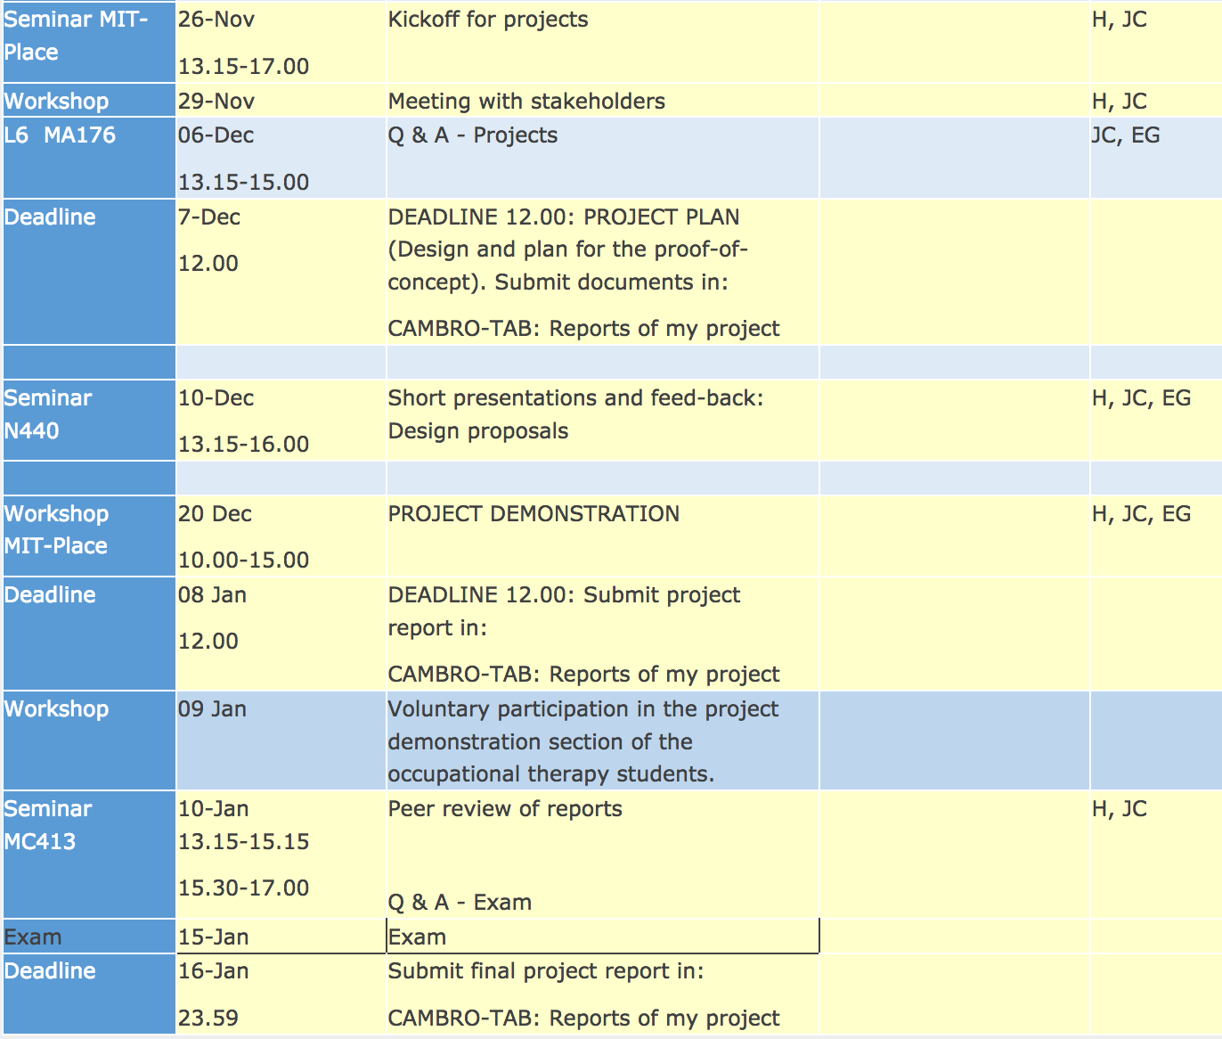

Slide 43
Interactive, Intelligent Systems and Environments
SOLUTIONS TO PERSON-ADAPTED SUPPORT
Interpretation of the situation and knowledge:
User model
…
Reasoning and decision making:
…
Interaction design:
…
INPUT
Sensor (implicit / contextual) information
Manual (explicit / intensional) information
OUTPUT
(actions/behaviour)
Advice
Decision
Direction
Question
Confirmation
Alert
Facial expression
Change of
environment
…
WHAT IS THE PURPOSE?

Slide 44
Introduction to the project
SOCIETAL CHALLENGES:
Work ergonomics
Cultural City
Safe City for Youth
…DETAILS WILL COME LATER…

Slide 45
From Nov 26:
Project work relating
to a societal challenge
Applying new knowledge
and understanding

Slide 46
PROJECT & GROUP WORK
Project topics x 3
ORGANISATION
x 3
THEORETICAL BASE
Group ISE
4-5 persons
Group OT
2 persons
ISE Deadlines & Deliverables:
Nov 22
Dec 7
Dec 10
Dec 20
Jan 8
Jan 10
Jan 16
OT
Deadlines
&
Deliverables
KICKOFF NOV 26 MIT-Place
Collaboration ISE - OT
DEMO DAYS Dec 20, Jan 9

Slide 47
PROJECT
Societal challenge, a public organisation provides the “topic”, the course provides the “box”
Formation of project groups (will be 4-5 members in each group): To do before Thursday Nov 22 at 8.00:
Prioritise project topics
Form groups of 2-4 members, send to helena@cs.umu.se in one e-mail the following:
1) your group constellation with participant’s full name, which program you are enrolled in (year), if you attend the project management course, and your preferred e-mail addresses,
2) your prioritization of the project topics, with a short motivation
Based on your group proposals final groups will be formed and topics will be assigned before 12.00 the same day.
Project Kick-Off Monday Nov 26, 13-17 in the MIT Place
Finalisation of groups and topic assignments, each group will work together with two OT students.
Project Documentation and presentation:
Deadline 1: Dec 7 at 12.00. Project plan max 3 pages, use the template in Cambro
Deadline 2: Presentation at seminar Dec 10 at 13.15.
Deadline 3: Dec 20 at 8.00. Demonstrator of your design proposal for the exhibition.
Deadline 4: January 8 at 12.00. Project report for peer-review, use the template in Cambro
Deadline 5: january 16 at 23.59. Final project report.

Slide 48
Notes:
Not reinforce our tendency to impose sense of failour, shaming on persons who do not comply with what seems to be the logical route to health, sucess and happiness.

Slide 49
Reading scientific literature

Slide 50
3 chances to ”get” the message of A scientific article:
Typical disposition:
Abstract
Background/introduction with:
Problem statement
Research questions
Methods and materials
Results
Discussion
Conclusions
References
The mini version: the abstract
The short version: the conclusions
The long version: the inbetween

Slide 51
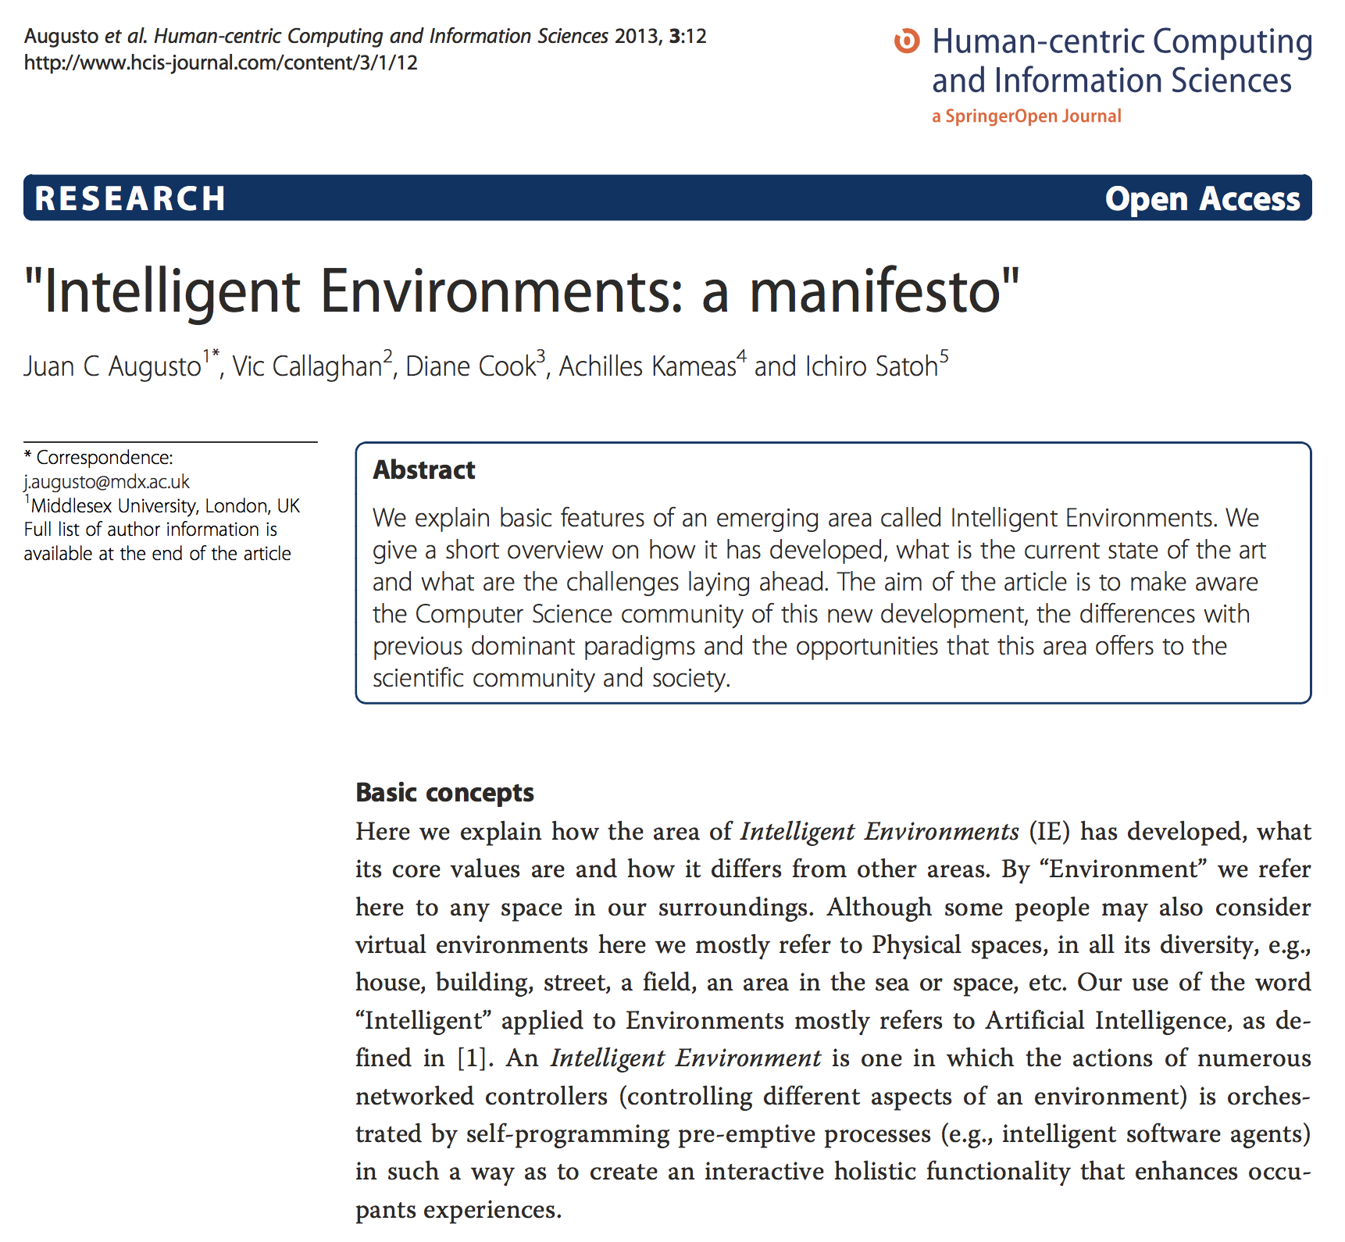

Slide 52
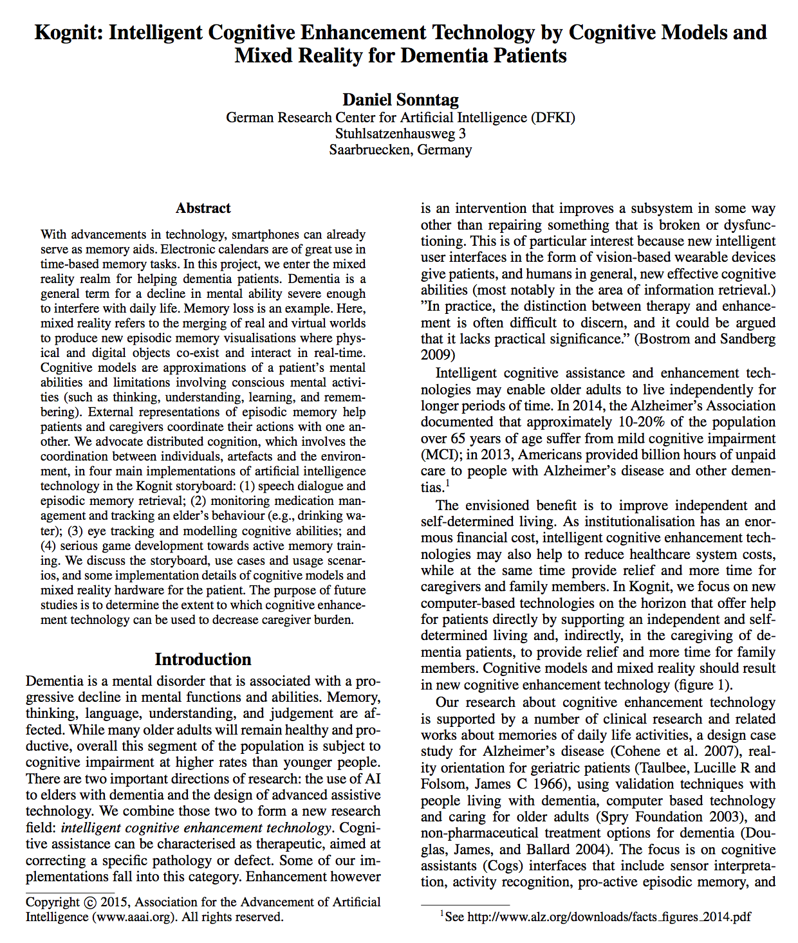
Technical conference paper:
Abstract
Background/introduction with:
Problem statement
Research questions
Presentation of the system/solution
Discussion
Conclusions
References
The mini version: the abstract
The short version: the conclusions
The long version: the inbetween

Slide 53
Questions?

Slide 54
Project topics and organisations

Slide 55
ProjeCtS
A. Smart environments for promoting healthier and safe work routines for logistics workers | (3)
B. OT: Promoting smart and safe active transport in shared green spaces for citizens; ISE: A digital-physical and cultural outdoor meeting place where resources are used efficiently | (3)
C. Promoting smart and safe social environments and activities for youth, and preventing drug and alcohol use | (3)

Slide 56
Volvo 1-3 Smart environment for promoting healthier and SAFE work routines for LOGISTICS workers
Client group: Logistics workers
How can we promote healthy work habits and routines for workers in a logistics unit?
Organization: Volvo Group Trucks Operations Europe & Brazil Manufacturing www.volvogroup.com
Volvo Lastvagnar AB
Contact person: Malin Andersson, Coordinator Volvo Cab Competence Center
Phone: +46 90 862 73 89 Mobile/SMS: +46 72 862 73 89
Email: malin.andersson.2@volvo.com

Slide 57
Cultural City 1-3 promoting Smart and safe active transport in shared GREEN spaces for citizens
Client group: University employees and students; University hospital employees, patients, and visitors
OT: How can we promote smart and safe active transport for citizens in shared green spaces within the university town?
ISE: How to create a digital-physical and cultural outdoor meeting place where resources are used efficiently?
Organizations: Umeå kommun (Sharing Cities project), Umeå University, mfl.
Contact person: Lisa Redin, Lokalförsörjningsenheten UmU, lisa.redin@umu.se eller 072-1432868.
Meeting dates: den 14-15/11 (arbetsterapeutstudenter) resp 27/11 på fm och 29/11 (datavetarstudenter)

Slide 58
Safe City for Youth 1-3 Promoting smart and safe social environments and activities for youth
Client group: Fältgruppen staff, parents, and youth
How can we promote smart and safe social environments and activities for youth including preventing drug and alcohol use?
Organization: Umeå kommun (Socialtjänsten, Fältgruppen)
Contact person: _
Helena Lindgren will have a meeting with Fältgruppen Umeå on 13 November.
For now, read information about the organization on their website http://www.umea.se/umeakommun/omsorgochhjalp/familjbarnochungdom/stodtillbarnochungdom/faltgruppen
Facebook page - Fältgruppen Umeå Socialtjänst

Slide 59
REMOVED

Slide 60
eHealth:
Digital health
Decision-support systems
Self-treatment apps
mobile health mHealth
Ambient Assisted Living
Assistive Technology
Quantified self
Service robots
Telemedicine
Digital health coaches
Health record systems
Social robots
Persuasive Technology
Behaviour change systems
Just-In-Time Adaptive Interventions
Computer-supported cooperative clinical work
AI For a puporse

Slide 61
AI for a purpose
Kliniska beslutstödsystem:
Förbättra kvalitét och mer jämlik vård
Självidanostik/
behandlingsapplikationer:
Förbättra kognitiva, fysiska, sociala och mentala funktioner, hantera stress
EMPOWERMENT
Beteendeförändringssystem,
“Persuasive Technology”:
Promota aktivt och hälsosamt liv och åldrande, social inklusion
Smarta hem, smarta arbetsplatser: promota hälsosamt, självständigt och aktivt liv och arbete
Notes:
I am interested in many things. I have a small spinoff company that manages the clinical decision support system for dementia diagnosis and management we have developed. I am priviliged, as a researcher, I can dive into many aspects that relate to personalisation, persuasive technology, behaviour change, and how the clinical experts can actively and hands-on develop knowledge-based applications they envision.

Slide 62
Fältgruppen, Umeå Municipality
Head: Lennart Andersson, 070-3007202
Group meetings Tuesdays at 13.00
Facebook group: Fältgruppen Umeå socialtjänst
https://www.facebook.com/F%C3%A4ltgruppen-Ume%C3%A5-Socialtj%C3%A4nst-417592198279328/

Slide 63
CONTEXT

Slide 64
RELEVANT CONTEXT

Slide 65
CONTEXT I
PHYSICAL
SPACE
3D
BODY
ROOM
HOME
OUTDOOR ENVIRONMENT
VILLAGE
TOWN
NATURE
LOCATION
PROXIMITY
LOCOMOTION
OBJECTS, ACTORS

Slide 66
CONTEXT II
PRO-
ACTIVE
DIGITAL/MENTAL
SPACE
MIXED-
INITIATIVE
CULTURAL
MENTAL
SOCIAL
RE-
ACTIVE
INTERNAL
TO AGENT
SOCIAL/
COOPERATIVE

Slide 67
AGENT/ACTOR:
AUTONOMOUS?
CAPABLE, DEVELOPING?
SOCIAL?
REACTIVE?
PROACTIVE?
MORAL?
BACK WALL:
CONTEXT I
PHYSICAL
SPACE
3D
BODY
ROOM
HOME
OUTDOOR ENV
VILLAGE, TOWN
LOCATION
PROXIMITY
LOCOMOTION
OBJECTS, ACTORS
PRO-
ACTIVE
MIXED-
INITIATIVE
PHYSICAL
sensors
RE-
ACTIVE
VIRTUAL/
MENTAL
DIGITAL/MENTAL
SPACE
INTERNAL
TO AGENT
SOCIAL/
COOPERATIVE
FRONT WALL:
CONTEXT II
CULTURAL
MENTAL
SOCIAL

Slide 68
AGENT/ACTOR:
AUTONOMOUS
CAPABLE, DEVELOPING
SOCIAL
REACTIVE
PROACTIVE
MORAL
BACK WALL:
CONTEXT I
PHYSICAL
SPACE
3D
BODY
ROOM
HOME
OUTDOOR ENV
VILLAGE, TOWN
LOCATION
PROXIMITY
LOCOMOTION
OBJECTS, ACTORS
PRO-
ACTIVE
COLLECTING OBJECTIVE DATA FROM HUMAN
MIXED-
INITIATIVE
COLLECTING SUBJECTIVE DATA FROM HUMAN
PHYSICAL
sensors
RE-
ACTIVE
VIRTUAL/
MENTAL
DIGITAL/MENTAL
SPACE
INTERNAL
TO AGENT
SOCIAL/
COOPERATIVE
FRONT WALL:
CONTEXT II
CULTURAL
MENTAL
SOCIAL

Slide 69
AGENT/ACTOR:
AUTONOMOUS
CAPABLE, DEVELOPING
SOCIAL
REACTIVE
PROACTIVE
MORAL
BACK WALL:
CONTEXT I
PHYSICAL
SPACE
3D
BODY
ROOM
HOME
OUTDOOR ENV
VILLAGE, TOWN
LOCATION
PROXIMITY
LOCOMOTION
OBJECTS, ACTORS
PRO-
ACTIVE
COLLECTING OBJECTIVE DATA FROM HUMAN
MIXED-
INITIATIVE
COMPUTING/REASONING
COOPERATIVE REASONING
COLLECTING SUBJECTIVE DATA FROM HUMAN
PHYSICAL
sensors
RE-
ACTIVE
VIRTUAL/
MENTAL
DIGITAL/MENTAL
SPACE
INTERNAL
TO AGENT
SOCIAL/
COOPERATIVE
FRONT WALL:
CONTEXT II
CULTURAL
MENTAL
SOCIAL

Slide 71
