Slide 1
Unity + AI
Lecture 24/04/2019
Esteban
esteban@cs.umu.se

Slide 2
Agenda
Goal
Setting up Microsoft Hololens
Setting up Vuforia in Unity
Setting up Vuforia database
Adding script events and physics to objects

Slide 3
Goal
The goal of this tutorial is to show how to setting up some tools such as Unity, Visual Studio and Vuforia.

Slide 4
Setting up Microsoft Hololens
These instructions are oriented to be used in a real Hololens device.
Steps in the following video:
https://www.youtube.com/watch?v=7sAouB7_V8Y&list=PLNzupYvW3tciBx2EKUYTkvCpGIxqxwy7w&index=3&t=0s

Slide 5
Setting up Vuforia in Unity
WHY? It is a manner to load some Vuforia objects in your project, e.g. a AR camera and Vuforia target images. With those two elements, it is possible to track elements (visual recognition)
Suggestion. Follow instructions in video:
https://www.youtube.com/watch?v=SoQuUW-oL3k&list=PLNzupYvW3tciBx2EKUYTkvCpGIxqxwy7w&index=7&t=0s

Slide 6
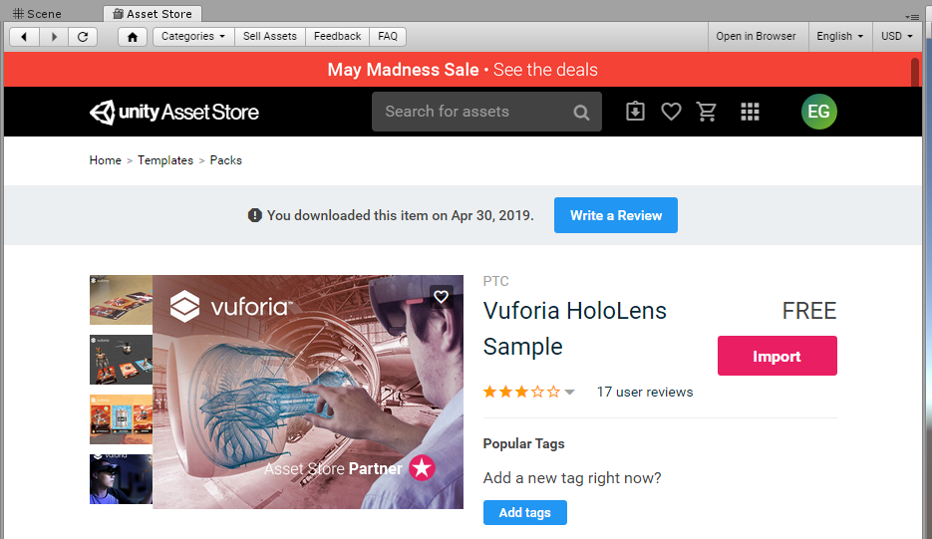
Setting up Vuforia in Unity
Straightforward method to get Vuforia: download the “Vuforia Holens Sample” from the Unity Asset Store

Slide 7
Setting up Vuforia in Unity
Configure the Unity project
Open File->Build Settings
Change to Universal Windows Platform
Target platform: Hololens
Select (check): Unity C# Projects
Click Build (create a folder where VS sources will be)
Open Player Settings
Revise that XR (miXed Reality) options are selected
Check following Capabilities: InternetClient, WebCam, Microphone and SpatialPerception
Check that .NET is selected in Configuration

Slide 8
Setting up Unity project for Hololens
Open Window -> Holographic Emulation
Paste the IP address from Microsoft Hololens in the Remote Machine field
Click Connect

Slide 9
Setting up Vuforia database
Go to https://developer.vuforia.com/
Create a license key
Copy the license key
Create (Add) a Database
Then, add a Target: this is the step where you need to train Vuforia with images of the object.
Download the database and import it to Unity

Slide 10
Setting up Unity project for Hololens
Open in Unity ARCamera -> VuforiaConfiguration
Add Licence key
Load Vuforia database
Add an Vuforia image: GameObject -> Vuforia -> Image
In Inspector select the Database, select Image Target

Slide 11
Adding script events and physics to objects
To add some events in Unity, scripts in C# can be added to objects.
Watch this video to further information on events and how to add dynamics to objects:
https://www.youtube.com/watch?v=IlKaB1etrik
https://www.youtube.com/watch?v=9ZEu_I-ido4

