Slide 2
Capacity Scaling for
Elastic Compute Clouds
Ahmed Aleyeldin Hassan ahmeda@cs.umu.se
Ph. Lic. Defense Presentation
Advisor: Erik Elmroth
Coadvisor: Johan Tordsson
Department of Computing Science
Umeå University, Sweden
www.cloudresearch.org

Slide 3
Outline
Introduction
Elasticity and Auto-scaling
Contributions
  Paper 1
  Paper 2
  Paper 3
Conclusions
Future Work
3

Slide 4
Computing as a utility: Cloud Computing
John McCarthy in 1961
Amazon announced first cloud service in 2006
  Renting spare capacity on their infrastructure
  Virtual Machines (VMs)
  Enterprise-scale computing power available to anyone (on demand)
A closer step to computing as a utility
4

Slide 5
Cloud Computing Definition
NIST definition
  model for enabling ubiquitous, convenient, on-demand network access to a shared pool of configurable computing resources that can be rapidly provisioned and released with minimal management effort or service provider interaction
On demand thus can handle peaks in workloads at a lower cost
One of the five essential characteristics of cloud computing identified by NIST is
  Rapid elasticity
5

Slide 6
Cloud Elasticity
The ability of the cloud to rapidly scale the allocated resource capacity to a service according to demand in order to meet the QoS requirements specified in the Service Level Agreements
Capacity scaling can be done manually or automatically
6

Slide 7
Outline
Introduction
Elasticity and Auto-scaling
Contributions
  Paper 1
  Paper 2
  Paper 3
Conclusions
Future Work

Slide 8
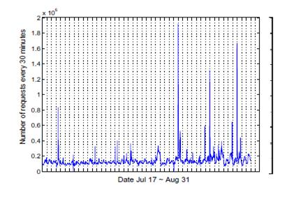
Motivation & Problem Definition
The cloud elasticity problem
  How much capacity to (de)allocate to a cloud service (and when)?
    Bursty and unknown workload
  Reduce resource usage
  Reduce Service Level Agreement (SLAs) violations
  In a cloud context
    Vertical elasticity: resize VMs (CPUs, memory, etc)
    Horizontal elasticity: add/remove VMs to service
8

Slide 9
Problem Description
Prediction of load/signal/future is not a new problem
Studied extensively within many disciplines
  Time series analysis
  Control theory
  Stock market predictions
  Epileptic seizure in EEG, etc.
Multiple approaches proposed to prediction problem
  Neural networks
  Fuzzy logic
  Adaptive control
  Regression
  Kriging models
  <your favorite machine learning technique>
However, solution must be suitable for our problem…
9

Slide 10
Requirements
Adaptive
  Changing workload and infrastructure dynamics
Robustness
  Avoid oscillations or behavioral changes
Scalability
  Tens of thousands of servers + even more VMs
Rapid
  A late prediction can be useless
10

Slide 11
Main Topics
This thesis contributes to automating capacity scaling in the cloud
Contributions include scientific publications studying:
  Design of algorithms for automatic capacity scaling
  An enhanced algorithm for automatic capacity scaling
  A tool for workload analysis and classification that assigns workloads to the most suitable capacity scaling algorithm
Common objective: Automatic elasticity control
11

Slide 12
Outline
Introduction
Elasticity and Auto-scaling
Contributions
  Paper 1
  Paper 2
  Paper 3
Conclusions
Future Work

Slide 13
Paper I: An Adaptive Hybrid Elasticity Controller
Hybrid control, a controller that combines
  Reactive control (step controller)
  Proactive control (predicts future workload)
  But how to best combine?
    For scale-up
    For scale down
Adaptive to workload and changing system dynamics
13

Slide 14
Assumptions (Paper I)
Service with homogeneous requests
Short requests that take one time unit (or less) to serve
VM startup time is negligible
Delayed requests are dropped
VM capacity constant
  Perfect load balancing assumed

Slide 15
Model
Infrastructure
Load, L(t)
...
Completed
requests
Dropped
requests
+/- N
Elasticity Controller
Monitoring

Slide 16
Controller
How to estimate change in workload?
F = C * P
Two control parameter alternatives studied
  Periodical rate of change of system load
    P₁ = Load change in T_{D}/ T_{D}
  2. Ratio of load change over average system service rate:
    P₂ = Load change / avg. Service rate over all time
Control parameter
Estimated
load change
Average capacity in last time window
Window size changes dynamically
  Smaller upon prediction errors
  A tolerance level decide how often window is resized
16

Slide 17
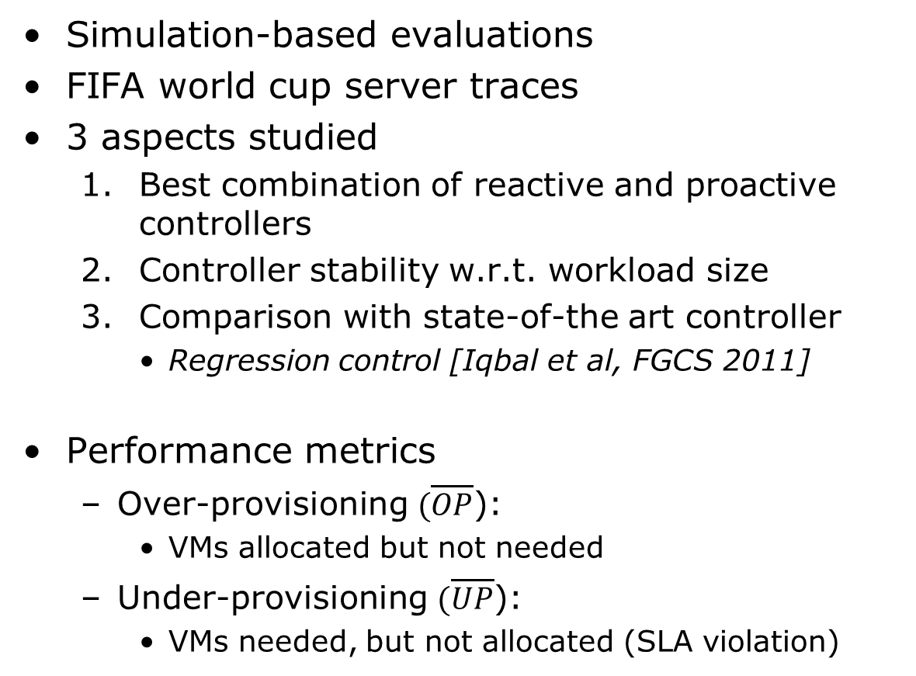
Performance Evaluation
Simulation-based evaluations
FIFA world cup server traces
3 aspects studied
  Best combination of reactive and proactive controllers
  Controller stability w.r.t. workload size
  Comparison with state-of-the art controller
    Regression control [Iqbal et al, FGCS 2011]
Performance metrics
  Over-provisioning $(\overline{OP}$):
    VMs allocated but not needed
  Under-provisioning $(\overline{UP}$):
    VMs needed, but not allocated (SLA violation)
17

Slide 18
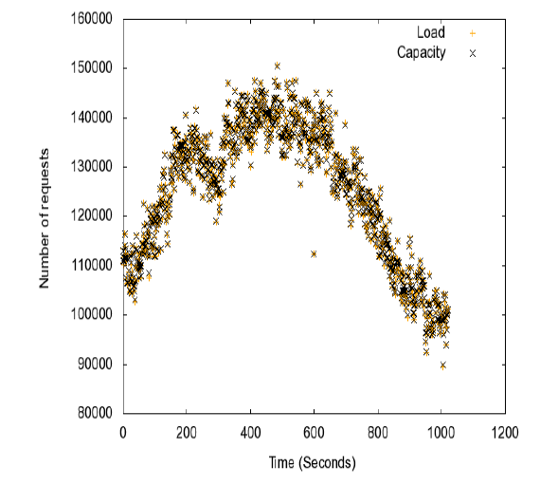

Selected Results
Baseline: Reactive scale-up, Reactive scale-down
  1.63% $\overline{UP}$
  1.40% $\overline{OP}$
18

Slide 19
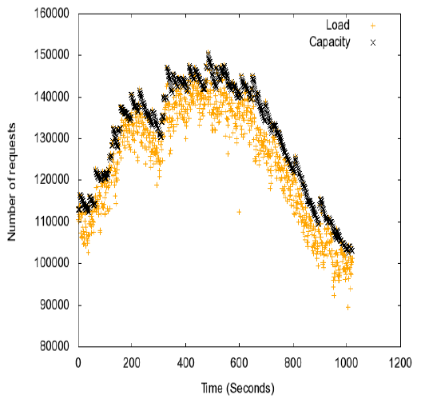

Selected Results (cont.)
Reactive scale-up, P₁ scale-down
  0.18% $\overline{UP}$ (1.63% for baseline)
  14.33% $\overline{OP}$ (1.40% for baseline)
19

Slide 20
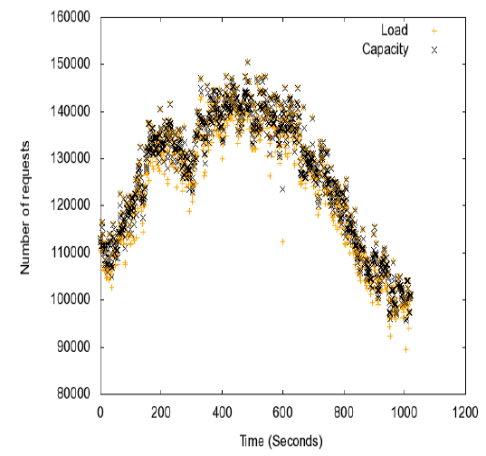

Selected Results (cont.)
Reactive scale-up, P₂ scale-down
  0.41% $\overline{UP}$ (1.63% for baseline)
  9.44% $\overline{OP}$ (1.40% for baseline)
20

Slide 21
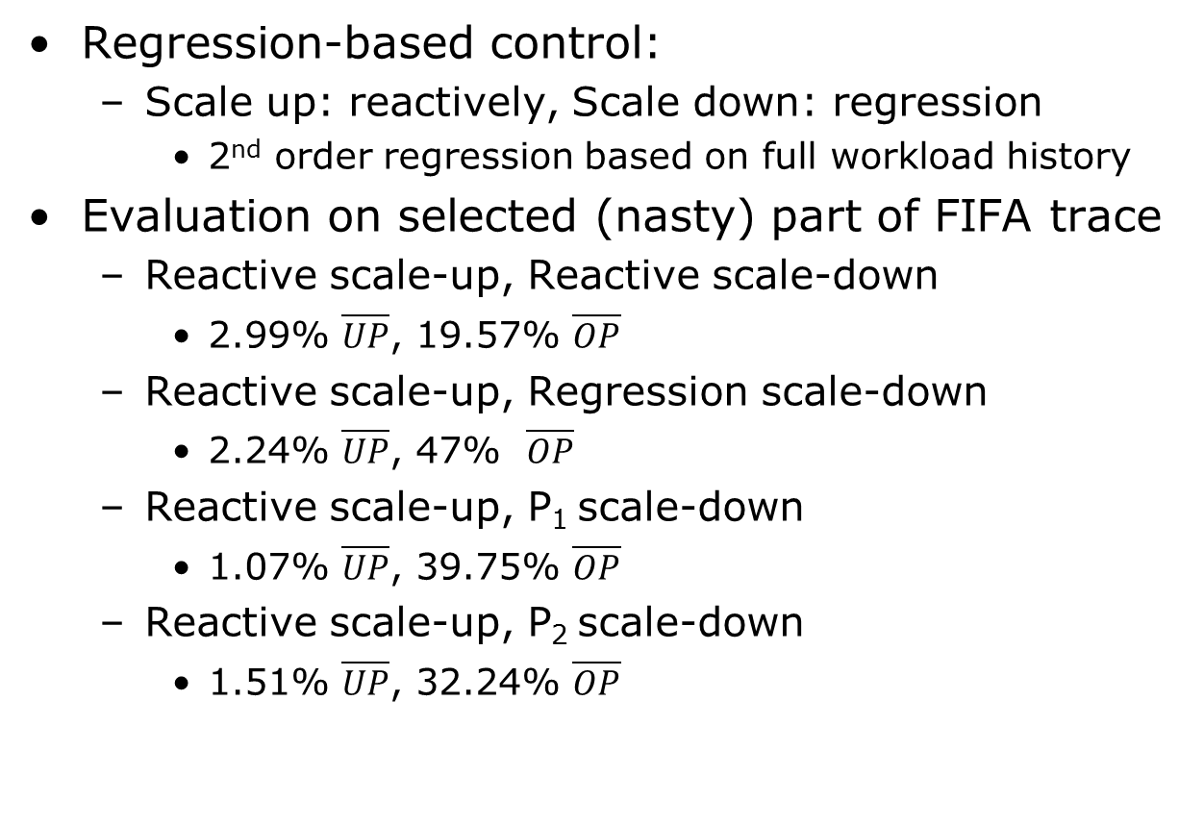
Comparison with Regression
Regression-based control:
  Scale up: reactively, Scale down: regression
    2nd order regression based on full workload history
Evaluation on selected (nasty) part of FIFA trace
  Reactive scale-up, Reactive scale-down
    2.99% $\overline{UP}$, 19.57% $\overline{OP}$
  Reactive scale-up, Regression scale-down
    2.24% $\overline{UP}$, 47% $\overline{OP}$
  Reactive scale-up, P₁ scale-down
    1.07% $\overline{UP}$, 39.75% $\overline{OP}$
  Reactive scale-up, P₂ scale-down
    1.51% $\overline{UP}$, 32.24% $\overline{OP}$
21

Slide 22
Outline
Introduction
Elasticity and Auto-scaling
Contributions
  Paper 1
  Paper 2
  Paper 3
Conclusions
Future Work

Slide 23
Assumptions (Paper II)
Assumptions:
  Homogeneous requests
  Short requests that take one time unit (or less)
  Machine startup time is negligible
  Delayed requests are dropped
  Constant machine service rate
  Perfect load balancing assumed

Slide 24
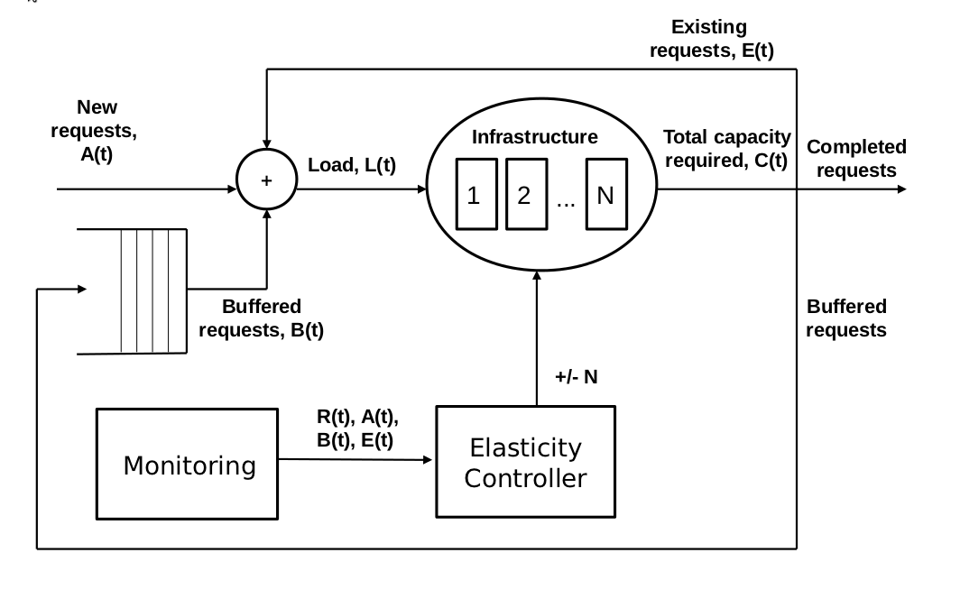
Model
G/G/N queue with variable N
(#VMs)
24

Slide 25
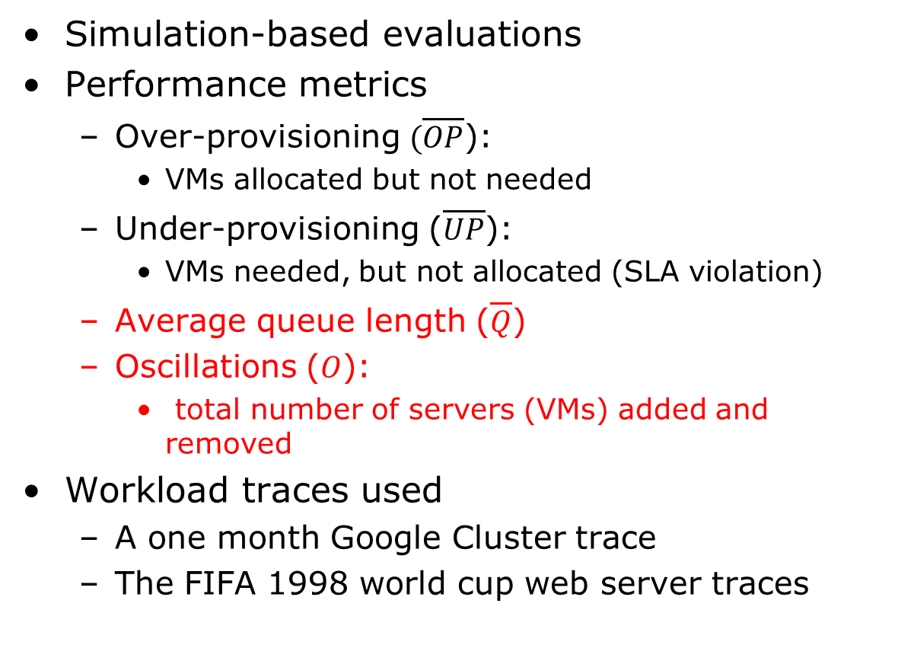
Performance Evaluation
Simulation-based evaluations
Performance metrics
  Over-provisioning $(\overline{OP}$):
    VMs allocated but not needed
  Under-provisioning ($\overline{UP}$):
    VMs needed, but not allocated (SLA violation)
  Average queue length ($\overline{Q}$)
  Oscillations ($O$):
    total number of servers (VMs) added and removed
Workload traces used
  A one month Google Cluster trace
  The FIFA 1998 world cup web server traces
25

Slide 26
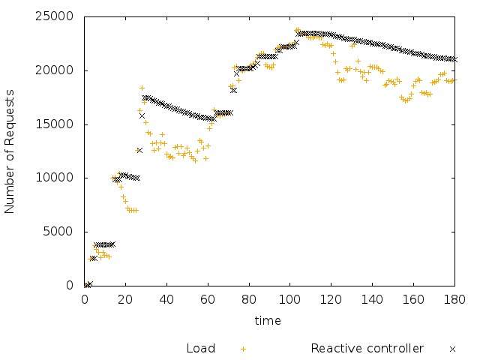
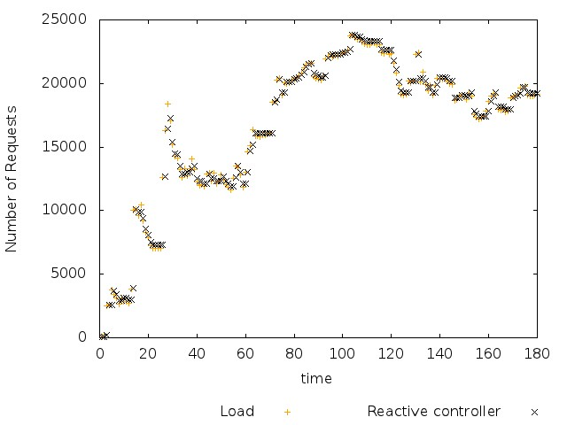
Selected Results: Google Cluster Workload
Our Controller vs. baseline Controller
26

Slide 27
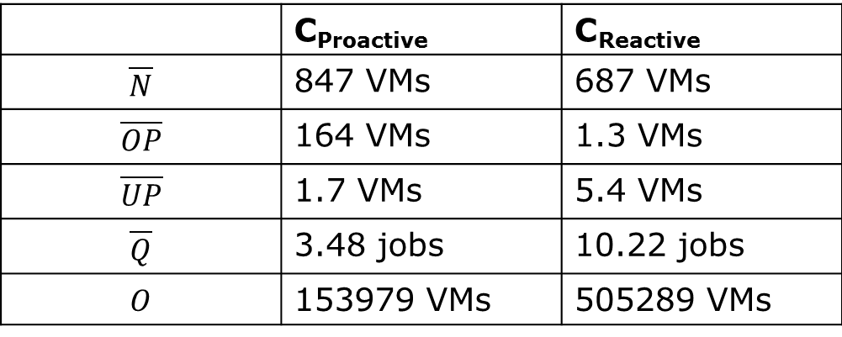
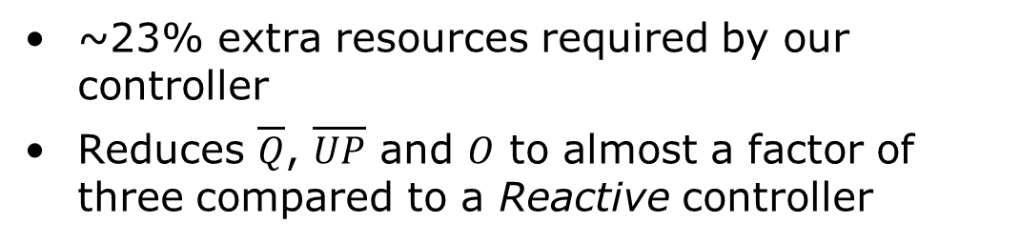
Selected Results: Google Cluster Workload
 | C_{Proactive} | C_{Reactive}
$$\overline{N}$$ | 847 VMs | 687 VMs
$$\overline{OP}$$ | 164 VMs | 1.3 VMs
$$\overline{UP}$$ | 1.7 VMs | 5.4 VMs
$$\overline{Q}$$ | 3.48 jobs | 10.22 jobs
$$O$$ | 153979 VMs | 505289 VMs
~23% extra resources required by our controller
Reduces $\overline{Q}$, $\overline{UP}$ and $O$ to almost a factor of three compared to a Reactive controller

Slide 28
Outline
Introduction
Elasticity and Auto-scaling
Contributions
  Paper 1
  Paper 2
  Paper 3
Conclusions
Future Work

Slide 29
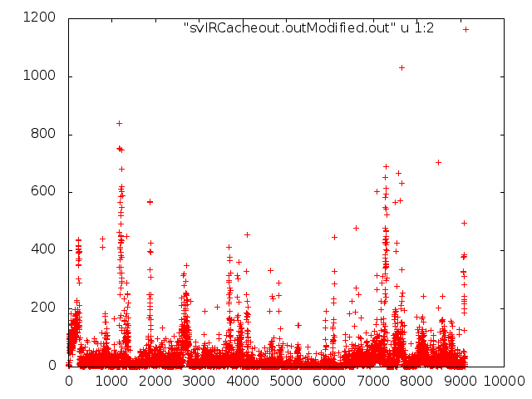
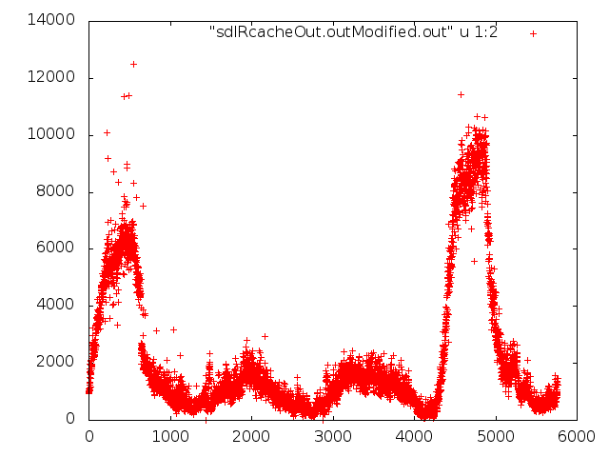
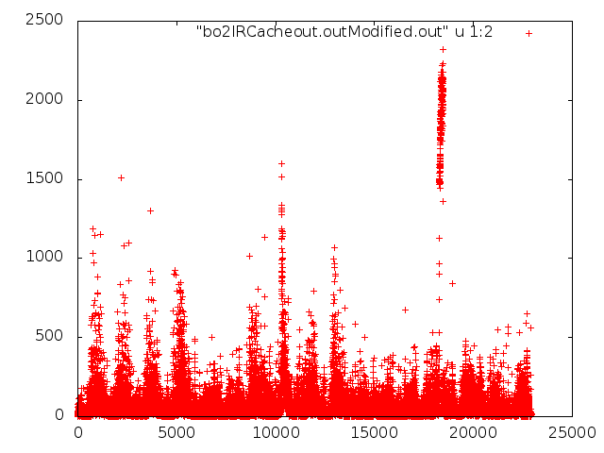
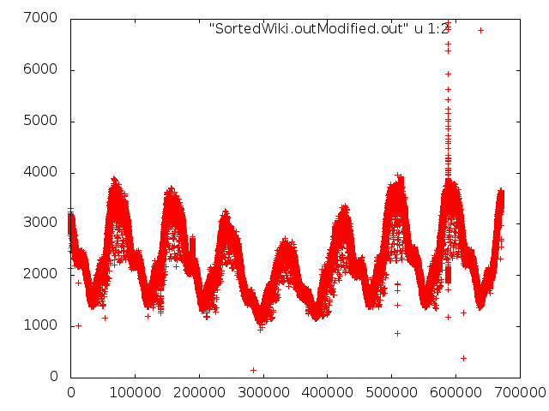
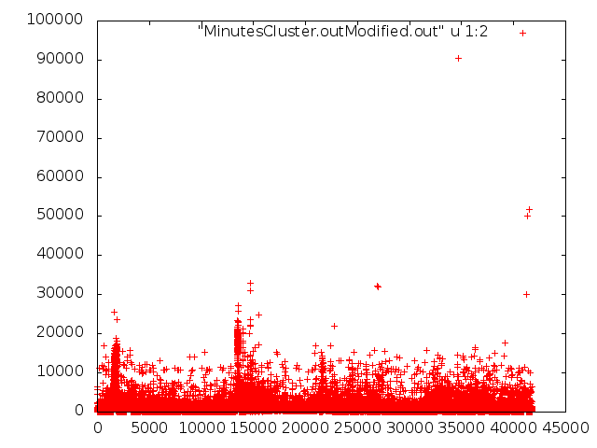
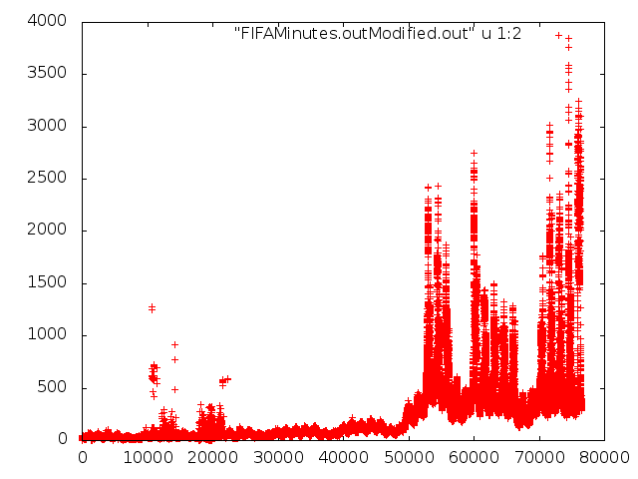
Different Workloads
No one size fits all predictors/controllers

Slide 30
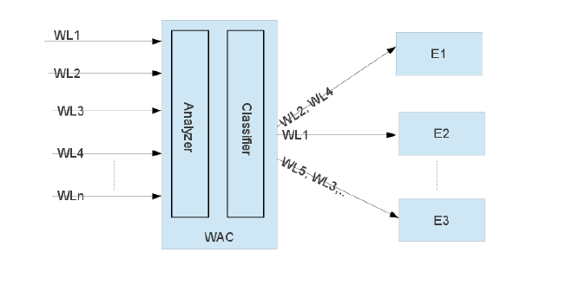
WAC: A Workload Analyzer and Classifier
30

Slide 31
Workload Analyzer
Periodicity means easier predictions
  Auto-Correlation Function (ACF)
  Almost standard
  The cross-correlation of a signal with a time-shifted version of itself
Bursts, difficult to predict!
Completely random bursts, very difficult to predict!!!
  Sample Entropy derivation from Kolmogrov Sinai entropy
  The negative natural logarithm of the conditional probability that two sequences similar for m points are similar at the next point
31

Slide 32
Workload Classifier
Supervised learning
  Training on objects with known classes
    Workloads with known best controller/predictor
K-Nearest Neighbors (KNN)
  Fast with good prediction accuracy
Two flavors during training
  Majority vote on the class
    Give equal weights to all votes
    Votes are inversely proportional to distance
Evaluation using 14 real workloads + 55 synthetic traces
32

Slide 33
Controllers Implemented
Controllers are the classes
  Modified second order regression [Iqbal et. al., FGCS 2011] (Regression)
  Step controller [Chieu et. al., ICEBE 2009] (Reactive)
  Histogram based Controller [Urgaonkar et. al., TAAS 2008] (Histogram)
  Algorithm proposed in our second paper (Proactive)

Slide 34
Controller Evaluation
Under-Provisioning
  How many requests can you drop?
Over-provisioning
  How much cost are you willing to pay to service all requests?
Oscillations
  Can the service handle frequent changes in the assigned resources ?
    Consistency ?
    Load migration ?
There are tradeoffs and objectives

Slide 35


Best Controller
 | Real workloads | Generated workloads
Reactive | 6.55% | 0.1%
Regression | 33.72% | 61.33%
Histogram | 12.56% | 4.27%
Proactive | 47.17% | 34.3%

Slide 36
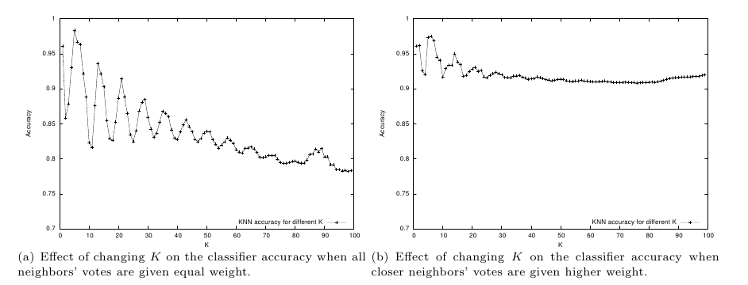
Classifier Results: Real Workloads (Selected Results)
Two controllers to choose from
36

Slide 37
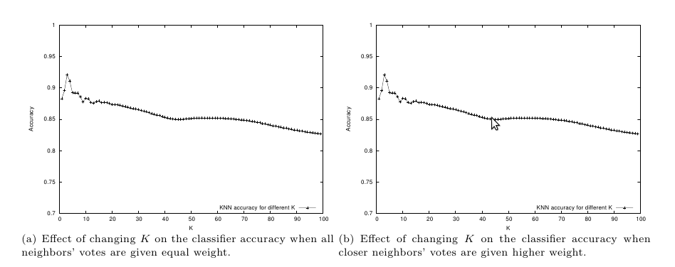
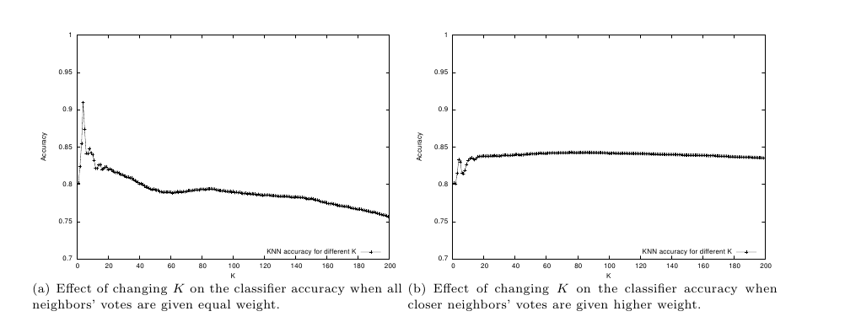
Classifier Results: Mixed Workloads (Selected Results)
Four controllers to choose from

Slide 38
Conclusions
General conclusions
  No one solution fits all
  Trade offs between overprovisioning, underprovisioning, speed and oscillations
Paper I
  Controllers that reduce underprovisioning
Paper II
  Enhancing the model in Paper I
Paper III
  A tool for workload analysis and classification
Common theme: automatic elasticity control
38

Slide 39
Future Work
Realistic workload generation
  Collaboration with EIT (LU) already started
Design of better controllers
  Collaboration with the Dept. of Automatic Control (LU) already started
A deeper study of workload characteristics and their impact on different elasticity controllers
  Collaboration with the Dept. of Mathematical statistics (UMU) already started
Workload classification
  Elasticity control vs. other management components, e.g., VM Placement (Scheduling)
39

Slide 40
Acknowledgments
Erik Elmroth and Johan Tordsson
Colleagues in the group
Collaboration partners
  Maria Kihl
Family
  Parents and siblings
  Wife and daughter
40

Slide 41


